Slide 1

Tutorial and Common Practices
Greg Rocco, MIT Lincoln Laboratory
With help from other VITA members
6 February 2024
DISTRIBUTION STATEMENT A. Approved for public release; distribution is unlimited.
This work is sponsored by the Department of the Air Force under Air Force Contract #FA8702-15-D-0001. Opinions, interpretations, conclusions and recommendations are those of the author and are not necessarily endorsed by the United States Government.
Notes:
1
1

Slide 2
Outline
Introduction
Protocols
Cooling, form factors, and copper connectors
Blind mate optical and coax connectors
Utility Plane including radial clocks and VITA 62 power supply Plug-In Modules
Slot, Backplane, and Module Profiles (Including AMPS)
Slot Profile and Backplane Profile examples
Summary and References
This tutorial along with some others is available at: http://www.vita.com/Tutorials
Slideshows: Sections, Overview, Moderate Overall, VITA F2F 2024-03
Notes:
Navigating in slide show mode
This presentation has hyperlinks and custom slide shows in order to help present subsets of the slides and to navigate to particular slides during discussions.
LL Logo goes to Outline slide – clicking on the LL logo in the upper left takes you to the overall outline slide (this slide).
The presentation is divided into subsections. The subsections are listed on the Outline slide (this slide). Each bullet of the Outline is a hyperlink that takes you to that section.
Each section has an outline slide that starts with “Subsection Outline” in the title. The Title is also a different color to make the outline slides stand out.
Down the bottom of the Outline slides are hyperlinks to Custom Slide Shows. Custom Shows take you through subsets of the slides. On the overall Outline slide there is a show called Sections. Sections takes you to each of the Outline slides. The shows are set up to return to where they started from when they complete. For each subsection there is a moderate detail show. One way to go through all the moderate detail slides is to invoke the Sections show, then as you go to each section, click on the link for the moderate show for that section. When the subsection’s moderate show complete, you will come back to the Outline Slide for that section. If you then click next slide you will go to the next section.
Overview version – There is a link at the bottom of this slide to a custom show, which is an overview version of the entire presentation.
Moderate Overall – There is a link at the bottom of this slide to a custom show, which give a moderate detailed version of the entire presentation. This is less detailed than the “Moderate detail” shows associated with each section.
Hyperlinks to specific slides – In some cases there are links to specific slides at the bottom of some of the slides, these are intended to be slides you might want to refer to during discussion. If you click on one of these links, to get back to where you were, do a right link and select “Last Viewed”.
Force next slide – In the lower right corner of each slide is a rectangle (it is white so you cannot see it, just put the cursor over it) that is a hyperlink to the next slide, numerically, as opposed to the next slide in the particular show that you are in. This way if in the middle of a show, you follow hyperlinks for a discussion, you can get to consecutive slides that are not part of the show, which you are currently showing. When you want to go back, you can either just hit next slide, which will take you to the first slide of the current show, you can use the presenter view to go to where you left off in the current show, or you can right click and go back to the “Last Viewed”.
Last viewed – In the lower right, over the “Lincoln Laboratory” there is an action button which will take you to the last viewed slide. Note: At the time I tested this it only goes back 1 slide. A right-click then selecting Last Viewed keeps going back through the slides in the reverse order from when they were viewed.

Slide 3
Subsection Outline: Introduction
Introduction
  Overview including OpenVPX Plans and Trends
  Brief history of VME, VXS, VPX, and OpenVPX
  Mezzanine Cards
  Rear-Transition Modules (RTMs)
  Terminology
  Two-level maintenance
Protocols
Cooling, form factors, and copper connectors
Blind mate optical and coax connectors
Utility Plane including radial clocks and VITA 62 power supply Plug-In Modules
Slot, Backplane, and Module Profiles (Including AMPS)
Slot Profile and Backplane Profile examples
Summary and References
Slideshows: Intro Moderate

Slide 4
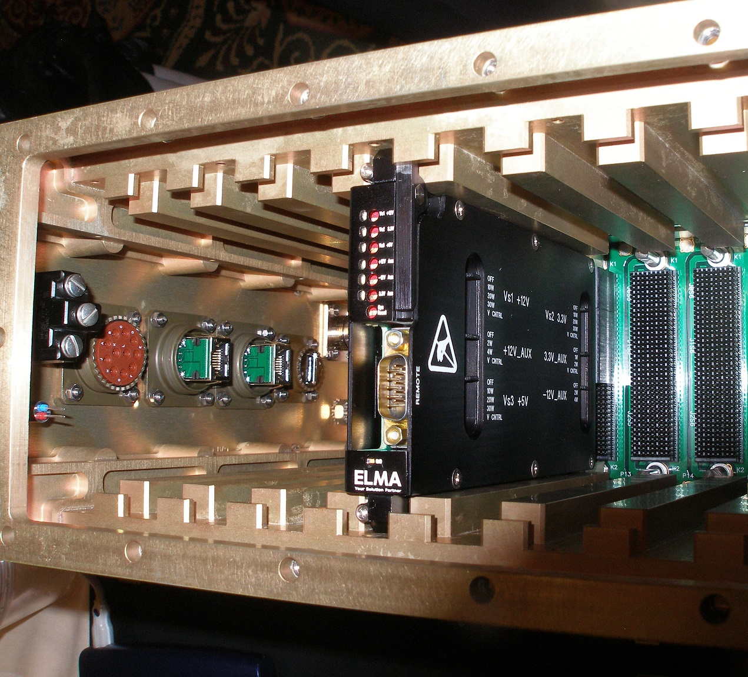
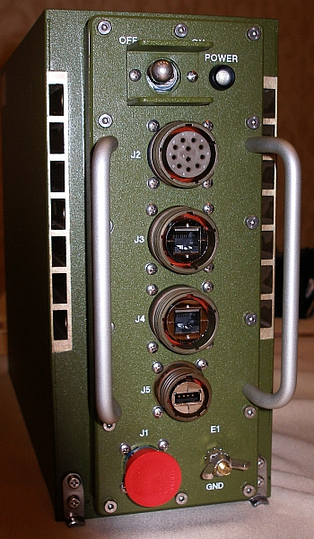
OpenVPX and Associated Standards
Conduction cooled chassis
Mechanical/cooling interface between Plug-In and Chassis interface specified by VITA 48
Channels for cooling air
Chassis front panel
3U x 160 mm (3.9 x 6.3”) Plug-In Module
Electrical interface between Plug-In Module and backplane specified by OpenVPX (VITA 65)
Pictures courtesy of Elma
These standards define interfaces between Plug-In Modules and chassis for products intended to be deployed in harsh environments

Slide 5
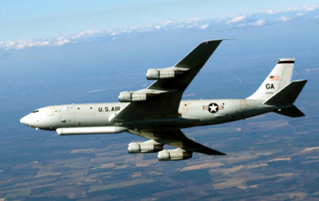

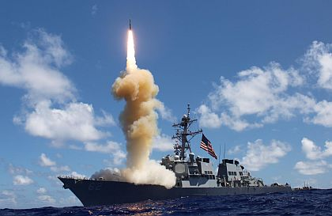
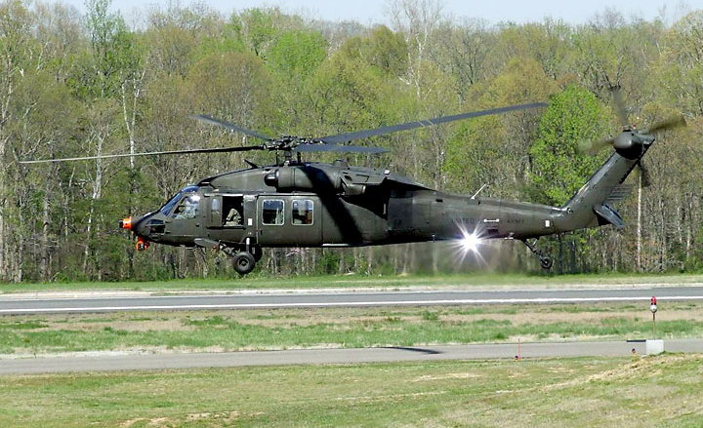
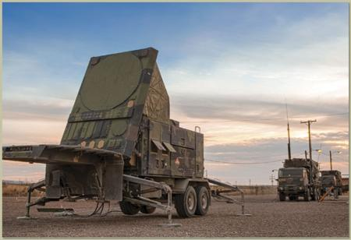

OpenVPX Is Widely Used In Embedded Systems
Military & Aerospace Sept 11, 2013:
Northrop Grumman orders airborne radar signal processors from Curtiss-Wright for Joint STARS
The Aviationist April 5, 2015:
Photo Shows A U.S. reaper drone carrying “Gorgon Stare” wide area airborne Surveillance system pod in Afghanistan
Military & Aerospace Nov 25, 2012:
Massive October ballistic missile defense test used Mercury's OpenVPX embedded computing
VITA Technologies Aug 3, 2012:
OpenVPX platform delivers horsepower needed to revolutionize helicopter flying
COTS Journal Dec, 2013:
Mercury to Provide Radar Subsystems for Patriot Air and Missile Defense Systems
Elektronik Aug 16, 2018:
Translated article title: “VPX system for space; Around the world in 90 minutes”
Picture of International Space Station from article
See slide notes for web pointers to press coverage.
Notes:
Web pointers to press coverage:
Top row:
http://www.militaryaerospace.com/articles/2013/09/jointstars-curtiss-radar.html
Image from: http://www.af.mil/AboutUs/FactSheets/Display/tabid/224/Article/104507/e-8c-joint-stars.aspx
http://theaviationist.com/2015/04/05/gorgon-stare-increment-2-kaf/
Article saying it is OpenVPX: http://www.suasnews.com/2012/01/11243/u-s-air-force%E2%80%99s-gorgon-stare-wide-area-persistent-surveillance-system-taps-mercury-federal-systems-onboard-real-time-processing-technology/
Same image also at:
http://www.af.mil/News/ArticleDisplay/tabid/223/Article/581953/reaper-maintainers-ensure-isr-mission-accomplishment.aspx
http://www.militaryaerospace.com/articles/2012/11/mercury-bmd-test.html
Same image also at: http://www.mda.mil/global/images/system/aegis/2012_Aegis_2.jpg
Bottom row:
http://vita.opensystemsmedia.com/articles/openvpx-needed-revolutionize-helicopter-flying/
Image from: http://www.raytheon.com/capabilities/rtnwcm/groups/sas/documents/content/rtn_p_sas_adas_ghtml.html
http://www.cotsjournalonline.com/articles/view/103746
Info that system is OpenVPX: http://www.army-technology.com/news/newsmercury-openvpx-patriot-missile
Image also on page: http://www.raytheon.com/news/feature/rtn13_pas13a.html
https://www.elektroniknet.de/elektronik/embedded/in-90-minuten-um-die-welt-156822.html
The above web page can be translated into English, selecting English and giving the above URL to http://itools.com/tool/google-translate-web-page-translator

Slide 6
Goals of This Tutorial
If one thinks of the OpenVPX standards as like a reference manual
  Think of this material as a user’s manual
  Help sort through the large number of options in the standard
Further lock in common industry practices
  This will help build a more consistent eco-system
Give some suggestions for practices in emerging areas

Slide 7
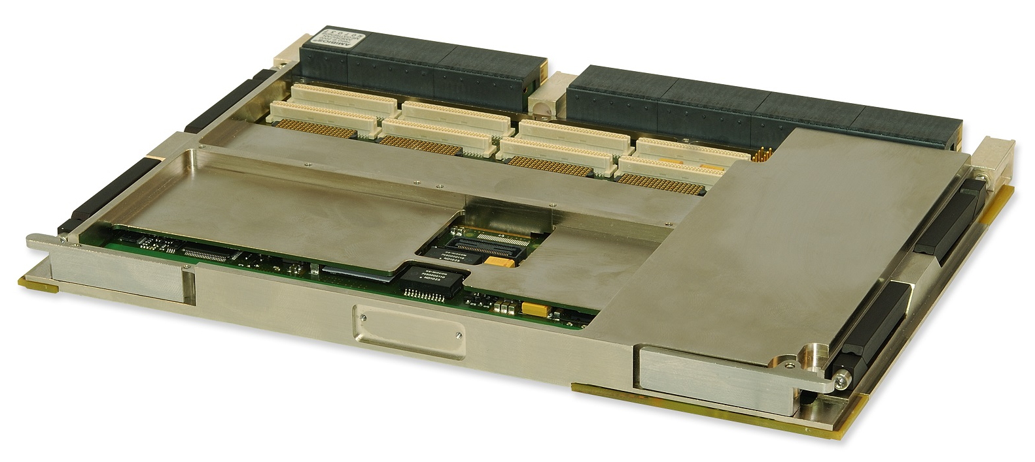
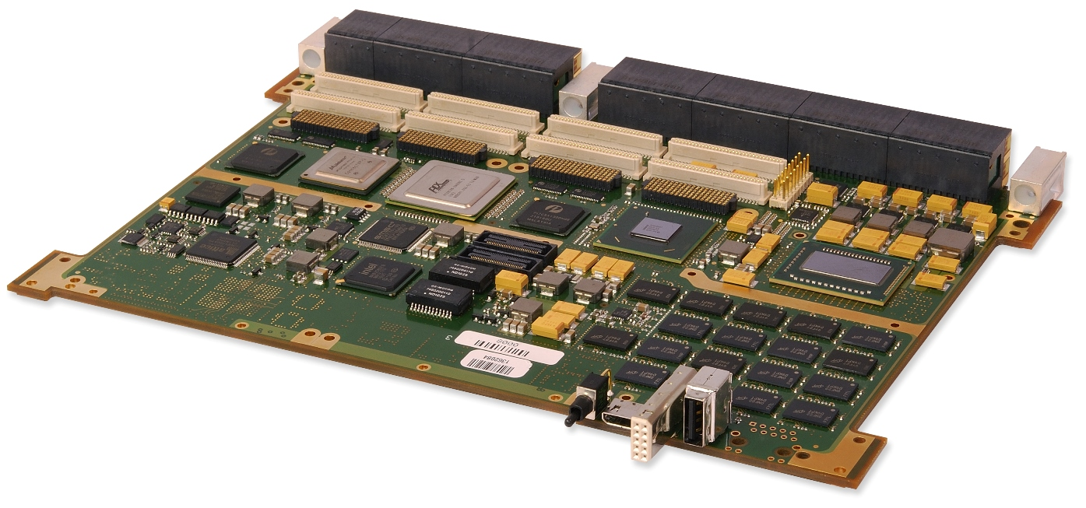
Conduction Cooled OpenVPX Plug-In Module
Wedge locks
Backplane connectors
PMC site connectors
XMC site connectors
Abaco Systems SBC624 OpenVPX 6U Intel based processing Plug-In Module with 2 PMC/XMC sites
6U x 160 mm – 233.35 mm x 160 mm or 9.187” x 6.299”
Plug-In Module shown
  Other Plug-In Module sizes:
    3U x 160 mm – 100 x 160 mm or 3.937 x 6.299” inches – standard 3U (more common size)
    3U x 160 mm – 100 x 100 mm or 3.937 x 3.937” inches – 3U-S (3U-Short); added to [VITA 48.2] with 2022 revision
  The slot pitch can vary based on the cooling methodology, see “Cooling options” section
Plug-In Module shown is designed for conduction cooling [VITA 48.2]
Two mezzanine sites for either PMCs or XMCs
Pictures: © 2014 Abaco Systems. All rights reserved. Reprinted with permission. Copies may be made solely for training and education about the OpenVPX standard.

Slide 8

Vision for Data Conversion Subsystem
Initial versions of OpenVPX focused on processing subsystems
[VITA 65.0-2017] added support of RF and data conversion subsystems
Ancillary subsystems, for example dish antennas
Copper Control Plane to ancillary subsystem and RF/analog from ancillary subsystem
OpenVPX Chassis for converting:
RF & Analog Digital
. . .
Optical-fiber Control and Sensor Plane to the rest of the system
Radial clocks enable applications needing much higher precision clocks than what bussed clocks can provide
  Data conversion subsystems where groups of A/D and D/A converters are clocked at the same time
    Many systems use distribution of timing via coax to get even higher quality clocks
  Precision time synchronization
    For time stamping, as is done for creation of [VITA 49.0] data packets with timestamps
    For controlling devices, such as receivers and exciters, using [VITA 49.2]
OpenVPX to support this vision
  Option for Radial clocks or bussed clocks by slot
  Optical (VITA 66.x) & coax (VITA 67.x) portions of backplane
    Organizational changes to handle significant expansion of optical/coax
  Control Plane Switch Profiles to support mix of:
    Copper connections within the chassis – 1000BASE-KX or higher
    Copper connections to local ancillary devices – 1000BASE-T
    Fiber connections to rest of system – 10GBASE-SR or higher
  Data Plane Switch Profiles to support mix of:
    Copper connections within the chassis – 40GBASE-KR4 or higher
    Fiber connections to rest of system – 40GBASE-SR4 or higher

Slide 9
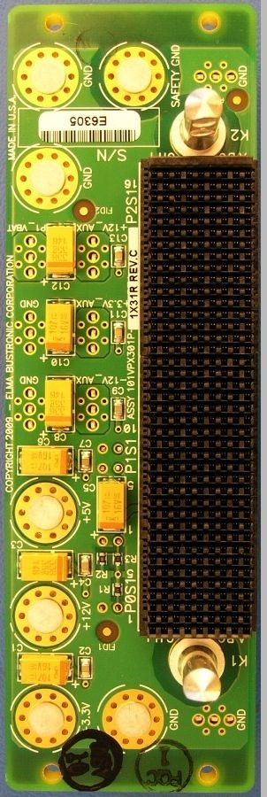
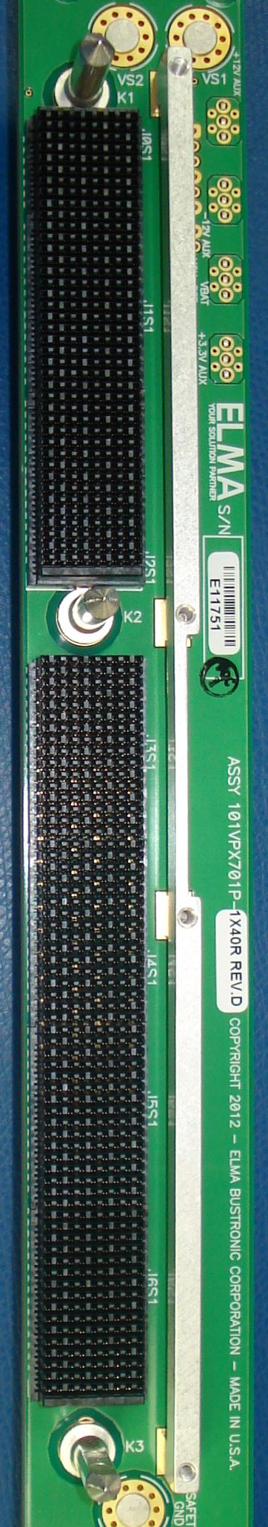
OpenVPX Profiles
Slot Profiles specify
  Pins associated with a backplane slot
  Pins associated with a Plug-In Module’s backplane connector
  Pins assigned to particular ports
  Example Slot Profile name: SLT6-PAY-4F1Q2U2T-10.2.1
Backplane Profiles specify
  Which Slot Profiles a particular backplane has
  How its Slot Profiles are interconnected
  Example Backplane Profile name: BKP6-CEN16-11.2.2-n
Slot and Backplane Profiles are protocol agnostic
Module Profiles specify
  The protocols to be mapped to the ports defined by the Slot Profile (e.g. 10GBASE-KR Ethernet)
  Example of Module Profile name using classic naming:
  MOD3p-PAY-1F1U1S1S1U1U2F1H-16.6.11-13
  Example of Module Profile name using AMPS
  (Alternative Module Profile Scheme) – an AMPS String:
  MODA3p-16.6.11-1-4-F2C-(E8-E7)(P3F-A2F)(E7)(N-G5)
J0
J0
J1
J1
J2
J2
J3
3U OpenVPX 1-slot backplane
J4
3U OpenVPX Slot Profile diagram
J0 – J2 are backplane connectors and
P0 – P2 are Plug-In Module connectors
J5
Backplane pictures courtesy of Elma
J6
6U OpenVPX Slot Profile diagram
J0 – J6 are backplane connectors and
P0 – P6 are Plug-In Module connectors
6U OpenVPX 1-slot backplane
Links: OpenVPX Profiles, VXS P0, RTM, Connector, Contacts, RT 2-R Wafer, Slot Profiles, Pin Numbering

Slide 10
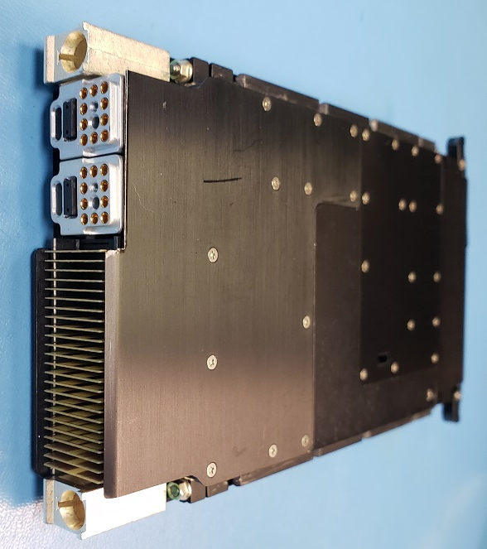
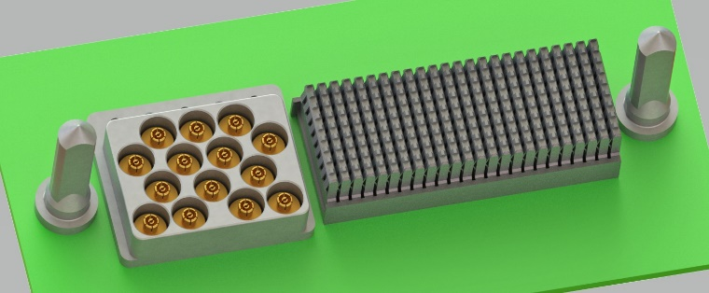
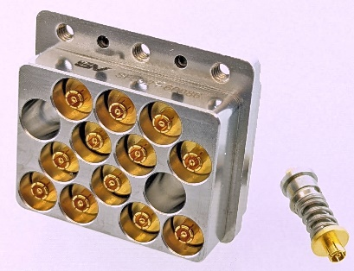
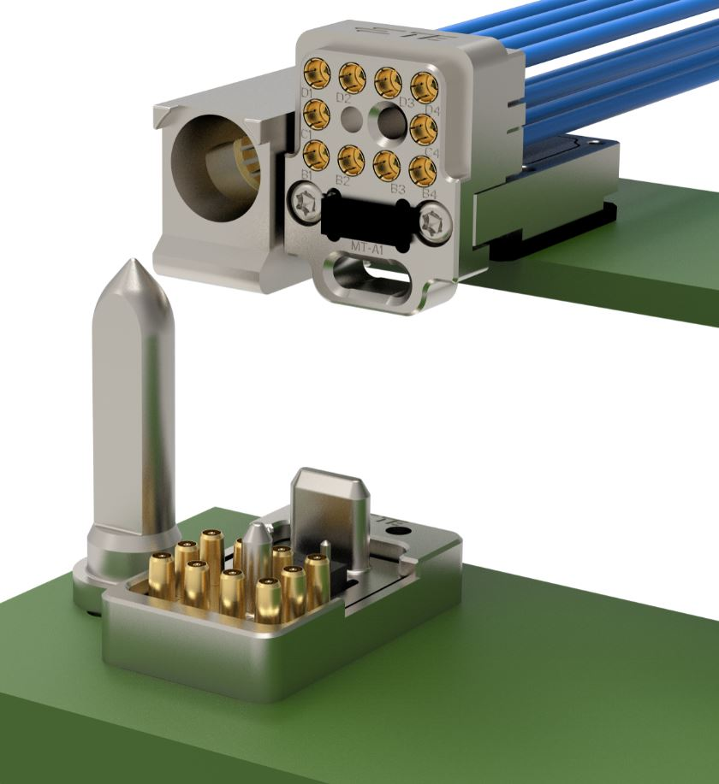
Slot Profiles Dash Options
3U Plug-In Module using Slot Profile
SLT3-PAY-1F1U1S1S1U1U2F1H-14.6.11-12
Uses a [VITA 67.3] Type C backplane Connector Module
  [VITA 65.1] Connector Module name:
  2_Style_C_inserts_and_20 NanoRF_contacts-6.4.5.6.10
  2 MTs of 12 optical fibers each, total of 24
  20 NanoRF contacts
[VITA 65.1] has tables of Slot Profile dash options
  Slot Profiles dash options specify what goes in apertures for optical/coax
  “-0” version of Slot Profile has aperture empty
  If a Slot Profile does not have one or more apertures for optical/coax then it does not have dash options
[VITA 65.1] has specifications of Connector Modules referenced by Slot Profile dash options
  Includes tables of Optical/Coax contact locations
Image courtesy of Mercury
[VITA 67.3] Type D Connector Module
  [VITA 65.1] Connector Module name: 1_Style_C_insert_and_10_NanoRF_contacts-6.4.5.7.4
  10 NanoRF contacts
  1 MT with 12 or 24 optic fibers
Images courtesy of SV Microwave
Images courtesy of TE Connectivity
Backplane connector using [VITA 67.3] Type C
  [VITA 65.1] Connector Module name:
  14_SMPM_contacts-6.4.5.6.4
Slot dash, Fiber numbering, VITA 65.1 Excerpt, Optical Profiles

Slide 11
VITA 65.0 and 65.1 Partitioning Starting with [VITA-2017]
Adding dash options to Slot Profiles also increases dash options for Backplane and Module Profiles as well as adding tables for Slot Profiles
Tables of Backplane & Module Profile dash options are in [VITA 65.1]
  Associated text stays in [VITA 65.0]
  [VITA 65.0] references tables in [VITA 65.1]
  Module Profile Tables include Alternative Naming Structures (ANSes) which specify the where Protocols Fields, for various ports, are within an AMPS (Alternative Module Profile Scheme) String
[VITA 67.3] standardizes coax Connector Module PCB footprints but not contact locations
  [VITA 65.1] includes tables of contact locations
[VITA 65.0] and [VITA 65.1] section numbers are consistent with each other
  [VITA 65.1] has lots of skipped sections
[VITA 65.1] written using Microsoft Excel in order to make dealing with tables easier
  Many of the tables are wider than what will nicely fit in the width of a page
  Available in both Excel and .pdf
65.0/65.1 Partitioning, Connector Module Standards: first, 2nd

Slide 12
OpenVPX Plans and Trends
Latest version of OpenVPX™ Published May & June 2023
  ANSI/VITA 65.0-2023, OpenVPX™ System Standard; June 5, 2023
  ANSI/VITA 65.1-2023, OpenVPX™ System Standard – Profile Tables; May 30, 2023
Some highlights of what was added with ANSI/VITA 65.0-2023 and ANSI/VITA 65.1-2023
  Added multiple analog and digital video protocols
  Added Ethernet protocols: 50GBASE-KR, 100GBASE-KR2, 200GBASE-KR4, 400GBASE-KR8
  Added sFPDP (Serial Front Panel Data Port) over both copper and optical fiber
  No new Slot, Module or Backplane Profiles
Improving interoperability
  Moving ecosystem toward Plug-In Modules only using 12 VDC, 3.3V_AUX and VBAT
    The Module Profiles for all Slot Profiles added in [VITA 65.0-2019] and later require the use of only 12 VDC, 3.3V_AUX and VBAT
  Most of the Slot Profiles added in [VITA 65.0-2019] and later have no UD (User Defined) pins
    Intended that where User Defined pins needed, restrict them to a few specific slots
The VITA 65 Working Group is working on the next version, expect: Additional protocol options

Slide 13
Recommend 12 VDC Only for Plug-In Module Power
Plug-In Modules using multiple supplies makes it more difficult to interchange boards
  If have chassis full of Plug-In Modules using primarily 5 VDC and then change to ones using primarily 12 VDC, might need to change the power supply also, even if the total power drawn is the same.
  Recommendations for all Slot Profiles
  Rules for all Slot Profiles added with [VITA 65.0-2019] and later
  With ANSI/VITA 65.0-2019 have Recommendations for all Plug-In Modules to only use 12 VDC, 3.3V_AUX, and VBAT
    In ANSI/VITA 65.0-2019 see Section 3.2.1 for Recommendations
  The Module Profiles for all Slot Profiles added from ANSI/VITA 65.0-2019 and beyond require 12 VDC, 3.3V_AUX, and VBAT only
    Specified on a Slot Profile by Slot Profile basis whether a given Slot Profile’s Module Profiles will be 12 VDC, 3.3V_AUX, and VBAT only – Require adherence to Section 8.8
  Backplanes still required to have distribution busses for all supplies
  Up to system integrators as to how much power to make available on each buss
  Gradually migrating ecosystem to 12 VDC, 3.3V_AUX, & VBAT only
  Some end customers might require this for all Slot Profiles used in their system
  All OpenVPX Slot Profiles in [SOSA] required to only use 12 VDC, 3.3V_AUX, & VBAT
Links to name construction: 12V only intro, Power Dist.

Slide 14
6U Slot Profiles Added by [VITA 65.0-2019] & [VITA 65.0-2021]
Module Profiles for these Slot Profiles only use the following for power from the backplane:
  12 VDC (VS1 and VS2)
  3.3V_AUX
  VBAT
SLT6-PAY-. . .-10.6.6-n is the only Slot Profile added by [VITA 65.0-2021]
  Same as 10.6.5 except some of the pins are User Defined
SLT6-PAY-4U2U-10.2.8 & SLT6-PAY-. . .-10.6.6-n are the only ones of these with UD (User Defined) pins
No Slot Profiles added with [VITA 65.0-2023]
SLT6-PAY-
4U2U-10.2.8
SLT6-PAY-
. . .-10.6.3-n
SLT6-PAY-
. . .-10.6.4-n
SLT6-PAY-
. . .-10.6.5-n
SLT6-PAY-
. . .-10.6.6-n
SLT6-SWH-
. . .-10.8.1
Links: Slot Profiles added to 65.0-2019: 6U, 3U; Isolate UD; Slot Profiles with lots UD; RTMs; Dealing with UD

Slide 15
3U Slot Profiles Added by [VITA 65.0-2019]
Module Profiles for these Slot Profiles only use the following for power from the backplane:
  12 VDC (VS1)
  3.3V_AUX
  VBAT
SLT3-PAY-2U2U-14.2.17 is the only one of these with UD (User Defined) pins
There were no 3U Slot Profiles added by
[VITA 65.0-2021] and none by [VITA 65.0-2023]
SLT3-PAY-. . .-14.2.16
SLT3-PAY-2U2U-14.2.17
SLT3-SWH-6F8U-14.4.15
SLT3-PAY-. . .-14.6.13
SLT3-PAY-. . .-14.6.14
SLT3-PAY-. . .-14.9.2
Links: Slot Profiles added to 65.0-2019: 6U, 3U; Isolate UD; Slot Profiles with lots UD; RTMs; Dealing with UD

Slide 16
Isolating User Defined Pins to a Small Number of Slots
SLT6-PAY-4F1Q1H4U1T1S1S1TU2U2T1H-10.6.3-n
SLT3-PAY-1F1F2U1TU1T1U1T-14.2.16
Use network interfaces for
control when practical
  Avoid using discretes
  (individual signals) as
  much as practical
Many applications will require
use of discretes
These Slot Profiles are intended for
SBCs (Single Board Computers) with XMC sites
  6U also intended for other applications such as RF input/output
Drive system specific pins, such as discretes, using XMC
  XMC can be system specific and stay with the platform as SBC upgraded
  Use XMC for driving legacy signals
If all the needed system specific pins do not fit available XMC sites use Slot Profiles with lots of UD pins
Links: Slot Profiles added to 65.0-2019: 6U, 3U; Isolate UD; Slot Profiles with lots UD; RTMs; Dealing with UD

Slide 17
Slot Profiles with Lots of User Defined Pins
SLT6-PAY-4U2U-10.2.8
SLT3-PAY-2U2U-14.2.17
If cannot fit the required system specific pins on XMCs use these
Slot Profiles
Get all the User Defined pins driven by a few slots
Intended for one of two use models:
  Subservient to other Plug-In Module(s) via Expansion Plane
  Able to receive commands from many Plug-In Modules via Control Plane
Links: Slot Profiles added to 65.0-2019: 6U, 3U; Isolate UD; Slot Profiles with lots UD; RTMs; Dealing with UD

Slide 18
Overview Wrap-Up
OpenVPX and associated standards define interfaces between Plug-In Modules and backplane/chassis
  For products intended to be deployed in harsh environments
Evolved to support data acquisition and RF subsystems in addition to processing
  Radial clocking for high precision clocking of A/D and D/As
  Blind mate backplane optical and coax connectors to support 2-level maintenance
[VITA 65.0] is the main body of the standard referencing tables in [VITA 65.1]
Slot Profiles specify how ports are mapped to the pins of the interface between Plug-In Modules and backplane slots
  Also specify optical and coax Connector Modules
Backplane Profiles specify which Slot Profiles and how they are interconnected
Module Profiles map Protocols to the ports of a Slot Profile
Backplane pictures courtesy of Elma

Slide 19
Timeline VME, VXS, VPX, and OpenVPX Thru 2017
OpenVPX builds on VPX to add system thinking
  VPX (VITA 46) has dot standards for each protocol and some others: VME, RapidIO, PCIe, Ethernet
  OpenVPX has profiles which spell out how multiple protocols are to be used together
Not shown is the timeline for VITA 48 standards for cooling and packaging
Note with timeline: Products have frequently been available before the associated standards are all the way through the ANSI standardization process

Slide 20
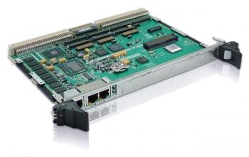
The VMEbus
Started in early 1980’s
Parallel bus, similar to Motorola 68000 address/data memory architecture
Initial support for 16, 24, and 32 bit address bus
Initial support for 8, 16, and 32 bit data bus
Evolved into ANSI/VITA 1-1994 VME64
  64-bit address and 64-bit data bus support
  Interoperable connector for P1 and P2 expanded from 96 to 160 pins
P0 – (optional)
P2
P1
6U x 160 mm VMEbus Module –
233.35 mm x 160 mm or
9.187” x 6.299”

Slide 21
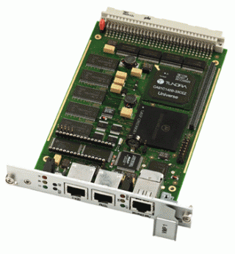
VMEbus (continued)
P1 (only)
Asynchronous handshaking bus, no clock required
Based on 3U and 6U, 160 mm Eurocard Printed Circuit Board Standard
Interoperable support
  Modules with larger address or data buses would interoperate with modules with smaller address or data buses
Provided 64 user defined pins for use as I/O interconnects or secondary buses (standard or proprietary)
  Does not include the additional pins by going from 96 to 160 pin connectors, which were all grounds or reserved until ANSI/VITA 1.1-1997 VME64 Extensions
3U x 160 mm VMEbus Module –
100 mm x 160 mm or
3.937” x 6.299”

Slide 22
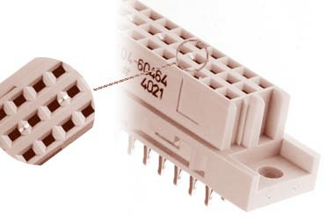
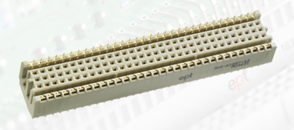
Connectors – VME & VME64
Original VME “DIN” 96 pin connector
  Supports both 32 and 64-bit address and data transfers
Enhanced VME 160 Pin Connector
  Interoperable with 96 pin connector
  ANSI/VITA 1-1994 left the additional pins as ground and reserved
  ANSI/VITA 1.1-1997 VME64 Extensions assigned the additional pins for additional power, some management functions, User Defined, and a few reserved
    Among power pins, 3.3V added
    The user defined pins were used for I/O and secondary buses such as RACE++
3.10” (78.7 mm)

Slide 23
The VMEbus (Secondary Buses)
Secondary buses - provide additional data transfer capability concurrent with data transfers on the VMEbus
  Took advantage of user defined pins on P2
Early secondary buses (fabric* in case of RACEway)
  VMX, 24 bit address, 32 bit data, provided extended memory
  MVME32, 32 bit address, 32 bit data, added I/O capability
  VSBbus, combination of VMX and MVME32
  Raceway Interlink, circuit switched, active backplane, standardized as ANSI/VITA 5-1995, RACEway Interlink
Raceway Interlink
* Definition of fabric: A set of paths used for communication between elements of a system

Slide 24
Transition to Serial Fabrics
In 2000 Intel begin investigating using serial fabrics to replace parallel buses
  Initial effort was called HSI for high speed interconnect
  Later changed to 3GIO for 3rd generation input/output
  Eventually became upon release PCI Express®, also known as PCIe®
RapidIOTM started by Mercury and Motorola
  RapidIO trade association formed in 2000
  Released parallel version: Physical Layer 8/16 LP-LVDS in 2001
  Released serial version: 1x/4x LP-Serial Physical Layer in 2002
Other serial fabrics: Ethernet and InfiniBandTM
Serial fabrics advantages
  Lower pin count
  Lower power requirements
  Less chip/board space required
  Lack of timing skew increases data transfer speeds compared to parallel buses
  Address bus not required
  Increase data transfer by using additional channels

Slide 25
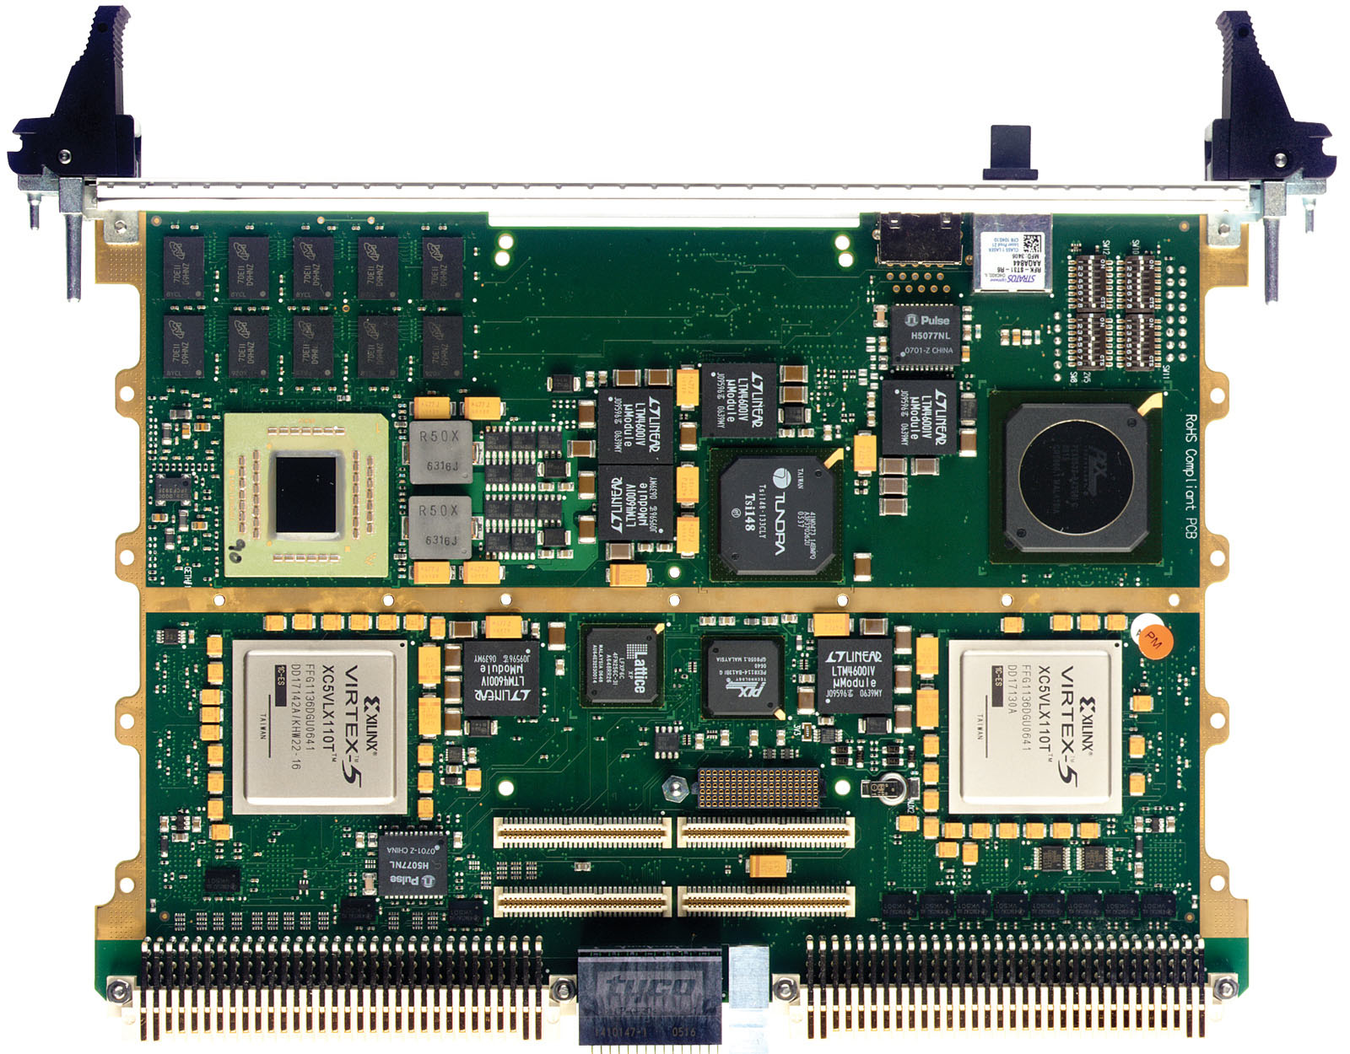
VME to VXS
Serial fabrics added to VME early 2000’s as ANSI/VITA 41.0
VME’s P1 and P2 connectors were retained for backwards compatibility
High density P0 connector added
for serial fabric
  This is also a much higher bandwidth connector than P1 and P2
  Similar to the connectors used for VPX
This new VMEbus form factor was called VXS and was interoperable with VME except for the P0 connector
  VME boards without P0 can plug into VXS backplane, which has J0
A switch board was also defined to support multiple VXS payload boards
VXS Module
P2
P1
New P0 Connector
9.187” (233.35 mm)

Slide 26
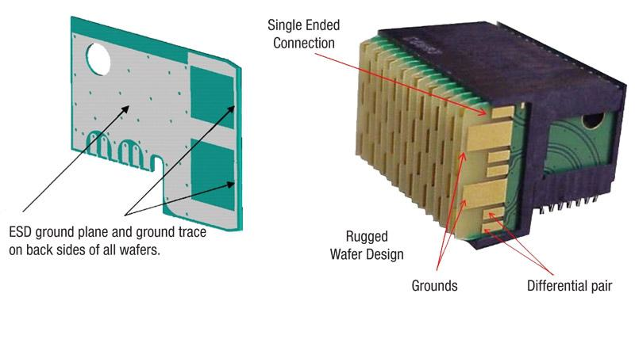
VXS P0 Connector
22.31 mm (0.878”)
P0 connector supports channels for serial fabrics
ESD = Electrostatic Discharge
Links: OpenVPX Profiles, VXS P0, RTM, Connector, Contacts, RT 2-R Wafer, Slot Profiles, Pin Numbering

Slide 27
The Need for More Pins – VPX is Started
VXS incorporated serial fabrics into the 6U VMEbus framework, but still maintained a degree of interoperability with VME only boards
However, the need for more pins put pressure on the VME community to move away from the DIN connector to a more dense connector that would not be intermatable with standard VMEbus boards
There was also a need to bring serial fabrics to 3U systems
  VXS is not available with 3U

Slide 28
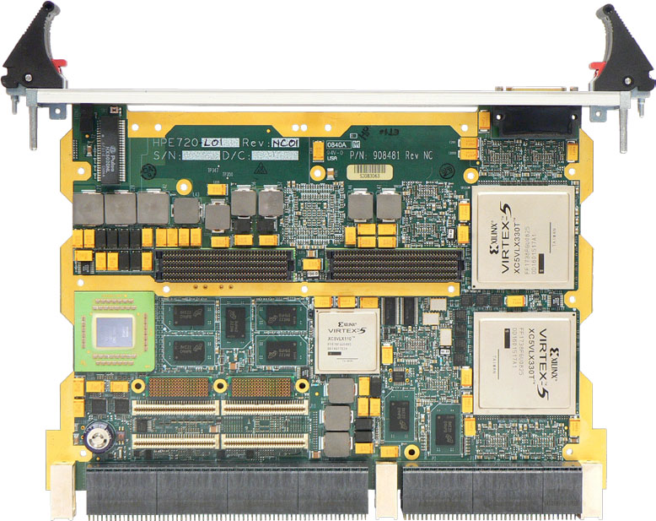
VPX
VPX working group started in
March 2003 releasing a baseline
VPX standard in 2007 followed
by a series of dot standards
  ANSI/VITA 46.0 Baseline Standard
  ANSI/VITA 46.3 Serial RapidIO
  ANSI/VITA 46.4 PCI Express
  ANSI/VITA 46.6 Gigabit Ethernet Control Plane on VPX
  ANSI/VITA 46.7 Ethernet
  VITA 46.8 InfiniBand (draft for trial use)
  ANSI/VITA 46.9 PMC/XMC rear I/O
  ANSI/VITA 46.10 Rear Transition Module
  ANSI/VITA 46.11 System Management on VPX
Same Modules sizes as VME
  6U x 160 mm – 233.35 mm x 160 mm or 9.187” x 6.299”
  3U x 160 mm – 100 mm x 160 mm or 3.937” x 6.299”
In 2009 a working group was started to provide a systems level approach to VPX
  In 2010 the first OpenVPX standard was released as ANSI/VITA 65
VPX Module

Slide 29
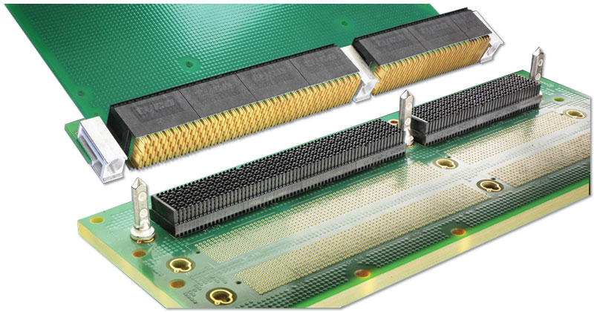
VPX Connector
VPX Connector for 6U Module
9.187” (233.35 mm)
Same type of connector as used for P0 of VXS
Used along entire edge of board instead of just a single connector

Slide 30
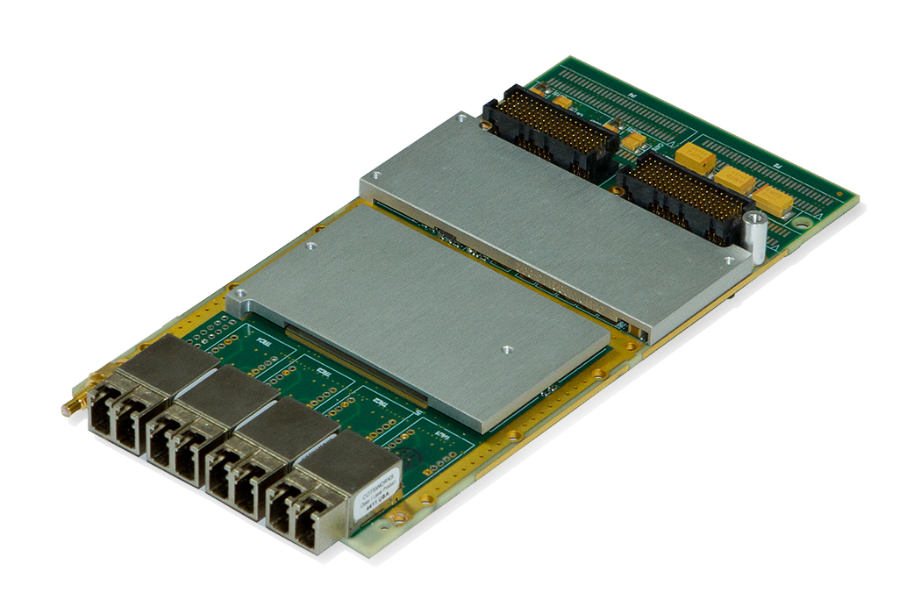
PMC and XMC Modules
P15
OpenVPX Plug-In Modules are frequently adapted for
particular I/O needs using mezzanine cards
  XMCs used on processing modules or carrier
  cards to add I/O and other features
PMC – PCI Mezzanine Cards
  IEEE 1386.1-2001
  Use PCI with a data bus of 32 or 64 bit
  XMC is becoming more common
XMC – ANSI/VITA 42.0-2016
PMC and XMC based on IEEE 1386-2001 Common Mezzanine Card (CMC)
  Single-width is 149.0 x 74.0 mm (5.87 x 2.91 inches); double-width is 149.0 x 149.0 mm
There are dot standards for various protocol options
  ANSI/VITA 42.1-2006 (R2012) for Parallel RapidIO 8/16 LP-LVDS
  ANSI/VITA 42.2-2006 (R2012) for Serial RapidIO
  ANSI/VITA 42.3-2006 (R2014) for PCI Express (PCIe) – most popular for current systems
  ANSI/VITA 42.6-2009 (R2015) for 10 Gbit Ethernet (approved 2009)
P16
Abaco Systems SPR507B
VITA 42 single-width XMC with 4 fiber SFPDP (VITA 17.1) connections
Pictures: © 2014 Abaco Systems. All rights reserved. Reprinted with permission. Copies may be made solely for training and education about the OpenVPX standard.
Hyperlinks: XMC Connectors

Slide 31
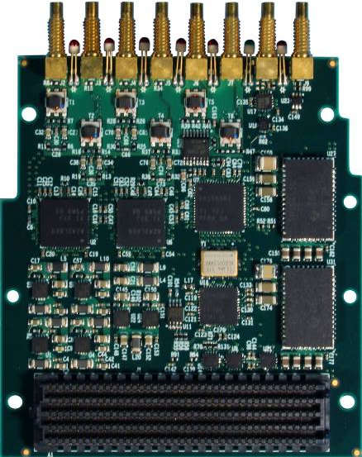
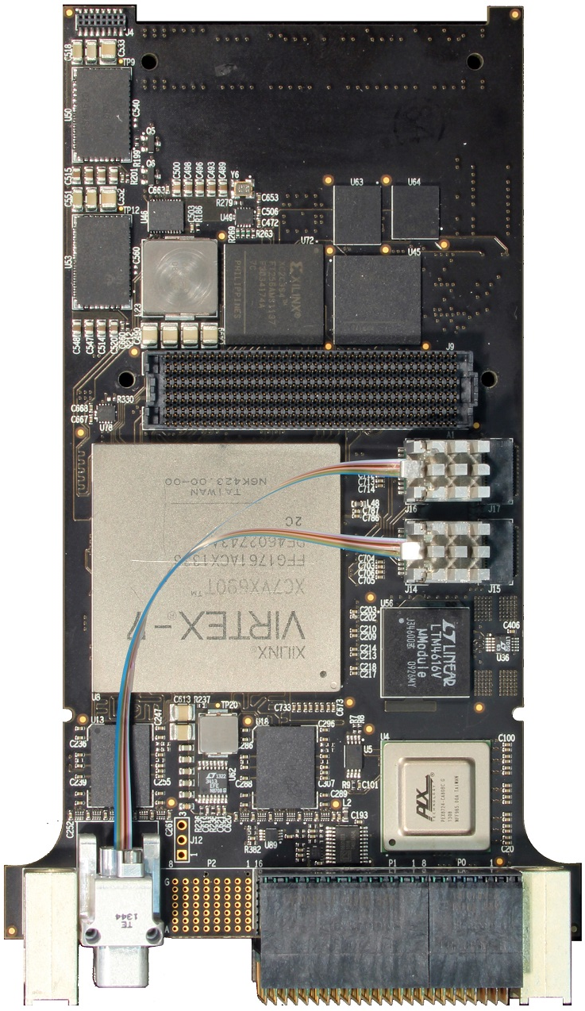
FMC (FPGA Mezzanine Card)
Mercury Model 3312 single-width FMC 4 chan. of A/D and 2 chan. of D/A
Mercury Model 5973 FMC FPGA carrier, 3U x 160 mm
OpenVPX Plug-In Modules are frequently adapted
for particular I/O needs using mezzanine cards
  FMCs used on FPGA boards to add things like:
    Analog to digital and digital to analog converters
    Fiber-optic transceivers
FMC – [VITA 57.1] FPGA Mezzanine Card
  Single width: 69 x 76.5 mm (2.717 x 3.012 inches)
    Includes regions 1 & 2 as shown in picture, not region 3
  Double width: 139 x 76.5 mm (5.472 x 3.012 inches)
FMC connector
FMC site connector

Slide 32
FMC (FPGA Mezzanine Card) Connectors
Mercury Model 3312 single-width FMC 4 chan. of A/D and 2 chan. of D/A
Mercury Model 5973 FMC FPGA carrier, 3U x 160 mm
FMC LPC (Low Pin Count) connector has 4 x 40 pins
  34 differential pairs
  2 differential clocks from mezzanine to carrier
  1 high-speed SERDES lane, with 1 SERDES clock
  I2C Control interface
  Misc: GA, JTAG, Present, Power Good, Power/GND
FMC HPC (High Pin Count) connector has 10 x 40 pins
  The HPC adds to the LPC giving the totals:
    80 differential pairs
    4 differential clocks, 2 optionally sourced by carrier
    10 high-speed SERDES, with 2 SERDES clocks
    I2C Control interface
    Misc: GA, JTAG, Present, Power Good, Power/GND
FMCs with the LPC can intermate with carriers that have an HPC and vice versa
FMC connector
FMC site connector

Slide 33
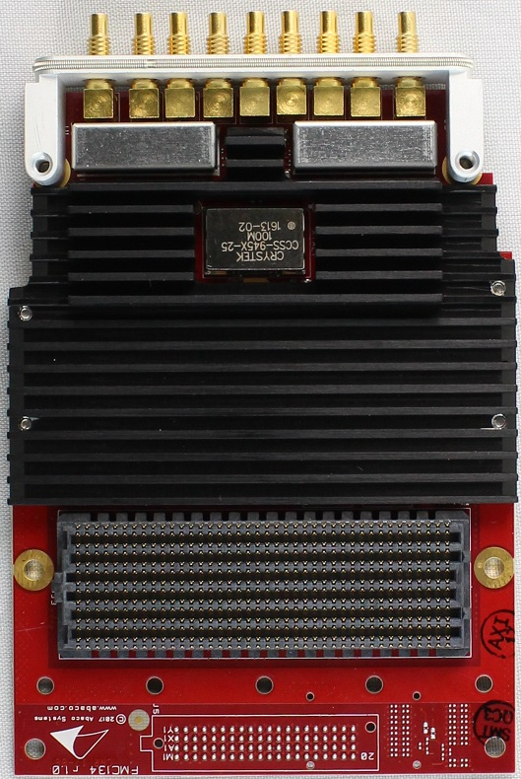
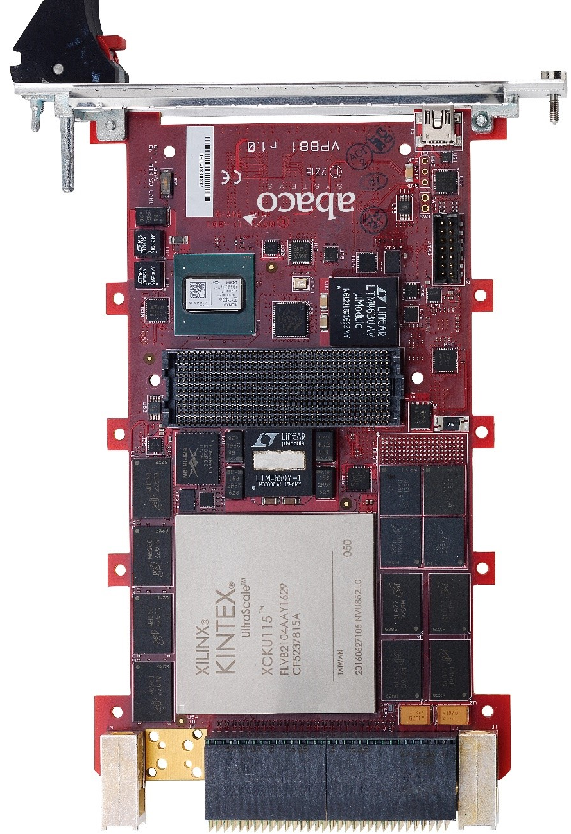
[VITA 57.4] FPGA Mezzanine Card Plus (FMC+) Standard
Abaco FMC134 FMC+ with 2 or 4 channels of A/D
Abaco VP881 FMC+ carrier, 3U x 160 mm
FMC+ – [VITA 57.4]
  Single width: 69 x 94 mm (2.717 x 3.701 inches)
    Includes regions 1 thru 4 as shown in picture
  Double width: 139 x 94 mm (5.472 x 3.701 inches)
FMC+ HSPC (High Serial Pin Connector) 14 x 40 pins
  80 differential pairs
  24 high-speed SERDES, with 2 SERDES clocks
    All 24 intended for operation to 28 Gbaud
  4 differential clocks, 2 optionally sourced by carrier
  Additional clock and sync from carrier to FMC+
    Carrier can use to pass backplane radial clocks to FMC+
  Addition clock and sync from FMC+ to carrier
  I2C Control interface
  Misc: GA, JTAG, Present, Power Good, Power/GND
Optional 4 x 20 Aux HSPCe (High Serial Pin Connector extension)
  Additional 8 SERDES (32 in all) + 2 SERDES clocks
    All 8 intended for operation to 28 Gbaud
    FMC+ carriers can accept FMC mezzanines
FMC+ connector
FMC+ site connector
PCB Footprint for optional HSPCe
Pictures: © 2018 Abaco Systems. All rights reserved. Reprinted with permission. Copies may be made solely for training and education about the OpenVPX standard.

Slide 34
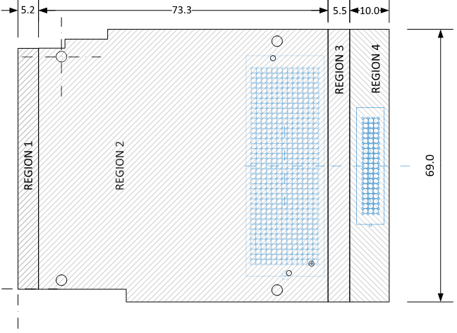
FMC and FMC+ Regions
Regions 1 and 2 – Typically used on air cooled commercial grade carrier cards
Regions 2 and 3 – Typically used on ruggedized conduction cooled carrier cards
Regions 1, 2 and 3 – Typically used on ruggedized carrier cards needing Region 1
Regions 1, 2, 3, and 4 (FMC+ only) – Used when the optional HSPCe connector area is needed
FMC regions
FMC+ regions

Slide 35
RTM (Rear-Transition Modules)
Backplane
RTM
Used as a way to bring I/O from a Plug‑In Module to cable connectors
  Can have some active components such as line drivers
    Many chassis do not have much cooling in the rear so power is generally kept low
Standardized for VPX by [VITA 46.10] Rear Transition Module for VPX
RTM pin numbering is different from that of Plug-In Modules, see [VITA 46.10]
Connector designations:
  RP0 to RP6 – Connectors on RTM
  RJ0 to RJ6 – Connectors on RTM side of backplane
  J0 to J6 – Connectors on Plug-In
  Module side of backplane
  P0 to P6 – Connectors on Plug-In Module
6U VPX Plug-In Module
Links: OpenVPX Profiles, VXS P0, RTM, Connector, Contacts, RT 2-R Wafer, Slot Profiles, Pin Numbering

Slide 36
Lanes, Pipes, Planes, and Ports
Term | Definition
Lane | An electrical lane consists of one transmit differential pair and one receive differential pair, point-to-point, crossed connection (transmit connects to receive and receive to transmit). An optical lane consists of a transmit and receive fiber, point-to-point, crossed connection.
Pipe | A physical aggregation of differential pairs or optical fibers used for a common function that is characterized in terms of the total number of differential pairs. A Pipe is not characterized by the protocol used on it. The following Pipes are predefined by OpenVPX: Single Pipe (SP): A Pipe comprised of a single differential pair or optical fiber. Example: radial REF_CLK and radial AUX_CLK Ultra-Thin Pipe (UTP): A Pipe comprised of 2 differential pairs or 2 optical fibers. Example: 1000BASE-KX Ethernet, 1x Serial RapidIO, and x1 PCIe interfaces. Thin Pipe (TP): A Pipe composed of 4 differential pairs or 4 fibers. Example: 1000BASE-T interfaces. Fat Pipe (FP): A Pipe composed of 8 differential pairs or 8 optical fibers. Example: 4x Serial RapidIO, x4 PCIe, and 10GBASE-KX4 interfaces. MP: A Pipe composed of 10 differential pairs or 10 optical fibers. WP: A Pipe composed of 12 differential pairs or 12 optical fibers. Double Fat Pipe (DFP): A Pipe composed of 16 diff pairs or fibers. Example: x8 PCIe interface. Triple Fat Pipe (TFP): A Pipe composed of 24 diff pairs or fibers. Example: 12x InfiniBand interface. Quad Fat Pipe (QFP): A Pipe composed of 32 diff pairs or fibers. Example: x16 PCIe interface. Octal Fat Pipe (OFP): A Pipe composed of 64 diff pairs or fibers. Example: x32 PCIe interface.
Plane | A physical and logical interconnection path among elements of a system used for the transfer of information among elements. Also see slides discussing Communication and Utility Planes.
Port | A physical aggregation of pins for a common I/O function on either a Plug-In Module’s backplane Connectors or a backplane slot’s Connectors.

Slide 37
User Defined and Reserved Pins in Slot Profiles
Term | Definition
Reserved | In Slot Profile pin assignment tables Reserved pins (also referred to as RSVD) are to be left as not connected on both Plug-In Modules and backplanes. They might be used at some time in the future. For more information, in [VITA 65.0], see Section 6.2.1.
User Defined | In Slot Profile pin assignment tables, User Defined pins are those that are not defined by the Slot Profile; they are left for suppliers or integrators to define. Frequently they are defined for application or platform specific uses. Different uses for the same pin of a Slot Profile lead to interoperability problems, see the slide: Interoperability – Dealing with User Defined Pins. Also in [VITA 65.0], see Sections 1.1.5 and 8.3.

Slide 38
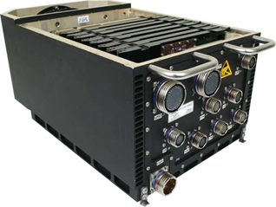
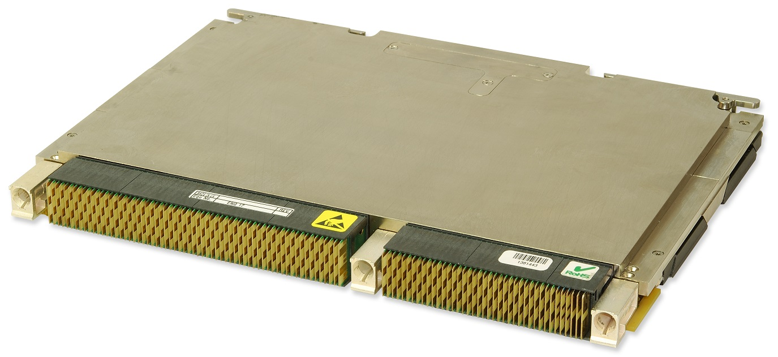
Two-Level Maintenance
A maintenance system where Plug-In
Modules are replaced in the field
  Systems are frequently implemented such that OpenVPX Plug-In Modules can replaced in the field
Two-level refers to:
  Organization-Level also referred to as the field
  Depot-Level
Typical requirements on Plug-In Modules to be replaced in the field
  Must be changeable in the field with minimal tools
  ESD (Electrostatic Discharge) protection – prevent
  damage by handling
  Be able to change in a relatively short time
  Minimize chances of error – e.g. use Slot Keying
  With OpenVPX Plug-In Modules front panel connections tend to be counter to the last two requirements above
6U field replaceable Plug-In Modules within a Conduction Cooled chassis
6U Conduction Cooled field replaceable Plug-In Module
Pictures: © 2014 Abaco Systems. All rights reserved. Reprinted with permission. Copies may be made solely for training and education about the OpenVPX standard.

Slide 39
Subsection Outline: Protocols
Introduction
Protocols
  Baud Rate
  Baud rates and data rates for Ethernet, PCIe and digital video
  Effect that can reduce signaling margin
  Single-Ended Utility Pane and GP I/O electrical characteristics
  Differential General Purpose I/O electrical characteristics
Cooling, form factors, and copper connectors
Blind mate optical and coax connectors
Utility Plane including radial clocks and VITA 62 power supply Plug-In Modules
Slot, Backplane, and Module Profiles (Including AMPS)
    List of [VITA 65.0] protocol sections
Slot Profile and Backplane Profile examples
Summary and References
Slideshows: Protocols_Moderate

Slide 40
Baud Rate
  Baud rate definition – the number of symbols (data signaling events) per second sent across a single transmission path
  Depending on the encoding method used, a data signaling event may contain less than 1 bit, exactly 1 bit, or more than 1 bit
PCI Express 2.0 over a single lane has a bit rate of 4.0 Gbits/sec
  Data transmitted using 8B/10B encoding – encodes 8 bits of data into a 10 symbols
  A way to look at the encoding is that each transmitted symbol represents 0.8 of a bit
  Thus the baud rate to achieve a 4.0 Gbit/second data rate is the bit rate divided by the symbols per bit which is 4 Gbits/sec / 0.8 = 5 Gbaud
    PCIe standard refers to this as 5 GT/s (GigaTransfers/sec)
1000BASE-T
  Bit rate – 1 Gbit/sec in one direction using 4 paths (pairs)
  Baud Rate Determination
    4 transmission paths
    PAM 5 encoding (Pulse Amplitude Modulation with 5 levels – +2, +1, 0, -1, -2 )
      4 levels are used for encoding two bits of data per symbol (00, 01, 10, 11)
      5th level is used to support forward error correction
    Baud rate = bit rate / number of paths / bits per symbol
    Baud rate = (1 Gbit/sec) / 4 / 2 = 125 Mbaud

Slide 41
Relating Frequency in Hertz to Baud Rate
Hertz definition – measure of frequency of a periodic signal in cycles/sec
Relation of frequency to baud rate
  An example of a truly periodic digital signal is a signal with alternating 1’s and 0’s where one complete cycle or 1 hertz would consists of a 1 and a 0.
    Since baud rate is a measure of symbols/sec we can see that 1 Hz is equal to a baud rate of 2.
    People frequently talk in terms of Hz when referring to a digital signal, they could be referring to the clock rate of the symbols or the actual signal.
    This confusion can lead to a factor of 2 error. It is best to talk in terms of baud when referring to the rate of symbols.
Digital Signal Frequency and Bandwidth
  While the primary frequency of a digital signal will be ½ its baud rate, harmonics of the primary frequency will also be present.
    The strength of these harmonics will depend on the sharpness of the edges of the digital signal.
    Therefore, while looking at signal loss versus frequency across a digital transmission path may be a good start at determining channel capability requirements other factors may need to be considered also.

Slide 42
Ethernet Baud Rates and Data Rates – BASE-T
Ethernet is standardized by [IEEE 802.3]
BASE-T Ethernets are intended for twisted pair cables (see this slide, others see next slide)
  In an OpenVPX environment these are generally used to go outside a chassis

Slide 43
Ethernet Baud Rates and Data Rates – Non BASE-T
BASE-KX & BASE-KR are for going over copper pairs in backplane
BASE-SR is for multi-mode optical fiber and BASE-FR is for single-mode optical fiber
BASE-LR & BASE-ER are for single-mode fiber with multiple
channels/fiber using WDM (Wave Division Multiplexing)

Slide 44
PCIe Baud Rates and Data Rates
PCIe is standardized by [PCIe Base]

Slide 45
Digital Video Baud Rates and Data Rates
CoaXPress is standardized by [CoaXPress]
ADVB (Avionics Digital Video Bus) is standardized by [ARINC 818]
  [ARINC 818] (ADVB) does not specify the use of FEC but if required by an application, FEC should be specified by the ADVB ICD (Interface Control Document).
  See [ARINC 818] Appendix F-3 for more information.

Slide 46
Effect That Can Reduce Signaling Margin
Signal and power grounds use the same physical conductors (connector pins, ground plane, etc.)
  Ground currents can reduce margin:
    With single-ended signals can appear as a reduction or increase in signal voltage at the receiver
    With differential signals can bias the common mode up or down
Active components on Plug-In Modules are generally powered by supplies local to the Plug-In Module
  Plug-In Modules meeting newer Slot Profiles are using only using 12 VDC, 3.3V_AUX, & VBAT from the backplane
  Many ICs specify logic voltage thresholds as a percentage of the voltage of the power being supplied to the IC
    The interface between Plug-In Modules and the backplane is specified in terms of absolute voltages
    If the output of Plug-In Module’s local supply is too different from the nominal, it can cause the drive and receive levels to not meet the [VITA 65.0] Rules, further reducing margin. Using power supplies with lower tolerances can improve margins.

Slide 47
Single-Ended Utility Plane and GP I/O Electrical Characteristics
With LVGPIO the minimum of high out of driver is 1,260 mV,
receiver guarantee to receive as a high up to 1,230 mV -> giving 30 mV of margin
  In design of systems make sure that the signal/power ground does not vary so much, with respect to the other end of LVGPIO signals, as to significantly reduce the available margin.
  Be particularly careful if going off a backplane – for example using LVGPIO to a chassis-level board for driving signals such as [TIA-422] for going outside of a chassis.
    Even with non-[VITA 65.0] loads, adhere to the receiver requirements of not loading with more than 50 μA and have a ≥ 9.5 kΩ pull-up resistor (see Rules 5.15.6-4 and 5.15.6-6), in which case the driver will drive a high to a higher voltage than the 1,260 mV it is required to drive into a 2 ma load, increasing margin.

Slide 48
Differential General Purpose I/O Electrical Characteristics
Common mode for GPLVDS15 has no margin
  Voltage levels chosen to match specifications of FPGAs
    FPGA designers probably intended for going between FPGAs on same PCB
  Recommendations:
    Minimized the movement of signal/power ground between transmitter and receiver

Slide 49
Subsection Outline: Cooling, Form Factors & Copper Connectors
Introduction
Protocols
Cooling, form factors, and copper connectors
  Cooling options
  IEEE 1101.10 vs. VITA 48.1 Plug-In Module Front Panels; Slot pitch
  3U vs. 6U Plug-In Modules
  VITA 46 (VPX) backplane connectors; Vibration testing and connector fretting
  XMC connectors
Blind mate optical and coax connectors
Utility Plane including radial clocks and VITA 62 power supply Plug-In Modules
Slot, Backplane, and Module Profiles (Including AMPS)
Slot Profile and Backplane Profile examples
Summary and References
Slideshows: Cooling FF Connectors Moderate; Connector Fretting Full Detail

Slide 50
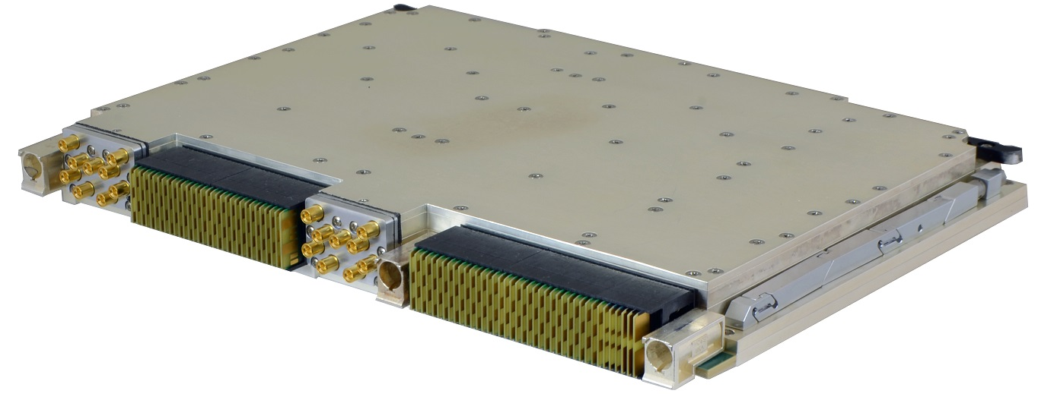
Cooling Options
OpenVPX references VITA 48 standards for mechanical and cooling
  [VITA 48.0] Mechanical Specification for Microcomputers Using Ruggedized
  Enhanced Design Implementation (REDI) – Base standard
Options where cooling air normally comes in contact with electronic components
  [VITA 48.1] Air cooled – widely used
    Can handle up to around 75 W per 3U and 175 W per 6U Plug-In Module
    Plug-In Module pitch of .80, 0.85, and 1.00 inches allowed; 1.00 inches is the most common
Options where cooling air normally has no contact with electronic components – better for harsh environment
  [VITA 48.2] Conduction Cooled – widely used
    Limited to around 75 W per 3U and 150 W per 6U Plug-In Module, with air-cooled chassis side walls (higher with liquid cooled walls)
    Plug-In Module pitch of .80, 0.85, and 1.00 inches allowed; 1.00 inches is the most common
  [VITA 48.4] Liquid Flow Through (LFT) – Only 6U
    Can handle >400 W per 6U Plug-In Module
  [VITA 48.5] Air Flow Through (AFT) – Only 6U
    Can handle up to around 200 W per 6U Plug-In Module
    Typical Plug-In Module pitch of 1.0 and 1.2 inches. Up to 1.52 inches allowed
  [VITA 48.7] Air Flow-By™
    Can handle up to around 200 W per 6U Plug-In Module
    Plug-In Module pitch of .85, 1.00, 1.10, and 1.20 inches allowed; 1.0 inches is most common
  [VITA 48.8] Air Flow Through (AFT) – 3U and 6U
[VITA 48.2] Conduction Cooled Plug-In Module
Power numbers in this section are approximate, to give an idea of typical high-end usage.
  Actuals will vary depending on details of the system
Vesper SI-9173 picture courtesy of Leonardo DRS

Slide 51
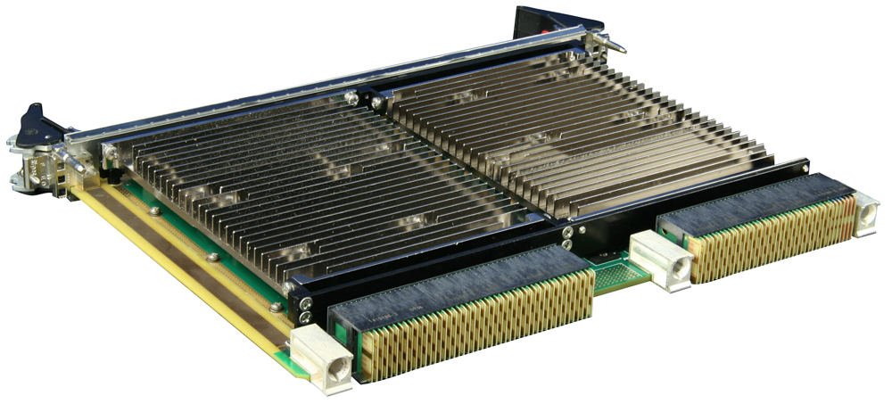
[VITA 48.1] Air Cooling
Can handle up to around 75 W per 3U x 160 mm and 175 W per 6U x 160 mm Plug-In Module
Plug-In Module pitch of .80, 0.85, and 1.00 inches allowed
  1.00 inches is the most common
Components and connectors exposed to cooling air
6U 1.0” pitch Curtiss-Wright VPX6‑490 [VITA 48.1] GPU (NVIDIA®) Accelerator
6U and 3U backplanes, showing airflow direction
Hyperlinks to CC: Chassis, Plug-In Module

Slide 52
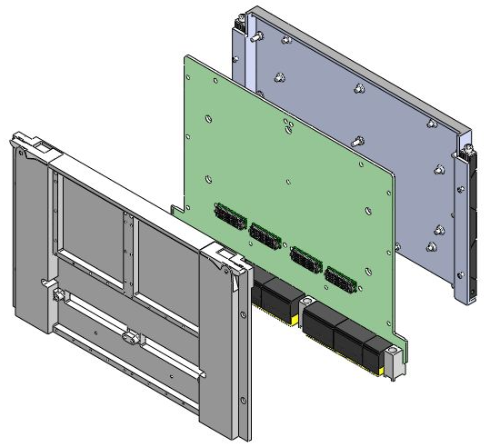
[VITA 48.2] Conduction Cooling
Limited to around 75W per 3U x 160 mm and 150 W per 6U x 160 mm
Plug-In Module, with air-cooled side walls
  With liquid cooled chassis sidewalls can handle more
  XMC and other mezzanine cards can make cooling more difficult
Plug-In Module pitch of .80, 0.85, & 1.00 inches allowed; 1.00 by far most common
Proven rugged approach with long heritage
  Newer approaches tend to handle higher power levels or give lower
  junction temperature at the same power level
    Lower junction temp tend to increase the MTBF (Mean Time Between Failure)
Suppliers tend to spec the temperature at the
Plug-In Module’s edge (in accordance with VITA 47 standards)
  Be aware there will be a drop between the card and the
  chassis side wall – this can be a performance limiter
    The temperature drop from Plug-In Module edge to chassis rail is a significant part of
    the budget, e.g. 55ºC air at 10,000 ft. to a card edge of 85ºC max = 30ºC budget
    Temperature drop varies considerably based on power dissipation, wedge clamp section etc.
    [VITA 47.1] specifies the minimum performance of Plug-In Module retainers
  Also a drop between cooling fluid (i.e. air or liquid) and chassis wall at Plug-In Module interface
    Temperature drop varies considerably based on fluid type, fluid temp, fluid mass flow rate etc.
Secondary Cover
PCB (Printed Circuit Board)
Primary Cover
Diagrams from Mercury presentation given at Sept 2012 VITA Standards meeting
Hyperlinks: CC Plug-In Module Example

Slide 53
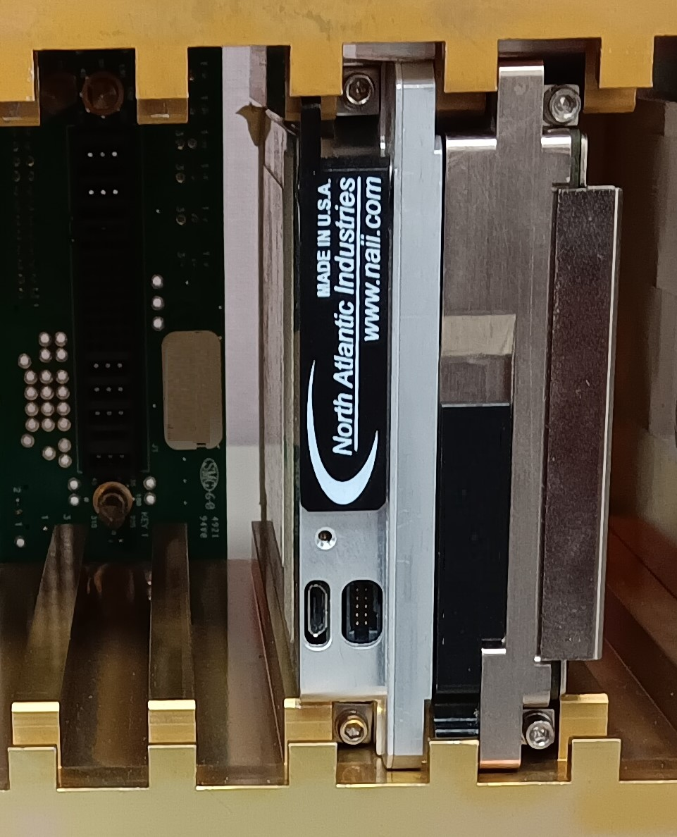
[VITA 48.2] Cooling – Primary vs. Secondary Side Wedge Locks
With [VITA 48.2] there is a thermal interface between the Plug-In Module and the Chassis Rail (card guide).
  The Chassis Rail is part of the chassis side-wall
Chassis side walls can be cooled in many different ways:
  Fins can be used to conduct the heat to the surrounding air; in many cases with the air being forced through the fins using a fan or blower
  Side-walls can be cooled by having cooled liquid flow through them
With wedge locks on the primary side of some Plug-In Modules and on secondary side of others; a single Chassis Rail can end up doing double duty – handling the heat from two Plug-In Modules
  If both Plug-In Modules are relatively high power, this can cause the pair of Plug-In Modules to not get enough cooling
Wedge lock used as retainer on primary side of a Plug-In Module
Chassis Rail doing double duty – conducting heat away from two Plug-In Modules – also referred to as rail sharing
Wedge lock used as retainer on secondary side of a Plug-In Module
Picture courtesy of North Atlantic Industries

Slide 54
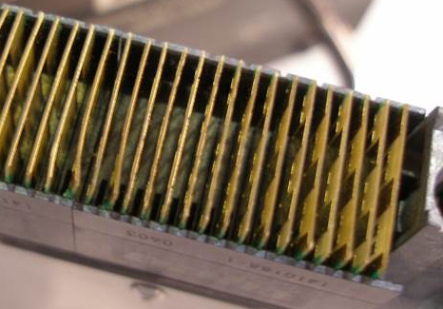
Extended Covers for Protecting Connectors
Picture courtesy of Elma
Unprotected [VITA 46.0] connectors can easily be damaged by dropping a Plug-In Module
For Plug-In Modules intended to meet 2-level
maintenance requirements
  It is recommended that top and bottom covers
  be extended in order to protect the connectors
  Backplanes for such Plug-In Modules must avoid having tall components between the connectors, on the side where Plug-In Modules plug in
    Components such as capacitors can interfere with a Plug-In Module’s extended covers
Connector protection can be implemented with [VITA 48.1], [VITA 48.2], [VITA 48.4], and [VITA 48.5] covers
  Particularly important for [VITA 48.4], which does not have guide sockets
Connector damage
Secondary Side Cover
Extension
Primary Side Cover
Extension
PMC/XMC Cover
Extension

Slide 55
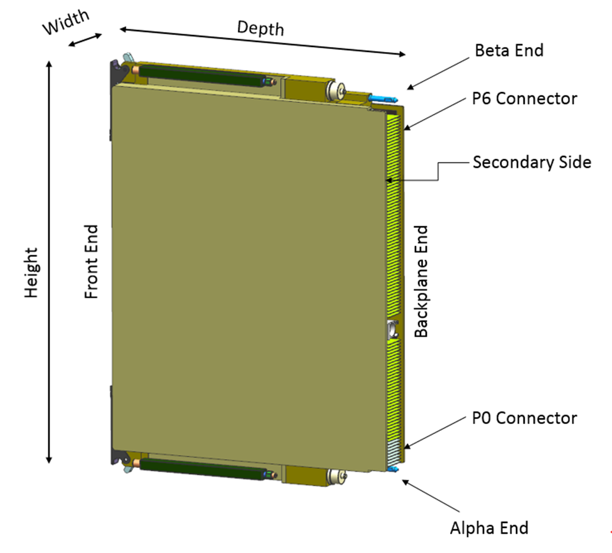
[VITA 48.4] Liquid Flow Through Cooling
Can handle >400 W per 6U x 160 mm Plug-In Module
  6U only
Plug-In Module pitch of 0.80, .85, 1.00, 1.20, 1.40, or 1.60 inches; expect 1.00 inches to be most common
QDs (Quick Disconnects) for connecting up liquid in and out when Plug-In Module is mated with backplane
Two classes of insertion/extraction lever
  Class A – latching, tolerance compensating
    Preferred selection for all high reliability/ruggedized solutions
  Class B – non-latching
Uses a single 64-position guide pin/socket between P2/J2 and P3/J3
  With others 3 of 5-position guide pin/sockets are used
The Plug-In Module P0 connector body is narrower than a standard [VITA 46.0] connector
  The connector wafers are located as specified by [VITA 46.0]
Shown with extended covers for recommended connector protection

Slide 56
[VITA 48.5] Air Flow Through Cooling
Can handle up to around 200 W per 6U x 160 mm Plug-In Module (is 6U only)
  Places chips directly against heat exchanger, eliminating need to transfer heat to chassis side walls like [VITA 48.2]
  Inlet area sized for EMI shielding and double-sided primary and mezzanine CCAs (Circuit Card Assemblies)
Typical Plug-In Module pitches are 1.0, and 1.2 inches; up to 1.52 inches allowed
Uses wedgelock retainer like [VITA 48.2], best for mixed cooling applications
Seals around heat exchanger inlet and exhaust prevent cooling air from
making contact with electronic components and connectors
  Seal design provides ability to install orifices which are used to flow balance a chassis
    Give more air to Plug-In Modules that need higher flow rates; restrict the air to lower power ones
  High maturity – design has been fielded in harsh environments since 1970s
0.301” MAX
Primary side of PCB
Mezzanine CCA
Heat Exchanger
Insertion / Extraction Lever
Covers
Alpha end (end nearest lowest number contact)
Plug-in Unit Thickness
Mezzanine Connector
Plug-in Unit Guide
Airseal Mating Surface
(0.5° taper top to bottom)
Top of Backplane
Plug-in Unit Connector
1.48” (37.59 mm) MAX
Plug-in Unit Thickness
Wedgelock Retainer
Beta end

Slide 57
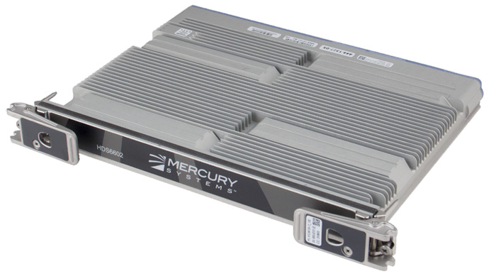
[VITA 48.7] Air Flow-By Cooling
Can handle up to around 200W per 6U x 160 mm Plug-In Module
Plug-In Module pitch of .85, 1.00, 1.10, and 1.20 inches allowed; 1.00 most common
2 classes of Plug-In Modules:
  Class A – Rugged implementation of Air Flow-By – Plug-In Modules utilize rugged insertion/extraction features and Plug-In Modules are sealed to the backplane cover plate.
    Cooling air prevented from making contact with electronic components and connectors
  Class B – Plug-In Modules utilize standard [IEEE 1101.10] insertion/extraction features and do not provide a means to seal the Plug-In Module to the backplane cover plate.
    Plug-In Modules can be installed in [VITA 48.1] compliant sub-rack.
Secondary side heat exchanger/cover
Primary side heat exchanger/cover
Seal plate
6U 1.0” Mercury HDS6602 – Dual Intel® 3rd Gen 10-core Xeon
Environmental sealing gaskets

Slide 58
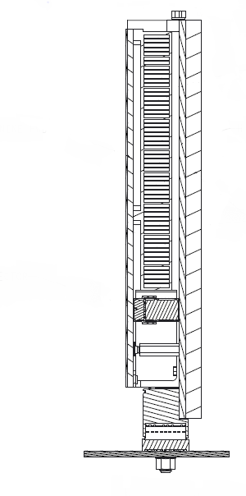
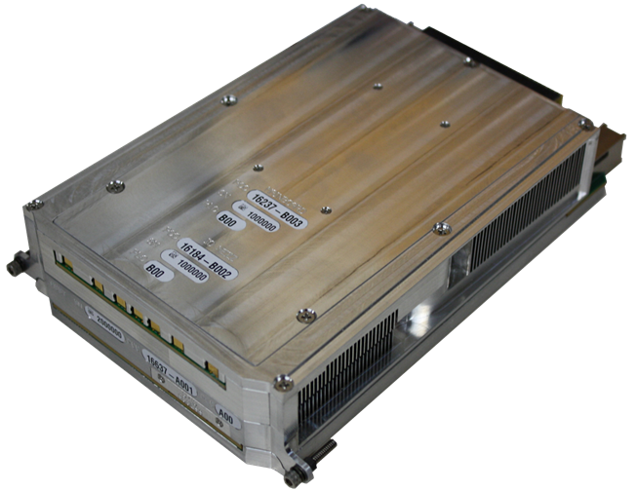
[VITA 48.8] Air Flow Through Cooling
Host PCB
Heat Exchanger
Like [VITA 48.5] air is directed through an internal heat exchanger without making contact with electronic components
  [VITA 48.8] permits the use of a front opening in addition to side openings
Plug-In Module pitch of 1.00, 1.20, and 1.50 inches allowed; 1.50 most common
Mezzanine PCB
Mezzanine Connector
Backplane Connector
Picture courtesy of Annapolis Micro Systems
Covers
Backplane

Slide 59
Comparison of [VITA 48.8] with [VITA 48.5] Air Flow Through Cooling
Description | [VITA 48.8] |  | [VITA 48.5]
Form Factors | 3U | 6U | 6U only
Pitch | 1.0, 1.2, and 1.5 inch |  | Typical 1.0, 1.2; up to 1.52 inch
Retention | Jack screws or tool-less lever |  | Card retainer
Air flow direction* | Alpha and Beta sides plus front option |  | Alpha and Beta sides only
Alpha / Beta sides air opening cross sectional area | 1.0 inch pitch: 5.5 x 0.475= 2.61in² 1.2 inch pitch: 5.5 x 0.675= 3.71in² 1.5 inch pitch: 5.5 x 0.975= 5.36in² Note: These are max inlet sizes, can be reduced by configuration of the CCA (Circuit Card Assembly) components, optional covers etc. |  | 4.00 x 0.221=0.884 in² Notes: 1) maximum for any pitch 2) Accounts for double-sided primary and mezzanine CCAs as well as EMI shielded covers.
Front Air opening cross sectional area# | 1.0 inch pitch: 3.0 x 0.475=1.43 in² 1.2 inch pitch: 3.0 x 0.675=2.03 in² 1.5 inch pitch: 3.0 x 0.975=2.93 in² | 1.0 inch pitch: 7.0 x 0.475=3.33 in² 1.2 inch pitch: 7.0 x 0.675=4.73 in² 1.5 inch pitch: 7.0 x 0.975=6.83 in² | Not specified
Essential IP | None |  | U.S. patent #7,995,346
* Alpha is the side nearest the lowest numbered contacts and the Beta side is opposite Alpha
# Front opening is limiting factor in the “T flow” configuration since both Alpha (side nearest lowest numbered contacts) and Beta (side opposite Alpha) opening areas are available for use.

Slide 60
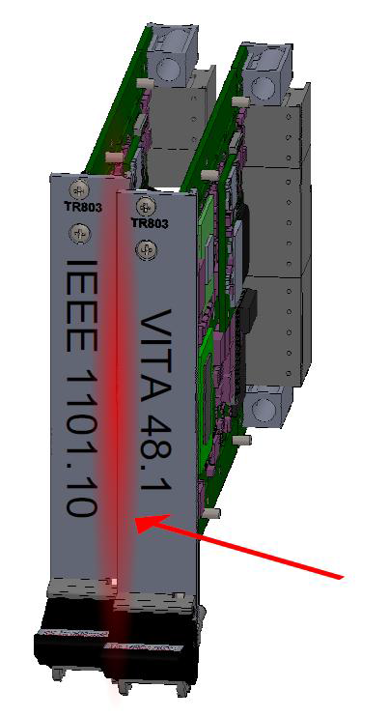
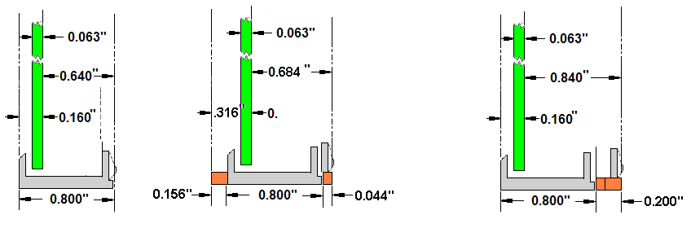
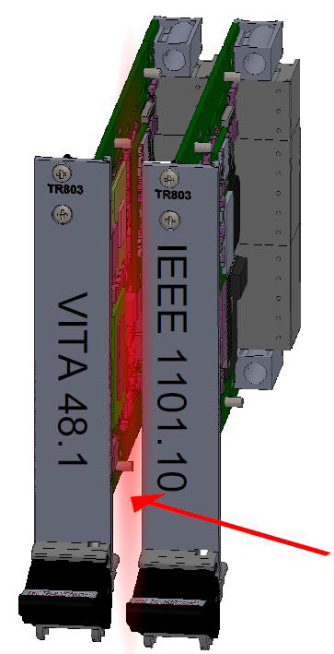
[IEEE 1101.10] vs. [VITA 48.1] Plug-In Module Front Panels
[IEEE 1101.10] 0.800 inch pitch
[VITA 48.1]
1.000 inch pitch
[IEEE 1101.10] 1.000 inch pitch
Plug-In Module Printed Circuit Boards (PCBs)
Front panels clashing
Plug-In Module Front Panels
With diagram above and below differences in front panel location with respect to PCB exaggerated for illustration purposes
With [VITA 48.1] front panels the additional width in going from a 0.8 inch pitch to a 1.0 inch pitch is added to both sides
  With [IEEE 1101.10] it is just added to above the primary side of the PCB
  [VITA 48.1] enables taller components on the secondary side of the PCB
Mixing [IEEE 1101.10] and [VITA 48.1] front panels will cause front panels to either clash or leave a gap
  Assuming front panels and backplane all at same pitch
  Gap can be both an EMC (Electromagnetic Compatibility) and air flow issue
  Incorporating [IEEE1101.10] front panels is undesirable but if filler panels are used to accommodate mixing of front panels, the fillers must be mechanically robust
Gap between front panels
Diagrams courtesy of Concurrent Technologies and Elma
[VITA 65.0] Rule 4-2, requires using [VITA 48.1] front panels

Slide 61
1.0 Inch Pitch Is By Far the Most Popular Pitch with OpenVPX
OpenVPX & many of the VITA 48.x standards allow down
to 0.8 inch pitch, but 1 inch pitch tends to be a sweet spot
With [VITA 48.1] Plug-In Modules, increasing to 0.85 inch
pitch enables rear covers
  Rear covers provide Electrostatic Discharge (ESD) protection,
  which facilitates 2‑level maintenance
Illustration shows backplane slots at 1.0 inch pitch
  Following design rules typically used for high-speed differential
  pairs, at 1.0 inch pitch, get 8 pairs between the pad arrays of
  adjacent slots, as shown
  0.8 inch pitch reduces this to 4 pairs, which can approximately
  double the number of signal layers, increasing cost
1.0 inch vs. 0.8 enables more volume for Plug-In Modules – tends to be put to good use
  Tends to be used for more robust cooling – enabling higher power dissipation
  Additional height on rear of Plug-In Module of VITA 48.x standards, enables taller components
Design rule information and diagram courtesy Elma

Slide 62
VITA 48 Plug-In Modules – 3U vs. 6U
3U | 6U
3U Better:
3U is more rugged than 6U. | Stiffening by conduction cooling heat sinks, covers etc. can help. The RT 2-R connectors reduce fretting corrosion.
With [VITA 48.2] (Conduction Cooled), 3U gives higher power density. The interface between the Plug-In Module edge and chassis sidewalls along with whatever is cooling the chassis sidewalls tends to be limit. | With [VITA 48.2] 6U, there is the area of contact between Plug-In Module and chassis is the same as for 3U. Max per Plug-In Module is around 150 W.
6U Better:
Products tend to have PCIe interfaces, which tend to give tighter coupling. | Products with 10 Gbit Ethernet & InfiniBand are available, which make it easier to have looser coupling.
If a lot of processing and connectivity is required, the number of pins available is a severe constraint. | There is a lot more board area and connectivity to the backplane. 6U Switch Plug-In Modules give a lot of connectivity.
It Depends:
For smaller systems, a 3U Plug-In Module or two of each type, 3U can make sense. If a small modularity is required 3U can make sense. | For larger systems, 6U Plug-In Modules allow overhead of mechanicals (holding the board in place) and power supplies to be amortized over a larger board. Hence, 6U gives more performance density (with [VITA 48.2] assumes power per Plug-In Module is not limit).

Slide 63
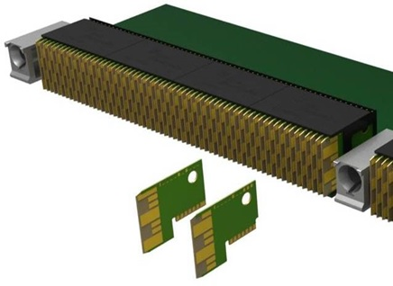
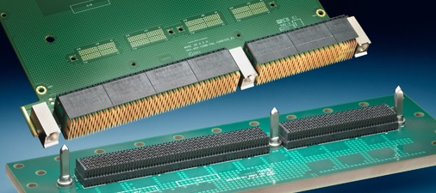
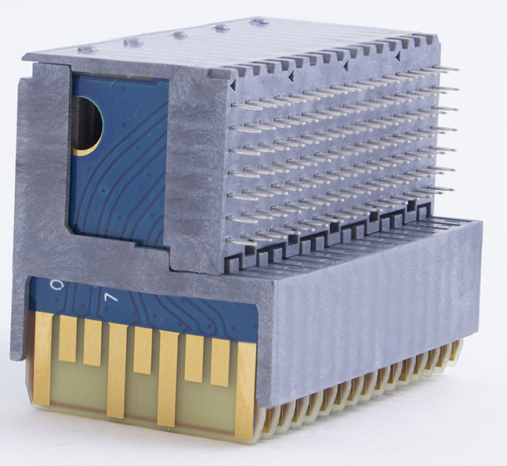
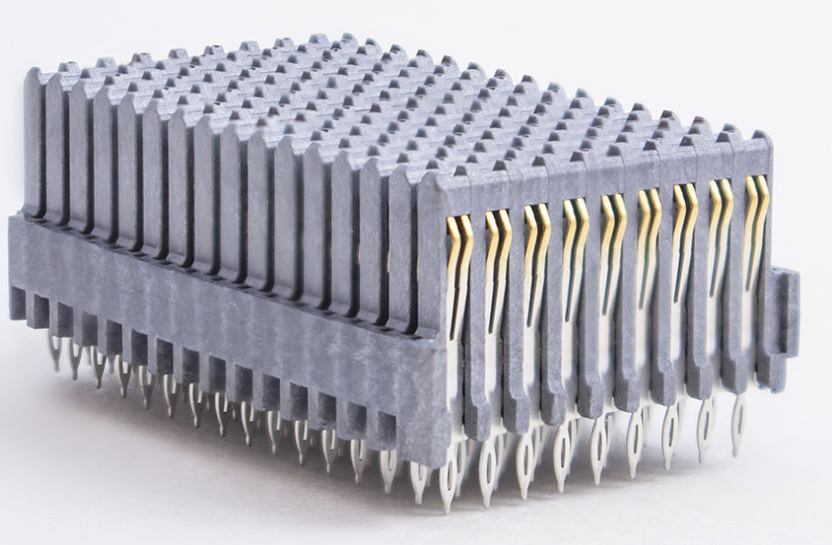
VPX Backplane Connector Options
TE Connectivity RT 2 shown
Plug-In Module
[VITA 46.0] connectors
  TE Connectivity RT 2 – original
  [VITA 46.0] connector, deployed
  in many applications
  TE Connectivity RT 2-R – [VITA 46.0] connector developed to be more rugged
    Inter-mates with RT 2 and the PCB (Printed Circuit Board) footprints are the same for both – connectors are footprint compatible
  Amphenol R-VPX – inter-mates and PCB footprint compatible with RT 2 and RT 2-R
    Rugged like RT 2-R with 4 points of contact
  Higher bandwidth [VITA 46.0] connectors being standardized by [VITA 46.30] and [VITA 46.31]
  Intended to go to at least 25 Gbaud signaling for protocols such as 100GBASE-KR4 and PCIe Gen 4
  [VITA 46.30] connectors mount to PCB using press fit pins; [VITA 46.31] connectors are surface mount
  Inter-mate with RT 2, RT 2-R, and R-VPX; but the PCB footprints are different from RT 2, RT 2-R, and R-VPX
  TE Connectivity RT 3 and Amphenol RVPX EVO 2 are designed to be compliant to [VITA 46.30]
    RT 3 and RVPX EVO 2 have same PCB footprints and inter-mate with each other as well as other [VITA 46.0] connectors
    Rugged like RT 2-R
Amphenol Viper [VITA 60.0] and Hypertronics [VITA 63.0]
  Do not inter-mate with each other or with [VITA 46.0] connectors
  Footprint compatible with RT 2-R and R-VPX – same PCB can be used with any of these connectors
For additional info see VPX connector reports; Available at: http://www.vita.com/VPX_Reports
Even differential wafer
Odd differential wafer
Backplane
Pictures above & left courtesy of TE Connectivity
R-VPX Plug-In Module (above) and backplane (below) connectors, courtesy of Amphenol Aerospace
Links: OpenVPX Profiles, VXS P0, RTM, Connector, Contacts, RT 2-R Wafer, Slot Profiles, Pin Numbering

Slide 64
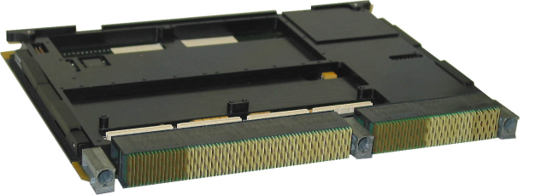
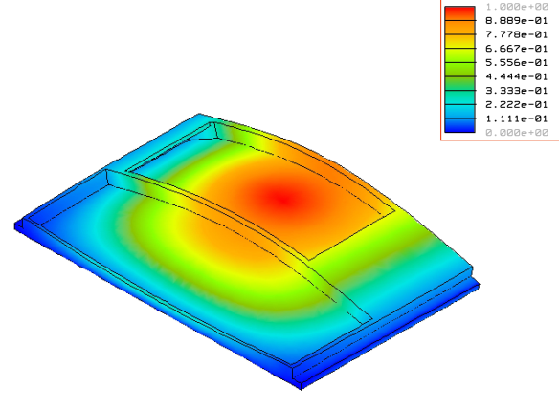
Plug-In Module Vibration Response
1st Mode Shape
Clamped
Connector edge
Clamped
In addition micromotion of Plug-In Module is a potential cause of connector fretting wear/corrosion, backplane micromotion can also be an issue.
Most of the slide content is from a Curtiss-Wright presentation given at Nov 2012 VITA Standards meeting

Slide 65
VITA 46 Qualification and HALT Vibration Testing of Original RT 2 Connector
Qualification Vibration Results
  All 64 LLCR measurement deltas <<10 mΩ
    LLCR = Low level contact resistance (EIA-364-23B)
  No interrupts on 32 channels of interrupt monitoring.
  Safety ground measurements <<0.1 ohms.
  No leakage current during DWV.
  Visual inspection passed.
HALT Vibration Results
  All 64 LLCR measurement deltas <<10 mΩ
  No interrupts on 32 channels of interrupt monitoring.
  Safety ground measurements <<0.1 ohms.
  No leakage current during DWV.
  Visual inspection showed some contacts with gold wear-through and fretting corrosion.
  HALT discovered limit of connector at 0.2 G²/Hz for a 0.8” pitch 6U Plug-In Module (would be higher for stiffer Plug-In Modules, e.g. 1” pitch, 3U)
HALT
Qual
VITA 46 “Qual” Vibration (1 UUT)
  MIL-STD-1344A, Method 2005.1, Test cond. V, letter D, 1.5 hrs. each axis, 11.6 Grms
VITA 46 “HALT” Vibration (1 UUT)
  0.125, 0.15, 0.175 G²/Hz, 15 min. each then 0.2 G²/Hz, 45 min., each axis
Slide content from Curtiss-Wright presentation given at Nov 2012 VITA Standards meeting

Slide 66
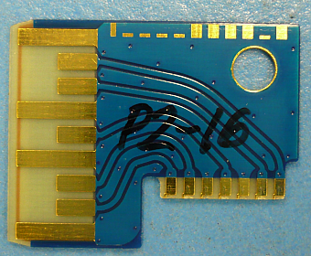
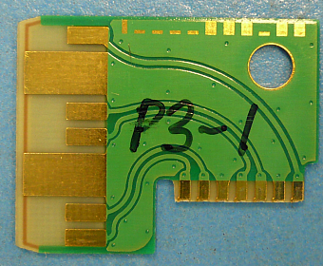



Curtiss-Wright Vibration Testing (VITA 46 Plus)
Vibration: 12 Grms, 2 hrs./axis
Performance verification: LLCR, Interrupt monitoring & Near-continuous LLCR
Results
All 64 LLCR measurement deltas <10 mΩ
No interrupts on 32 channels of interrupt monitoring.
Near-continuous LLCR passed.
No gold wear-through or fretting corrosion.
0.09” thick PCB vs 0.07” thick in VITA 46 testing
Backplane with reduced support
Slide content from Curtiss-Wright presentation given at Nov 2012 VITA Standards meeting

Slide 67
Summary of Testing Done to Qualify Original VITA 46 Connector (RT 2)
VITA 46 Test Report available at: http://www.vita.com/VPX_Reports
See: VPX (VITA 46) Connector/Module Test Report
Issued by Contech under the direction of the VPX Working Group
Slide content from Curtiss-Wright presentation given at Nov 2012 VITA Standards meeting

Slide 68


Torturous Vibration Testing of VITA 46 Connectors
Tested per MIL-STD-810F, Method 514.5
Extended Duration Random Vibration Testing conducted (referred to as VITA 72 Study Group Levels, also referred to as torturous levels)
  1 hour per orthogonal axis at Mercury RL3 standard profile
  1 hour per orthogonal axis at Mercury RL3 + 3dB standard profile
  12 hours, Z-axis only @ +3dB over Mercury RL3 standard profile
Failure Analysis includes high resolution / SEMS photos of contact mating surfaces on all connectors for visual comparison
Slide content from Mercury presentation given at Sept 2012 VITA Standards meeting

Slide 69



Fretting Corrosion with Original RT 2 Connector Resulting From Torturous Vibration Testing
Fretting corrosion is contact wear due to motion of backplane with respect to Plug-In Module
Fretting can be an issue for systems operating in high vibration environments
Fretting can be exacerbated by a poor design and/or poor fabrication
Pictures show wafers from RT 2 connectors, Plug-In Module side, subjected to torturous vibration testing
Mercury and TE have developed the RT 2-R connector to reduce the susceptibility to vibration
RT 2 contacts wore through Gold, Nickel, & Copper pads on wafer (Plug-In Module side)
Believe two rows of holes as opposed to one because board was unplugged and plugged part way through testing (and did not seat in exactly the same place) or board moved during testing.
22.31 mm (0.878”)
Connector wafer
Connector wafer
Pictures from Mercury presentation given at Sept 2012 VITA Standards meeting and courtesy of TE Connectivity
Hyperlinks: Testing parameters: Original, Torturous

Slide 70






RT 2-R Enhanced Contact Design (Backplane Side)
MULTIGIG RT 2
MULTIGIG RT 2-R
RT 2-R is more rugged than RT 2
  Changes made to both backplane and Plug-In Module sides
  Backplane side pins changed from 2 points of contact to 4
RT 2 and RT 2-R inter-mate and PCB footprints are the same
2 Contact Points
4 Contact Points
10.5 mm (0.413”)
Pictures courtesy of TE Connectivity
Links: OpenVPX Profiles, VXS P0, RTM, Connector, Contacts, RT 2-R Wafer, Slot Profiles, Pin Numbering

Slide 71

RT 2-R Enhancement – Extended Pads
(Plug-In Module Side)
Plug-In Module wafer
Ground pad
22.31 mm (0.878”)
RT 2
RT 2-R (Extended pads)
RT 2 and RT 2-R VPX Plug-In Module wafers
are plated with .000050” min gold over nickel.
  Note: TE Connectivity uses the term “Daughter card”
  to refer to what [VITA 65.0] refers to as a “Plug-In Module”
RT 2-R signal pads extended 1.20mm to maintain
at least 2 mm contact wipe with all 4 contact points.
RT 2 Plug-In Module connectors can be used with RT 2-R backplane connectors and maintain 4 point redundancy if connectors are within 0.5 mm of being fully mated in application.
Pictures courtesy of TE Connectivity
Links: OpenVPX Profiles, VXS P0, RTM, Connector, Contacts, RT 2-R Wafer, Slot Profiles, Pin Numbering

Slide 72


Minimizing Fretting Requires Attention to More Than Just Connectors
Movement of Plug-In Module with respect
to backplane must be minimized
  Consider stiffness of backplane – backplane bowing can be an issue
  Pay close attention to all mechanical aspects of Plug-In Module, backplane and chassis that can affect motion of Plug-In Module connectors with respect to backplane connectors
TE has “Ruggedized” guide hardware – machined hardware as opposed to die cast
  Stainless steel guide pin
  Aluminum (6061) guide socket (9.0 mm wide, 0.354”)
    Ni plated
    With optional ESD contact
Guide Module Assembly Shown w/ optional ESD contact (2000713-X)
Pictures courtesy of TE Connectivity

Slide 73







Comparison of Highest Wear Locations Under Torturous Vibration Testing of RT 2 and RT 2-R
RT 2 with Standard Guide Hardware Location P2-15
RT 2-R (4-pt) Contact w/ Standard Guide Hardware Location P2-12
RT 2-R (4-pt) Contact w/ Rugged Guide Hardware Location P4-1
Pictures courtesy of TE Connectivity

Slide 74
Summary of [VITA 46.0] Connector Testing and Connector Fretting
The RT 2 is a rugged connector, and is qualified for many embedded applications
  The RT 2-R is a more rugged connector pair
    Both backplane and Plug-In Module connectors inter‑mate with RT 2 connectors
    The RT 2 meets ANSI/VITA 47 Vibration Class V3
    The RT 2-R meets VITA 72 Study Group levels
Mitigating the issue of connector fretting
  Reduce it
    Use connectors that are more rugged
    Pay attention to all mechanical aspects, which influence motion of Plug-In Module connectors with respect to backplane connectors – 1) Plug-In Module; 2) Backplane and guide pins; 3) Chassis, card cage etc.
  If fretting does occur, notice it and replace affected connectors
    In Utility Plane section see: Prognostics and Predictive Maintenance
  According to Darryl McKenney, VP, Engineering Services at Mercury: All connectors will get fretting if they are subjected to enough vibration for long enough duration
RT 2-R (4-pt) Contact w/ Rugged Guide Hardware Location P4-1
Pictures courtesy of TE Connectivity
Slideshows: Connector Fretting Full Detail

Slide 75
XMC Connectors
[VITA 42.0] standardizes original connectors
  VSO (VITA Standards Organization) recognizes that
  these connectors are prone to damage particularly
  with extractions and insertions of XMCs
[VITA 61.0] uses an improved connector over what is used in VITA 42
  More rugged than the VITA 42 connector
  > 5.0 Gbaud – supports PCIe Gen 2 (5.0 Gbaud)
  and Gen 3 (8.0 Gbaud)
Footprint (on PCB) compatible but [VITA 61.0] and [VITA 42.0] do not inter-mate
  Many suppliers offer the option of using [VITA 61.0] connectors instead of [VITA 42.0]
P15
P16
Abaco Systems SPR507B
VITA 42 XMC with 4 fiber SFPDP (VITA 17.1) connections
Make sure XMC and carrier card are both following the same standard
Pictures: © 2014 Abaco Systems. All rights reserved. Reprinted with permission. Copies may be made solely for training and education about the OpenVPX standard.
Hyperlinks: XMC Module

Slide 76
Subsection Outline: Blind mate Optical and Coax Connectors
Introduction
Protocols
Cooling, form factors, and copper connectors
Blind mate optical and coax connectors
  VITA 66 – Blind-Mate VPX Optical Connectors
  VITA Standards Defining Mechanical Interface of Optical/Coax Connector Modules
  [VITA 66.1], [VITA 66.4], [VITA 66.5], and [VITA 65.0] Fiber Numbering Conventions
  VITA 67 – Blind-Mate VPX Coax Connectors
  Summary of VITA 67.x options
  Summary of VITA 65 Optical and Coax Apertures
  Connector Modules standardized by each revision of VITA 65.1 – [VITA 65.1-2017], [VITA 65.1-2019], [VITA 65.1-2021]
  Some Connector Configurations Can Cause Damage
Utility Plane including radial clocks and VITA 62 power supply Plug-In Modules
Slot, Backplane, and Module Profiles (Including AMPS)
Slot Profile and Backplane Profile examples
Summary and References
Slideshows: Blind_Mate_Connectors_Moderate

Slide 77


VITA 66 – Blind-Mate VPX Optical Connectors
Plug-In Module side
VPX connectors for optical
  Enable optical connections to mate
  when Plug-In Module is plugged in
  Eliminates front panel connections
The following ANSI/VITA are standards
for rear optical connections
  [VITA 66.0] – base standard
  [VITA 66.1] – MT variant
    Up to 2 MT ferrules, each with 2 rows of 12 = 48 fibers total
    Also can have 2 MT ferrules with 1 row of 12 = 24 fibers total
  [VITA 66.4] – half-width MT variant – 1 MT ferrule with up to 24 fibers
    Up to 1 MT ferrule with either 2 rows of 12 = 24 fibers
    Also can also have 1 MT ferrule with 1 row of 12 = 12 fibers total
  [VITA 66.5] – Optical Interconnect on VPX – Hybrid Variants
    As of February 2022 this standard is still a draft, it is expected to be published in 2022
    Enables hybrids of MT ferrules for optical and VITA 67.3 coax contacts for RF
    The type and location of optical and contacts is defined by VITA 65.1
    Allows for integration of edge mount transceivers on Plug-In Module
    In same space as VITA 66.1 can fit up to 6 MTs, each with 2 rows of 12 = 144 fibers
    In same space as VITA 66.4 can fit up to 3 MTs, each with 2 rows of 12 = 72 fibers
    Bottom figure shows 2 VITA 66.5 Style C-Hybrid optical inserts giving a total of
    2 MT ferrules (up to 48 fibers) and 20 NanoRF contacts
Backplane side
Plug-In Module side
Images courtesy of TE Connectivity
Plug-In Module side
Backplane side

Slide 78



VITA 66.x Standards
[VITA 66.1]
2 MT’s in a full-width
Connector Module
Style A
Style B
Style C
Style C - Hybrid
Style D
[VITA 66.5] inserts for Backplane Connector Modules (shown above)
  [VITA 67.3] Type D Connector Modules (half-width) use one insert
  [VITA 67.3] Type C Connector Modules (full-width) use two inserts
Style A is legacy only and not used in any current VITA 65 Slot Profiles
Style B is not recommended for new designs
  VITA 65 Slot Profiles using Style B inserts are not recommended for new designs
  Style D is preferred for new designs over Style B due to higher optical density
    If need be the empty MT locations can be blocked in order to not cause air flow problems.
  Style C can support a stand-alone single MT optical interface or be integrated with coax contacts in a Style C-Hybrid
[VITA 66.4]
1 MT in a half-width
Connector Module
VITA 66.1 and 66.4 images courtesy of TE Connectivity

Slide 79


[VITA 66.5] Features
Cabled MT
Plug-In Module side
Same mating interface
Edge Mount Transceiver
Backplane side
Plug-In Module PCB
Style C – Hybrid
Style D
[VITA 66.5] Optical Connector Modules designed to enable MT float only on the backplane, enabling both:
  Cabling to a mid-board transceiver
  Transceivers at the edge of the Plug-In Module
Style D has highest optical density with 3 MT’s in a half-width connector module.
[VITA 66.5] has the MT alignment pins on the backplane connector
  VITA 66.1 and VITA 66.4 have the alignment pins on the Plug-In Module side
Images courtesy of TE Connectivity

Slide 80
VITA 66 and Two-Level Maintenance
Plug-In Module side
With 2-level maintenance, Plug-In
Modules are replaced in the field
  See slide in introductory section for
  definition of two-level maintenance
Backplane connectors such as VITA 66 are much nicer for two-level maintenance than front panel connectors
  They avoid a tangle of front panel cables interfering with changing a Plug-In Module
With [VITA 66.1], [VITA 66.2], [VITA 66.4], and [VITA 66.5] dust contamination may be an issue in a two-level maintenance environment
  Recommended cleaning procedures might not be practical, when changing Plug-In Modules, in some environments
  There is ongoing work in the community to reduce the susceptibility to contamination
Backplane side
Plug-In Module side
Images courtesy of TE Connectivity
Plug-In Module side
Backplane side

Slide 81




[VITA 66.4] and [VITA 66.5] Half-Width MT
Versatility for 3U applications by occupying just half the width of P2/J2
MT Ferrule backplane side with VITA 66.4, Plug-In Module side with VITA 66.5
Plug-In Module side with VITA 66.4 and backplane side with VITA 66.5
VITA 66.5 Connector Module
VITA 66.4 Connector Modules
3U x 160 mm Plug-In Module Plugged into a single-slot backplane with VITA 46.x connectors in P0, P1, and P2A. VITA 66.5 Half-width fiber-optic Connector Module in P2B with 12 transmit and 12 receive fibers
[VITA 46.0] Plug-In Module Connectors
MT Ferrule
MPO fiber-optic plug connector
[VITA 46.0] Backplane connectors J0, J1 & J2A
Picture to the upper left is Model IC-FEP-VPX3f 3U x 160 mm carrier, courtesy of Interface Concept. Picture lower-right courtesy of Elma and TE Connectivity. Picture lower-center Author: Kirnehkrib;
from http://commons.wikimedia.org/wiki/File:MTP-Connector.jpg, license: http://creativecommons.org/licenses/by-sa/3.0/deed.en; No changes to image.

Slide 82


[VITA 66.4] Half-Width MT Variant on 3U Backplane
Prototype [VITA 66.4] Receptacle (backplane) connectors
MT Ferrule
1 row x 12 fibers
Front of Backplane
MT Ferrule
2 row x 12 fibers
MT Ferrule with protective cap
MT Ferrule
1 row x 12 fibers
Pictures courtesy of Elma and TE Connectivity.
Pictures courtesy of Elma and TE Connectivity.
Rear of backplane

Slide 83

VITA Standards Defining Mechanical Interface of Optical/Coax Connector Modules
[VITA 67.3]
[VITA 66.5]
Secondary guide features for
Optical and Hybrid Connector Modules
RF contact interface
RF Connector Module guide feature
MT ferrule interface
Primary guide features (tab/slot) for Optical and Hybrid Connector Modules
Backplane Aperture –
dimensions and location within a slot
[VITA 65.1]
Backplane Connector Module
dimensions (RF, optical and hybrid)
X-Y locations for RF contacts, MT ferrules, and guide features within a backplane Connector Module
65.0/65.1 Partitioning, Connector Module Standards: first, 2nd

Slide 84

VITA Standards Defining Mechanical Interface of Optical/Coax Connector Modules – More Detailed
[VITA 67.3]
RF contact interface
Primary guide features (tab/slot) for Optical and Hybrid Connector Modules
[VITA 66.5]
[VITA 67.3]
[VITA 66.5]
Secondary guide features for
Optical and Hybrid Connector Modules
RF Connector Module guide feature dimensions
MT ferrule interface
[VITA 65.1]
[VITA 67.3]
Backplane aperture –
dimensions and location with a slot
X-Y locations for RF contacts, MT ferrules, and guide features within a backplane Connector Module
Backplane Connector Module dimensions (RF, optical and hybrid)
Connector Modules can be added to [VITA 65.1] without having to change [VITA 67.3] or [VITA 66.5]
[VITA 65.0] Slot Profiles specify Apertures and [VITA 65.1] Slot Profile dash options specify what goes in the Apertures
  Apertures are holes on backplane slots and on Plug-In Modules for coax/optical Connector Modules
65.0/65.1 Partitioning, Connector Module Standards: first, 2nd

Slide 85
[VITA 66.1], [VITA 66.4], [VITA 66.5], and [VITA 65.0] Fiber Numbering Conventions
[VITA 66.1] – MT variant, two of the options for MTs:
  2 MT ferrules, each with 2 rows of 12 fibers = 48 fibers total
  2 MT ferrules, each with 1 row of 12 fibers = 24 fibers total
[VITA 66.4] – half-width MT variant, two of the options for MTs:
  1 MT ferrule with 2 rows of 12 fibers = 24 fibers total
  1 MT ferrule with 1 rows of 12 fibers = 12 fibers total
  [VITA 65.0] and [VITA 66.5] fiber numbering on Plug-In Module side:
  Numbered the same as an MPO plug as documented in Annex A of [TIA-604-5-E]
  65.0 & 66.5 have epoxy-window and fiber 1 ID mark up – away from PCB
  66.1 and 66.4 have epoxy-window and fiber 1 ID mark down – toward the PCB
  Order of precedence of standards in [VITA 65.0]: [VITA 65.0] overrides VITA 66.x
[VITA 66.1] MT fiber numbering convention
P2B
J2B
[VITA 66.4] MT fiber numbering convention
Epoxy-window
[VITA 65.0] numbering of fibers when using [VITA 66.x] Connector Modules (looking in to mating face of Plug-In Module from backplane side)
[VITA 66.1] and [VITA 66.4] MT ferrule fiber numbering
Slot dash, Fiber numbering, VITA 65.1 Excerpt, Optical Profiles

Slide 86


VITA 67 – Blind-Mate VPX Coax Connectors
VPX connectors for coax
  Enable coax connections to mate when Plug-In Module is plugged in
  Eliminates front panel connections
The following ANSI/VITA standards exist for rear coax connections
  [VITA 67.0] Coaxial Interconnect on VPX – base standard
  [VITA 67.1] VPX, 3U, 4 Position SMPM Configuration
  [VITA 67.2] VPX, 8 Position SMPM Configuration (approved July 2012)
  [VITA 67.3] Coaxial Interconnect on VPX, Spring-Loaded Contact on Backplane
Picture from [VITA 67.1]
[VITA 67.2] Connector Module in location P6/J6 of 6U connector set
[VITA 67.1] Connector Module in ½ of location P2/J2 of 3U connector set
Picture from [VITA 67.2]
[VITA 67.3] Connector Module 14_SMPM_contacts-6.4.5.6.4 in location P6/J6 of 6U connector set
Picture courtesy of TE Connectivity

Slide 87
VITA 66 and VITA 67 PCB Footprint Compatibility
The PCB footprint for [VITA 66.4] can accommodate [VITA 67.1] also, for both the Plug-In Module and the Backplane
  With Plug-In Modules the [VITA 66.4] footprint must include holes specified by [VITA 66.0] as optional for [VITA 67.1]
  The [VITA 67.1] PCB footprint cannot accommodate [VITA 66.4] Connector Modules
    [VITA 66.4] has a hole for an additional alignment pin which does not interfere with [VITA 67.1] Connector Modules
  OpenVPX profiles will be able to specify locations in backplanes that can be used for either
  Two adjacent [VITA 66.4] connectors occupy the same width as a single [VITA 66.1] connector
PCB footprints for the full-connector versions, [VITA 66.1] and [VITA 67.2], are not compatible
  Locations on backplanes and Plug-In Modules can only be designed for either [VITA 66.1] or [VITA 67.2] not both
[VITA 66.4] (optical) in location P2B
[VITA 67.1] (coax) in location P2B
Plug-In Module Connectors
Backplane connectors
Picture courtesy of Elma and TE Connectivity.
Picture from [VITA 67.1]

Slide 88

[VITA 67.3] Allows Contact Type and Configuration to Vary
3U Plug-In Module using Slot Profile
SLT3-PAY-1F1U1S1S1U1U2F1H-14.6.11-12
Uses a [VITA 67.3] Type C backplane Connector Module
  [VITA 65.1] Connector Module name: 2_Style_C_inserts_and_20 NanoRF_contacts-6.4.5.6.10
  2 MTs of 12 optical fibers each for a total of 24
  20 NanoRF contacts
Image courtesy of Mercury
Images courtesy of TE Connectivity
Images courtesy of SV Microwave
[VITA 67.3] Type D Connector Modules
  10 NanoRF contacts
  1 MT with 12 or 24 optic fibers
  [VITA 65.1] Connector Module name: 1_Style_C_insert_and_10_NanoRF_contacts-6.4.5.7.4
Backplane connector using [VITA 67.3] Type C Connector Module
  Takes advantage of 1.0” slot pitch to fit 14 SMPM contacts as opposed to the 8 that 67.2 gets in a 0.8” slot pitch
  [VITA 65.1] Connector Module name: 14_SMPM_contacts-6.4.5.6.4

Slide 89



[VITA 67.3] Coax Contact Interfaces
SMPM
  The coax contact interfaces for [VITA 67.1], [VITA 67.2] and initial release of [VITA 67.3]
  Supports frequencies to 40 GHz
  Up to 14 SMPM contacts in a full‑width module
SMPS
  Enables higher density than SMPM
  Supports frequency to 70 GHz
  Up to 19 SMPS contacts in a full‑width module
NanoRF
  Enables higher density than SMPM
  Supports frequency to 70 GHz
  Up to 9 NanoRF contacts in a half‑width module
  Used in [VITA 66.5] Style C-Hybrid optical/RF Connector Modules
SMPM and NanoRF images courtesy of TE Connectivity; SMPS image courtesy of SV Microwave

Slide 90



[VITA 67.3] Has Spring Loaded Contacts on Backplane Side
[VITA 67.1] and [VITA 67.2] have the spring loaded contacts on the Plug-In Module
[VITA 67.3] has spring loaded contacts on the backplane instead of the Plug-In Module
  Having the fixed contacts on the Plug-In Module enables it to use edge-launched connections
  A motivation behind support for variety of contact locations is the ability to position edge launched to where the Plug-In Module PCB is and the where the PCB of a mezzanine on the Plug-In Module is
Examples using SMPS contacts
Edge-launched connections from Mezzanine on Plug-In Module
Springs within Backplane Connector Module
Edge-launched connections from Plug-In Module
Images courtesy of SV Microwave

Slide 91
Summary of VITA 67.x Options
[VITA 67.1] and [VITA 67.2] have spring-loaded contacts on the Plug-In Module and fixed on the backplane
[VITA 67.3] has fixed contacts on the Plug-In Module and spring-loaded on the backplane
[VITA 67.3] allows for interface contact type and configuration to vary
“VITA 65 Aperture Pattern” column give apertures that accept the indicated 67.x Connector Module.
  In some cases the VITA65 Aperture Pattern has additional features in order to accept some VITA 66.x Connector Modules
VITA Standard | VITA 65 Aperture Pattern | Width | Min Slot Pitch (in) | Number of coax | Comments
67.1 | E | Half | 0.8 | 4 | Can fit in [VITA 66.4] footprint (see caveats on earlier slide).
67.2 | G | Full | 0.8 | 8
67.3 Type A | E | Half | 0.8 | varies | Can fit in [VITA 67.1] or [VITA 66.4] footprint (see caveats on earlier slide).
67.3 Type B | G | Full | 0.8 | varies | Can fit in [VITA 67.2] footprint.
67.3 Type C | H | Full | 1.0 | varies | Backplane Connector Modules that fit into these footprints and mate with [VITA 67.1] and [VITA 66.4] Connector Modules, on Plug-In Modules (P2 only), are available.
67.3 Type D | J | Half | 1.0 | varies | Backplane Connector Modules that fit into these footprints and mate with [VITA 66.4] Connector Modules, on Plug-In Modules, are available.
67.3 Type E | K | Full + Half | 1.0 | varies | Backplane Connector Modules that fit into these footprints and mate with [VITA 67.1] Connector Modules, on Plug-In Modules (P1B+P2 only), are available.
67.3 Type F | E | Half | 0.8 | varies | Footprint of [VITA 66.4]
Links to name construction: VITA 67 Options, Radial Clocks, Slot Profile, Backplane Profile, Module Profile

Slide 92
Summary of VITA 65 Optical and Coax Apertures
Although 0.8 inch Slot Pitch is supported, as time has gone on the OpenVPX ecosystem has evolved to primarily use slot pitches of at least 1.0 inches.
VITA 65 Aperture Pattern | VITA Standards that use the Aperture | Width | Min Slot Pitch (in) | Comments
A | 66.1 | Full | 0.8 | Only used in VITA 65 Slot Profile SLT6-PAY-4F1Q1H2U2T1H-10.6.1-n
B | 66.2 | Full | 0.8 | Not used in any VITA 65 Slot Profiles.
C | 66.3 | Full | 0.8 | Not used in any VITA 65 Slot Profiles.
E | 66.4 67.1 67.3 Type A 67.3 Type F | Half | 0.8 | Used by lots of 3U Slot Profiles that are in [VITA 65.0-2017]. Not used in any VITA 65 Slot Profiles after 2017.
G | 67.2 67.3 Type B | Full | 0.8 | Not used in any VITA 65 Slot Profiles.
H | 67.3 Type C | Full | 1.0 | Used in lots of VITA 65 Slot Profiles, both 3U and 6U.
J | 67.3 Type D | Half | 1.0 | Used in lots of VITA 65 Slot Profiles, both 3U and 6U.
K | 67.3 Type E | Full + Half | 1.0 | Used in a few 3U VITA 65 Slot Profiles.
Links to name construction: VITA 67 Options, Radial Clocks, Slot Profile, Backplane Profile, Module Profile

Slide 93





Connector Modules Standardized In [VITA 65.1-2017]
All three of these are VITA 65 Aperture H (VITA 67.3C Footprint)
Hybrid_66.4+67.1-6.4.5.6.1
9_SMPM_contacts-6.4.5.6.2
10_SMPM_contacts-6.4.5.6.3
[VITA 65.1-2017] is the first version of VITA 65.1
Prior to 2017 there were only two Slot Profiles with Coax Connector Modules in [VITA 65-2012]
  They referenced [VITA 67.1], which specified the locations of the 4 coax contacts
  No Slot Profiles with Optical Connector Modules
  Images are from [VITA 65.1-2021] and show Backplane Connector Modules viewed from Plug-In Module side of the backplane
66.4_in_67.3D-6.4.5.7.1 – VITA 65
Aperture J (VITA 67.3D Footprint)
3_of_67.1_in_67.3E-6.4.5.8.1 – VITA 65
Aperture K (VITA 67.3E Footprint)

Slide 94



Connector Modules Standardized In [VITA 65.1-2019] –
VITA 65 Aperture H (VITA 67.3C Footprint)
14_SMPM_contacts-6.4.5.6.4
2_Style_B_66.5_inserts-6.4.5.6.5*
2_Style_C_66.5_inserts-6.4.5.6.6
* 2_Style_B_66.5_inserts-6.4.5.6.5 should not be used for new designs
  Connector Modules using [VITA 66.5] Style B are not recommended for new designs
  Use 2_Style_D_inserts-6.4.5.6.11 with the MTC1 and MTC2 locations depopulated.
    Has 6 MTs, see VITA 65 Aperture H Connector Modules standardized by [VITA 65.1-2021]
  If need be, the empty MT locations can be blocked, in order to not cause air flow problems.
Images are from [VITA 65.1-2021] and show Backplane Connector Modules viewed from Plug-In Module side of the backplane
* Should not be used for new designs

Slide 95


Connector Modules Standardized In [VITA 65.1-2019] –
VITA 65 Aperture K (VITA 67.3E Footprint)
1_Style_B_66.5_insert_and_14_SMPM_contact-6.4.5.8.2*
1_Style_C_66.5_insert_and_14_SMPM_contact-6.4.5.8.3
* 1_Style_B_66.5_insert_and_14_SMPM_contact-6.4.5.8.2 should not be used for new designs
  Use 1_Style_D_insert_and_14_SMPM_contacts-6.4.5.8.7 with MTC1 depopulated.
    Has 3 MTs, see VITA 65 Aperture K Connector Modules standardized by [VITA 65.1-2021]
There were no additional Aperture J (VITA 67.3D Footprint) Connector Modules standardized with [VITA 65.1-2019]
Images are from [VITA 65.1-2021] and show Backplane Connector Modules viewed from Plug-In Module side of the backplane
* Should not be used for new designs

Slide 96





Connector Modules Standardized In [VITA 65.1-2021] –
VITA 65 Aperture H (VITA 67.3C Footprint)
19_SMPS_contacts-6.4.5.6.7
2_Style_C_inserts_and_
10_NanoRF_contacts-6.4.5.6.8
1_Style_C_insert_and_
14_NanoRF_contacts-6.4.5.6.9
Images are from [VITA 65.1-2021] and show Backplane Connector Modules viewed from Plug-In Module side of the backplane
2_Style_C_inserts_and_20 NanoRF_contacts-6.4.5.6.10
2_Style_D_inserts-6.4.5.6.11

Slide 97





Connector Modules Standardized In [VITA 65.1-2021] –
VITA 65 Aperture J (VITA 67.3D Footprint)
9_NanoRF_contacts-6.4.5.7.2
1_Style_C_insert_and_
5_NanoRF_contacts-6.4.5.7.3
1_Style_C_insert_and_
10_NanoRF_contacts-6.4.5.7.4
Images are from [VITA 65.1-2021] and show Backplane Connector Modules viewed from Plug-In Module side of the backplane
1_Style_B_insert-6.4.5.7.5*
1_Style_D_insert-6.4.5.7.6
* Should not be used for new designs

Slide 98






Connector Modules Standardized In [VITA 65.1-2021] –
VITA 65 Aperture K (VITA 67.3E Footprint)
31_SMPS_contacts-6.4.5.8.4
1_Style_B_insert_and_19_SMPS_
contacts-6.4.5.8.5*
3_Style_B_inserts-6.4.5.8.6*
Images are from [VITA 65.1-2021] and show Backplane Connector Modules viewed from Plug-In Module side of the backplane
1_Style_D_insert_and_
14_SMPM_contacts-6.4.5.8.7
1_Style_D_insert_and_
19_SMPS_contacts-6.4.5.8.8
3_Style_D_inserts-6.4.5.8.9
* Should not be used for new designs

Slide 99


Connector Modules Standardized In [VITA 65.1-2023] –
Adding 75 Ω Coax Contacts
2_Style_C_inserts_and_12_75-OhmNanoRF_contacts-6.4.5.6.12
1_Style_C_insert_and_6_75-OhmNanoRF_contacts-6.4.5.7.7
VITA 65 Aperture H (VITA 67.3C Footprint)
VITA 65 Aperture J (VITA 67.3D Footprint)
Images are from [VITA 65.1-2023] and show Backplane Connector Modules viewed from Plug-In Module side of the backplane

Slide 100


Some Connector Configurations Can Cause Damage
Plug-In Module connector extends further than backplane connector
With [VITA 46.0] connectors, if Plug-In Module connector extends further than backplane connector, damage can occur
  Assuming a normal thickness connector end-wall is present, at the end of the backplane connector
    Right end backplane Connector Modules have the end wall and center ones do not
    The end wall is required in order for the last Plug-In Module wafer to make good contact, particularly under shock and vibration
It is OK for the backplane connector to extend further than the Plug-In Module connector (next slide)
Right-end connector – J2A half of J2
Connector end wall
An alternate right end backplane Connector Module with a thinner end wall can be utilized to eliminate this risk of damage to the Plug-In Module.
If board is inserted this wafer will be damaged
3U Plug-In Module
Backplane
Picture on left courtesy of Mercury. Diagram on right courtesy of TE Connectivity.

Slide 101

A Configuration That Will Mate Without Damage
A Plug-In Module can mate with a backplane connector that extends further
  Inter-mating OK regardless of whether the connector at the end is a “center” or “right end” type
  Excerpt from [VITA 46.0]: Permission 5-2: Right end connectors for Plug-In Modules are purely cosmetic (as opposed to right-end connectors for backplanes) and may be used to terminate a strip of connectors. . . .
Plug-In Module with connectors that do not extend as far as backplane connectors
Plug-In Module with connectors that do not extend as far as backplane connectors
Picture courtesy of Mercury.

Slide 102
Subsection Outline: Utility Plane Including Radial Clocks and VITA 62 Power Supply Plug-In Modules
Introduction
Protocols
Cooling, form factors, and connectors
Blind mate optical and coax connectors
Utility Plane including radial clocks and VITA 62 power supply Plug-In Modules
  Utility Plane Introduction
  System Control Signals
  Clocks – including radial clocks
  Power Distribution and VITA 62 power supply Plug-In Modules
  System Management; Prognostics
Slot, Backplane, and Module Profiles (Including AMPS)
Slot Profile and Backplane Profile examples
Summary and References
Slideshows: Utility Plane Moderate

Slide 103
Utility Plane Introduction
The Utility Plane is composed of
  Reset and other control signals
  Clocks
  Power distribution
  System Management
Utility Plane
SLT3-PAY-1F1F2U1TU1T1U1T-14.2.16
SLT6-PAY-4F1Q1H4U1T1S1S1TU2U2T1H-10.6.3-n

Slide 104
Bussed Control Signals
Signal | Usage
SYS_CON* | Used to tell a Plug-In Module, which is capable of being a System Controller that it is the System Controller. It is intended that the Systems Controller drive bussed REF_CLK. It might also drive SYSRESET*, NVMRO and bussed AUX_CLK. This signal is generally pulled low by a jumper on the backplane, for the slot that holds the System Controller.
SYSRESET* | System Reset. Used to initialize Plug-In Modules to a known state. Open drain signal that may be driven by Plug-In Modules other than the System Controller.
NVMRO | Non-Volatile Memory Read Only. Active high open-drain. It is an optional signal that can be used to inhibit the writing of non-volatile memory, unless it is pulled low.
GDiscrete1 | A general purpose Open Drain I/O. Can be used for Plug-In Modules to signal each other. Plug-In Modules might be implemented such that this line can cause an interrupt. This signal can be used by controlling software to provide a common status or control function to all Plug-In Modules, which is unique to the application.

Slide 105
Other Control Signals
Signal | Usage
MaskableReset* | An additional reset, whose behavior is Plug-In Module dependent. A Plug-In Module may mask this bit. This signal may be bussed, but is not required to be bussed.
AXreset* | Auxiliary Resets. There can be more than one of these. They can be used to reset a group of Plug-In Modules. For example, it is included as part of the Expansion Plane, with some Slot Profiles. In such cases it can be used by a PCIe Root Complex to reset its PCIe Endpoints.
TCK | JTAG Test ClocK – JTAG is intended to be used for boundary scanning at time of manufacture
TDO | JTAG Test Data Output
TDI | JTAG Test Data Input
TMS | JTAG Test Mode Select
TRST* | JTAG Test Logic Reset

Slide 106
Clocks
Signal | Usage
REF_CLK+ REF_CLK- | Refers to Utility Plane bussed REF_CLK pins on P0/J0, not to be confused with other pins which may be defined for Expansion Plane or PCIe. Recommendations for frequency of clock: For bussed [VITA 65.0] Recommendation 3.5.1-1 recommends 25 MHz. For radial [VITA 65.0] Recommendation 3.5.4.1-1recommends 100 MHz. The PCIe protocol section of OpenVPX gives permission to use this clock as the PCIe reference clock, in which case it must be at 100 MHz. If going to operate at 100 MHz, seriously consider using radial clocks to help with signal integrity, particularly in with larger numbers of slots. The Backplane Profile Common Sections for the Utility Plane ([VITA 65.0] Sections 11.2.1.2.4 & 15.2.1.2.4) require the REF_CLK to be bussed, unless the slot is receiving a radial REF_CLK. [VITA 65.0] Section 5.3.2 gives requirements for PCIe clocks on pins other than the REF_CLK pins on P0/J0, these include the option for radial clock distribution.
AUX_CLK+ AUX_CLK- | This is an optional 1 PPS (pulse-per-second). It is either bussed or radial, similar to REF_CLK.
P1-REF_CLK no longer allocated | [VITA 46.0] used to allocate this pin for use as a clock by other VITA 46 dot standards. As of the 2019 version of [VITA 46.0] this is no longer then case. Starting with [VITA 65.0-2019] this pin (P1-G7 / J1-i7) is no longer reserved by the Utility Plane. It is now defined by each Slot Profile. Many older ones still have it reserved. Many newer ones have made use of it.
EPclock+ EPclock- | Expansion Plane clocks ([VITA 65.0] Section 5.3.2). These are not part of the Utility Plane. There can be more than one of these. With some Slot Profiles, they are included with the Expansion Plane pins, in order to enable one Plug-In Module to clock another, over the Expansion Plane connection. This is intended for use with PCIe, enabling systems where a Root Complex is the clock source for its PCIe Endpoints.

Slide 107
Introduction to Radial Clocks
Goal: Add precision timing for sensor I/O
  Enable clocking and triggers for both data acquisition and generation
Similar to some of the timing functionality of:
  [VXI] VXI (VMEbus Extensions for Instrumentation)
  [PXI] PXI™ – PCI Express eXtensions for Instrumentation
  [µTCA] µTCA® – MicroTCA Enhancements for Rear I/O and Precision Timing
Addition of radial versions of REF_CLK and AUX_CLK
  Slots receiving clocks use the same pins, just driven radially
  Radial clocks driven by Plug-In Module or active backplane
  Continue to use bussed versions for slots where radial not needed
No additional pins allocated for clocks, except for Clock Driver Plug-In Modules
  Want to conserve pins, especially with 3U OpenVPX
  Making trade that pins are more valuable than additional circuitry to get by with fewer backplane clocks

Slide 108
Location of Drivers and Other Requirements
Location of radial drivers is left open by this standard, some options:
  A Plug-In Module (a Slot Profile is on a later slide)
  Some sort of daughtercard to the backplane or components directly on the backplane
AUX_CLK & REF_CLK shall either both be bussed or both be radial to each slot
Observation: It is up to the system integrator to make sure clocks are only driven from one place.
  It is assumed that if the bussed clocks are driven by a Plug-In Module, driving both Radial clocks and bussed clocks, that the driving slot is the only one with SYS_CON true.
  Permission: A Plug-In Module driving radial clocks may drive the radial clocks regardless of the state of its SYS_CON.
Radial clock pair traces shall have a diff impedance within a range of 85 to 105 Ω

Slide 109
Driver and Receiver Voltage Level Requirements
Decided to depart from [LVDS] in order to better accommodate some higher speed devices
  Current version of [LVDS] (TIA-644-A) dated Feb 2001 – some of the “LVDS” components found do not met it
  LVDS limits rise and fall times to 260 ps and it has a recommendation that transition time should not exceed .5 of a unit interval, these together limit clock rate to 960 MHz
    Would like to leave open the option to have a clock higher than 960 MHz
  Enable option of LVPECL and other logic families
    In some cases capacitors and/or resistors for level shifting and/or reducing input amplitude might be required
Driver requirements for voltage at OUT+ and OUT- while driving 100 Ω (applies to drivers used for both parallel and series termination)
  Differential: The absolute value of the difference between OUT+ and OUT- shall be ≥ 247 mV and ≤ 800 mV
  Common mode: (OUT+ added to OUT-)/2 shall be ≥ 900 mV and ≤ 1,500 mV
  Symmetry: Steady-state of (OUT+ added to OUT-)/2, for the two binary states shall be equal to within 50 mV
Receiver, in the parallel term case, shall properly operate over the following input voltages:
  Differential: With the absolute value of the difference between IN+ and IN- ≥100 mV and ≤ 1200 mV
  Common mode: With (IN+ added to IN-)/2 ≥ 800 mV and ≤ 1,600 mV

Slide 110
Parallel vs. Series Termination
Radial clock terminations are either parallel or series
  Details on the next few slides
Hyperlinks: Slot Profile naming

Slide 111
Radial REF_CLK & AUX_CLK with Parallel Termination
Differential termination at the receiver shall be within a range of 85 to 110 Ω
  For best clock performance, have termination on the Plug-In Module right at receiver
  Plug-In Modules with terminations cannot be used in a slot with a bussed clock
  Slot Profile naming makes clear which Plug-In Modules have parallel terminations
A resistor may be added at the clock source, typically with a range of 85 to 110 Ω
  Clock source shall drive voltage levels as given on the Voltage Level Requirements Slide, at the Driver compliance
  points, for a 100 Ω load at the receiver, even if loaded with an additional resistor at the source
  Driver compliance points are as close as practical to the output of the driver’s termination network
  Permission: Voltage drop due to trace resistance may drop the voltage slightly below required driver levels, at a
  driving Plug-In Module’s backplane connector.
For REF_CLK and AUX_CLK there shall be a DC path from the Driver Compliance Points to the termination at the receiver
  There may be AC coupling between the driver and the Driver Compliance Points (See figure.)
    Resistors might be required in order to meet common mode voltage requirements at the Driver Compliance Points
  There may be AC coupling between the termination at the receiver and the receiver (See figure.)

Slide 112
Series Termination at The Source
If can tolerate slower edge rates etc., should use series termination to drive clocks
  Enables the driving of slots expecting radial clocks and those expecting bussed clocks
If using series termination, shall have series resistors, with a range of 40 to 55 Ω, at the source
  Series resistors shall be within ± 5% of each other
If using series termination, should have a parallel resistor, with a range of 85 to 110 Ω, at the driver
  85 to 110 Ω at source serves multiple purposes
    Helps with signal integrity, even when driving a Plug-In expecting radial clocks – reduces near-end crosstalk
    Establishes signaling voltages for unterminated Plug-In Modules (those expecting bussed clocks), for LVDS-like drivers
  What is important is that there be a low impedance (lower than 110 Ω) path between the driver outputs, in order to absorb reflections. This may be implemented with smaller value resistors or other techniques.

Slide 113
Series Termination Requirements
With series termination driving a Plug-In Module expecting bussed clocks
  Bussed REF_CLK in [VITA 46.0] uses M-LVDS drivers and receivers
  Radial clock driver required to drive at least 350 mV into an open circuit (not quite as high as M-LVDS spec of 480 mV)
With series terminations driving a Plug-In Module expecting radial clocks
  Driver shall drive voltage levels as given in Level Requirements Slide, at the compliance points even though loaded with approximately 67 Ω (100 Ω at both source and load & 50 Ω series resistors)
  Series resistors decrease slew rate, which might not be desired for high-frequency clock applications
M-LVDS (TIA-899) & LVDS (TIA-644-A) Standards driver and receiver requirements
  OpenVPX radial clocks: drive levels are diff 247 to 800 mV into 100 Ω; inputs OK with 100 to 1,200 mV diff
  [M-LVDS] drive levels are differential 480 to 650 mV into 50 Ω
  [LVDS] drive levels are differential 247 to 454 mV into 100 Ω;
  inputs OK with 100 to 600 mV differential
  [M-LVDS] type 1 inputs OK with 50 mV to 2,400 mV differential in
  [M-LVDS] type 2 inputs OK with 150 mV to 2,400 mV differential in
Notice in table to right that it takes 491 mV of drive into
series resistors to drive required 247 mV into 100 Ω
  M-LVDS driver might not drive enough, although M-LVDS is into 50 Ω
  and if used for OpenVPX series term will be driving 67 Ω

Slide 114
Slot and Module Profile Naming to Indicate Termination Type
Slot Profile naming for radial vs. bussed and location of termination
  An “p” after “SLT3” or “SLT6” indicates radial clocks with parallel terminations
    SLT3-PAY-2F2U-14.2.3 becomes SLT3p-PAY-2F2U-14.2.3
    “p” used with both Slot Profiles for driving clocks as well those receiving
  An “s” indicates radial clocks with series termination at clock source
    SLT3-PAY-2F2U-14.2.3 becomes SLT3s-PAY-2F2U-14.2.3
    Applies to clock driving Plug-In Modules but not to the Plug-In Modules receiving clocks
  A Slot Profile with no additional letter after the pipe counts indicates bussed clocks
  An “x”, in the case of a backplane slot, indicates a slot where a clock driving Plug-In Module determines parallel vs. series termination, for the slot being driven; e.g. SLT3x-PAY-2F2U-14.2.3
    Backplanes with active components for driving clocks, on the backplane are appropriately label the slots as “p” or “s”
    “x” is also used with Slot and Module Profile documentation, where it could be either series or parallel termination
Module Profiles follow the same convention – a “p” or “s” after “MOD3” or “MOD6”
Links to name construction: VITA 67 Options, Radial Clocks, Slot Profile, Backplane Profile, Module Profile

Slide 115
Slot and Module Profile Naming to Indicate Termination Type (Cont.)
Observation: Plug-In Modules configured to receive radial clocks with parallel termination, can be changed to receive bussed clocks by removing the termination resistor
  Changes the Slot Profile name of the Module to have nothing after “SLT3” or “SLT6” instead of “p”
  Must meet requirements for bussed clocks, such as stub length and work with M-LVDS input levels
    Note: There are differences between [LVDS] and [M-LVDS] input requirements
It is suggested that drivers of empty slots be turned off, when no termination at the source
  Turning off here means either tri-state the driver or always drive as a 1 or a 0, instead of switching
  Reduces EMI (Electromagnetic Interference), which could be a problem for RF Plug-In Modules
  Could be configured via System Management or Control Plane
  Another option is a Plug-In Module to fill unused slots – for air cooled chassis might be a slot blocker

Slide 116
Moving Plug-In Modules Between Radial‑Clock and Bussed‑Clock
Series termination may be used in order to enable the use of Plug-In Modules expecting bussed clocks, in backplane slots with radial clocks
  Applications requiring high-quality clocks might require Plug-In Modules with terminations
  If clocks driven from Plug-In Module, how clocks driven can be changed by changing driver Plug-In
Many existing Plug-In Modules, intended for current bussed clock environment, do not rely on REF_CLK and AUX_CLK
  So OK if they do not receive clocks
  For time synchronization, with some applications, Precision Time Protocol [IEEE 1588] or NTP (Network Time Protocol) can be used in lieu of 1 PPS (Pulse Per Second) over AUX_CLK
Suggest that Plug-In Module suppliers consider an assembly option to add or remove clock termination resistors, at the receiver, as needed

Slide 117
Inter-Operability of Clock Termination Options
Interoperability between clock driving and receiving Plug-In Module | Backplane with bussed clocks – “”¹ | Backplane/driver with radial clocks with series termination – “s” ¹ | Backplane/driver with radial clocks and no source termination – “p” ¹
Plug-In Module with no terminations, meeting requirements for bussed clocks – “”¹ | OK | OK | No²
Plug-In Module with terminations – “p”¹ | No³ | OK⁴ | OK
Plug-In Module not using REF and/or AUX CLK | OK | OK | OK
Notes: 1) Refers to letter after “SLT3” or “SLT6” in Slot Profile names.
2) In this case the clocks to the slot are not properly terminated
3) Plug-In Modules would add a 100 Ω across M-LVDS buss in addition to two 61.9 Ω terminations on backplane.
4) Series resistors, at clock source, may reduce the slew rate too much for some applications.

Slide 118
Clock Utilization
Radial Clocks do not need to be the same frequency as bussed clocks
If provided bussed REF_CLK recommended frequency is 25 MHz and bussed AUX_CLK is a 1 PPS
Radial clocks may be at different frequencies & have different timing for each slot
  Recommend that radial clocks default to 100 MHz REF_CLK and 1 PPS AUX_CLK
  It is suggested that there be the option to configure Radial REF_CLK to 25 MHz in order to support Plug-In Modules expecting a bussed 25 MHz REF_CLK
Radial REF_CLK may be at any frequency that is convenient for the application
  Might divide down for other uses on the board
  Might use a PLL (Phase Locked Loop) or DLL (Delay Locked Loop) to derive different frequencies from what is distributed
Radial AUX_CLK may be used as trigger or gate for A/Ds and/or D/As
  Bussed AUX_CLK stays at 1 PPS (Pulse Per Second)
  Radial AUX_CLK may have multiple clocks and/or triggers encoded on it
  Many systems use distribution of timing via coax to get even higher precision
  Signals on backplanes are subject to signal integrity issues, such as cross talk, which can degrade the precision of clock edges

Slide 119
REF_CLK and AUX_CLK Phase Relationship
Suppliers shall specify the timing relationship of REF_CLK and AUX_CLK to each other
When Radial REF_CLK is 100 MHz and Radial AUX_CLK is 1 PPS, it is recommended that the default be that rising edges be coincident to within ±2 ns, at the timing compliance points
  When the radial clocks are driven by a Plug-In Module, the timing compliance points are near the connector to the backplane – Compliance Point H, as defined by [VITA 68.1], section 2.3
  When the radial clocks are driven by other than a Plug-In Module, the Timing Compliance Points are at the output of the driver and any associated termination resistors
  Suggestion: If the recommendation is followed and the receiver of the clocks is going to use the 100 MHz REF_CLK to clock the 1 PPS AUX_CLK into a register, it is suggested that the AUX_CLK be delayed by ~5 ns, on the receiving Plug-In Module, in order to meet setup and hold times, thus avoiding the risk of a metastable state.
  Suggestion: AUX_CLK can be used to indicate which cycle of REF_CLK is the first of a one second interval, even if it is clocked in by the rising edge of the second cycle of REF_CLK
The timing generation circuitry may provide the option to delay AUX_CLK
  When Radial REF_CLK is 100 MHz and Radial AUX_CLK is 1 PPS and the option to delay AUX_CLK exists, it is suggested that AUX_CLK be delayed 5 ns, in order to facilitate clocking AUX_CLK into a register using REF_CLK

Slide 120
Timing Compliance Points
Figure 2.3-1 from [VITA 68.1] shows the location of the Compliance Point H, which is used as the timing compliance point
  See [VITA 68.1] for more detailed information concerning the location of the compliance point

Slide 121
Radial REF_CLK & AUX_CLK Length Matching – Backplane
Matching of lengths on backplane, including backplane connectors
  Connectors on the receiving Plug-In Module and on the driving Plug-In Module (if there is one) are included
    The channel definition is the same as [VITA 68.1], section 2.3, between compliance points H and S
  Shall match lengths, within a differential pair (intra-pair skew), to ≤ 42 ps
    Observation: This number is taken from the backplane budget of Table 2.4.7-1 of [VITA 68.1]. It assumes 17 inches at 2 ps/in of uncertainty due to PCB fiber weave + 2 ps for length uncertainty (0.011 in, assuming 180 ps/in) + 6 ps for two mated backplane connector pairs. For background see [PCB Weave].
    <.005 inch is what is in [PCIe Electromech]; <0.06 inches is what is in [VITA 46.0] for backplane (Rule 7-10e)
  Pair-to-pair matching (inter-pair skew) among all the REF_CLK and AUX_CLK pairs shall be ≤200 ps.
  Note: This includes matching of REF_CLK to AUX_CLK pairs and vice versa
    Observation: This number is taken from the backplane budget of Table 2.4.8-1 of [VITA 68.1] for lane-to-lane skew.
    Recommendation: Backplane designers should consider the precision of the applications they are targeting, in some cases more precision might be required than the above requirements.
    25 ps is what is in [PXI] for backplane for PXIe_DSTAR high-quality clocks & triggers
      Suspect that they did not take into account PCB fiber weave
  Backplane manufacturers should provide information as to how well lengths are matched

Slide 122
PCIe Clocks
When the PCIe reference clock is on pins other than P0/J0, the PCIe protocol section of [VITA 65.0] allows for multiple clock topologies
  Radial clocks (Section 5.3.2.1)
  One slot driving other slots (Section 5.3.2.2)
    This is used in some Backplane Profiles to enable a PCIe Root Complex to drive clocks (EPclocks) to its Endpoints; see backplane profiles:
      BKP6-CEN16-11.2.17-n
      BKP6-DIS06-11.2.18-n
      BKP6-CEN06-11.2.23-n
    Given the ability to distribute radial clocks to the P0 REF_CLK pins, there is less motivation to use pins other than REF_CLK on P0 for distributing PCIe clocks

Slide 123
Power Distribution – Backplane Buses
Signal | Voltage in 3U Systems | Voltage in 6U Systems | Comments
Vs1 | +12.0V | +12.0V | Primary power. backplanes can distribute more power via +12V than 5.0V. [VITA 46.0] has the option to have +48V on this pin with the return on Vs2. OpenVPX systems are currently not defined to utilize 48V.
Vs2 | +3.3V | +12.0V | Primary power. Notice that 3U and 6U are different. See comment for Vs1 for 6U.
Vs3 | +5.0V | +5.0V | Primary power.
3.3V_Aux | +3.3V | +3.3V | Management power. Can be available when main payload power is not (refers to all other supplies, except for VBAT). May be tied to Vs2 on 3U Systems.
+12V_Aux | +12.0V | +12.0V | The backplane traces for these supplies are required, but whether there is power on them is optional. They are intended for mezzanine cards that require these voltages. Carriers will need to generate if recommendation to not use these is followed.
-12V_Aux | -12.0V | -12.0V
P1-VBAT | 3.0V | 3.0V | Provides a battery voltage intended to supply low power devices, such as Real Time Clocks when main power is not available.
P1/J1 ground pins |  |  | These ground pins are used as part of the return path for power.
Recommend Plug-In Modules only use 12 VDC, 3.3V_AUX, and VBAT
  Recommend that voltages highlighted in orange, in table to left, not be used
  Some Module Profiles require this
  Intent is to gradually migrate ecosystem to only use 12 VDC, 3.3V_AUX, and VBAT
  For more on this see introduction slide: Recommend 12 VDC Only for Plug-In Module Power
Links to name construction: 12V only intro, Power Dist.

Slide 124
[VITA 62] Modular Power Supply Standard
[VITA 62] power subsystems are intended to be able to power OpenVPX systems
Single-stage power subsystems take prime power in and output the various required voltages
Two-stage subsystems have separate front-end and back‑end modules, with a intermediate voltage in between
Both single-stage and two-stage subsystems can be implemented with an energy storage device
  Capacitors can ride through 50ms Mil-STD-704F transfer operations
  Batteries can be used to implement an uninterruptable power supply
It is intended that all modules within a
power subsystem be from the same vendor
  [VITA 62] defines signals for communication among a subsystem’s modules, but the detailed behavior of these signals is not standardized by [VITA 62]
  It is expected that all the modules in a subsystem can be replaced, by a set of modules from another vendor
  Check to make sure the backplane interconnect among the subsystem’s slots is compatible with the new modules
    Will probably be OK, but there is not yet a backplane standard fully defining the interconnect among modules

Slide 125



[VITA 62] Modular Power Supply Form Factor
Power supply Plug-In Modules are available in 3U x 160 mm and 6U x160 mm with multiple cooling options
Elma 6U conduction-cooled Power Supply Plug-In Module
Dawn VME 3U air-cooled PSC‑6234
Dawn VME 3U conduction-cooled PSC‑6234

Slide 126


[VITA 62] Connectors
6U Backplane shown on left
  Front side shown – the side the power supply Plug-In Module plugs into
Both sides of 3U backplane shown to the right of the 6U
  Not to same scale as 6U picture
The connectors are different from VPX Plug-In Modules so [VITA 62] Plug-In Modules must go only into slots intended for them
These backplanes used in a development environment
  Cable are run between the power supply backplane and the OpenVPX backplane
Pictures courtesy of Elma

Slide 127

[VITA 46.11] System Management On VPX
For system management OpenVPX references [VITA 46.11]
Leverages ATCA (Advanced Telecommunications Computing Architecture) hardware management
  VPX systems do not implement hot swap and do not implement Electronic Keying
  [VITA 46.11] adds some features such as mandatory sensors for voltage, temperature, and overall health
  [VITA 46.11] Plug-In Modules activate payload power without asking permission from the Chassis Manager
Management subsystem features
  Inventory management
  Sensor and diagnostics management
  System configuration and recovery (reset and/or power cycle)
Management uses a separate power rail and can be used to monitor and control managed FRUs (Field Replaceable Units), even when their payload power is off
Diagram courtesy of Pentair

Slide 128
Logical Layers of System Management
IPMC (Intelligent Platform Management Controller) – bottom layer
  Monitors and represents the FRU (Field Replaceable Unit) and any devices subsidiary to it
  Interfaces to the System IPMB (Intelligent Platform Management Bus)
  Each VPX Plug-In Module is a FRU
Chassis Manager (including ChMC)
  A ChMC (Chassis Management Controller) is a physical entity, which is an IPMC, that includes additional support for some to all of the functionality required of a Chassis Manager
    Minimally a ChMC includes the portion of the Chassis Manager functionality associated with interfacing to the IPMB
  A Chassis Manager is a logical entity
    It can be implemented on a physical ChMC or a combination of a ChMC and other physical resources
    A Chassis Manager includes the functionality of a ChMC and has additional functionality, including interfaces to the System Manager and to IPMCs on the System IPMB
  There can be either a single Chassis Manager or redundant ones – with redundant ones, only one is active at a time
System Manager (not defined by [VITA 46.11]) – top layer
  Manages overall system, generally more than just what is in this chassis
  May be on a Plug-In Module in the same chassis or somewhere outside chassis
  Generally connects to Chassis Manager and VPX Plug-In Modules using Ethernet Control Plane
  The System Manager Interface is defined by [VITA 46.11] as an IP-based communication interface to the Chassis Manager that implements the IPMI LAN (Remote Management Control Protocol – RMCP) interface.
Diagram courtesy of Pentair

Slide 129
System IPMB (Intelligent Platform Management Bus) & Geo Address
System IPMB is implemented over I²C and optionally dual redundant
  I²C is a 2-wire bus, with a data and clock
  The clock is 100 kHz (I²C standard-mode) or 400 kHz (I²C fast-mode)
  In [VITA 46.11] IPMB-A is required and IPMB-B is optional
There are multiple System IPMB topology options as shown
  All the Backplane Profiles in [VITA 65.0-2023] use a bussed topology
On OpenVPX backplanes, IPMB-A and IPMB-B are implemented using the OpenVPX Utility Plane signals SM0 to SM3 as follows:
  SM0 – IPMBA_SCL (I²C clock)
  SM1 – IPMBA_SDA (I²C data)
  SM2 – IPMBB_SCL (I²C clock)
  SM3 – IPMBB_SDA (I²C data)
There are 5 geographical address bits and a parity bit – GA[4:0]*, GAP*
  Each slot in the backplane is assigned a unique Geographical Address
  Used by each IPMC on a Plug-In Module to determine its IPMB Address
Bussed Topology
Radial Topology
Hybrid Topology

Slide 130
Multiple Tiers of Functionality Chassis Manager and IPMCs
Highest functionality
Tier 3
Tier 2
IPMC Tiers
Minimum capabilities of a Tier-1 IPMC:
  Be responsible for System IPMB start-up and fault handling.
  Support the discovery of the FRU it controls.
  Support access to the management information for the FRU it controls.
Min capabilities of a Tier-2 IPMC, in addition to Tier-1:
  Participate in event generation and reception.
  Support Dynamic Sensor Devices.
  Optionally support Subsidiary FRUs.
Min capabilities of a Tier-3 IPMC, in addition to Tier-2:
  Support redundant System IPMB interfaces
  Support operating the System IPMB in FAST-MODE (400 kHz)
  Provide local event logging for locally generated events
  Support FRU activation, resets, and control bits
  Support IPMI message bridging for Intelligent Subsidiary FRUs
  Provide IPMI message firewall capability
Tier 1
Simplest
implementation
Chassis Manager Tiers
Minimum capabilities of a Tier-1 Chassis Manager:
  Maintain an FRU population table containing information for each FRU in the Chassis, be it a Plug-In Module or another type of Chassis FRU.
  Bridge between the System Manager logical layer and the IPMC logical layer.
  Maintain IPMC state information for each IPMC in the Chassis.
Min capabilities of Tier-2 & Tier 3 Chassis Managers, in addition to Tier-1:
  Support the discovery of each FRU – Plug-In Module or other Chassis FRU.
  Support management of Chassis infrastructure (power supplies, fans, etc.) including temperature, voltage, and intrusion sensors as well as power and thermal management.
  Participate in event generation and reception.
  Support event logging.
  Support Dynamic Sensor Devices.
  Support FRU recovery, including FRU reset and power cycling.
  FRU Payload Control – power, reset, graceful reboot & initiating diagnostics

Slide 131
Chassis Manager Physical Location
All the Backplane Profiles in [VITA 65-2012] indicate a location for the ChMC (presumed to be co-located with the Chassis Manager)
  A Switch Slot if there is one
  For topologies with no central switch, one of the other Plug-In Modules is indicated
  The Chassis Manager (including ChMC) may be where it is indicated on the topology diagram or somewhere else in the chassis
Starting with [VITA 65.0-2017] the location of the ChMC is not indicated on the backplane topology diagram
  For more background, see Observation 7.5-2 in [VITA 65.0]
The ChMC can be elsewhere in the chassis rather than on an OpenVPX Plug‑In Module
[VITA 65.0-2012] Backplane Profiles: BKP6‑CEN05‑11.2.5‑n

Slide 132
Prognostics and Predictive Maintenance –
A Way to Deal With Connector Fretting Corrosion
There are areas where a low error rate is considered normal and such errors are recovered from with no impact on mission
  An increased error rate indicates that there is more likely to be an impending failure that would interfere with mission
Examples of areas where a low rate of errors are routinely corrected
  Communication errors on serial links both internal and external
    Can give indication of health of connectors and fiber-optic transceivers
  Memory ECC (Error-Correcting Code)
  Storage (both magnetic and solid state)
Expect that an increased rate of correctable errors prognosticates likely impending hard failure:
  Expect that in the case of connectors the increase in errors will be gradual
    Warning before a connector deteriorates to point of interfering with application
Put infrastructure in place to log corrected errors
  Expect would enable predictive maintenance of connectors in high vibration environment as well as other components
Example of connector fretting
Pictures courtesy of TE Connectivity
Slideshows: Connector Fretting Full Detail

Slide 133
Subsection Outline: Slot, Backplane, and Module Profiles (Including AMPS)
Introduction
Protocols
Cooling, form factors, and copper connectors
Blind mate optical and coax connectors
Utility Plane including radial clocks and VITA 62 power supply Plug-In Modules
Slot, Backplane, and Module Profiles
  Slot Profiles, Name Construction, Pin Num, Dash Options, Optical Profiles, Unused Ports, Repartitioning
  Communication Planes
  Backplane Profiles
  A Plug-In Module can comply with Multiple Slot Profiles
  Classic Module Profiles, Alternative Module Profile Scheme (AMPS)
    List of [VITA 65.0] protocol sections
  Popular OpenVPX 3U Slot Profiles
  OpenVPX intended use & RTMs
  Interoperability – dealing with User Defined pins, Customizing backplanes
Slot Profile and Backplane Profile examples
Summary and References
Slideshows: Profiles Moderate

Slide 134
Slot Profiles
Slot Profiles Define Pin Assignments for Both Plug-In Modules and Backplanes, independent of protocol
  With 6U P0 thru P6 are Plug-In Module connectors and J0 thru J6 are backplane connectors
  With 3U P0 thru P2 are Plug-In Module connectors and J0 thru J2 are backplane connectors
With 6U Profile shown P1/J1 thru P6/J6 are mostly differential pairs
  32 differential pairs / connector – 16 lanes (right side of diagram )
  8 single-ended pins / connector (left side of diagram)
  6 connectors give a total of 192 pairs and 48 single-ended
Single-Ended (SE) pins
Differential (Diff) pins
A popular 6U Slot Profile:
SLT6-PAY-4F1Q2U2T-10.2.1
A popular 3U Slot Profiles for SBCs:
SLT3-PAY-1F1F2U1TU1T1U1T-14.2.16
Slot Profile with aperture so has dash options: SLT3-PAY-1F1U1S1S1U1U2F1H-14.6.11-n
Links: OpenVPX Profiles, VXS P0, RTM, Connector, Contacts, RT 2-R Wafer, Slot Profiles, Pin Numbering

Slide 135
Slot Profile Name Construction
SLTU y – PAY- nXnXnX-1X.x.x-n
Conventions for ‑n at end of Slot Profile name
  Slot Profiles with no optical/coax aperture do not have the “‑n”
  “‑0” means aperture is empty
  Diagrams frequently show optical/coax options (i.e. “67.3C” for [VITA 67.3] Type C instead of aperture pattern)
  Section number makes sure profile is unique
n = a line in the Slot Profile spreadsheet identifying specific connector aperture pattern (if any) and RF or optical module population (if any)
Board Size
U = 3 or 6
[VITA 65.0] Sections 10 or 14
n = # pipes
or connector patterns
y = Clock variations
p = parallel termination
s = series termination
x = radial - not defined
Omitted field = bussed
X = Type of Pipes or Aperture
Pipes (number of diff. pairs or discrete fibers)
S= Single Pipe (1)
U= Ultra-Thin (2)
T= Thin (4)
TU = Triple Ultra-Thin (6)
F= Fat (8)
M= Ten (10)
W=Twelve (12)
D= Double Fat Pipe (16)
TF = Triple Fat Pipes (24)
Q= Quad Fat Pipe(32)
O= Octal Fat Pipe (64)
V= VME
Connector Aperture Pattern (Connector Module width)
A= 66.1 (full)
B= 66.2 (full)
C= 66.3 (full)
E= 66.4/ 67.1/ 67.3A (half)
G= 67.2/ 67.3B (full)
H= 67.3C (full)
J= 67.3D (half)
K= 67.3E (full+half)
Slot type
PAY = payload
STO = storage
PER = peripheral
SWH = switch
TIM = timing
Note: That order of Pipes is from top to bottom and left to right in the physical slot (P0/J0 at top).
Links to name construction: VITA 67 Options, Radial Clocks, Slot Profile, Backplane Profile, Module Profile

Slide 136


OpenVPX Connector Pin Numbering – Differential Wafers
TE Connectivity RT 2 shown
Wafers of differential connectors used for P1 and P2 of 3U and P1 thru P6 of 6U of almost all Profiles
Odd wafers (odd rows of table)
Even wafers (even rows of table)
Example pin assignment table, see Section 6.3.1 of [VITA 65.0] for more detail
Rows of connector are columns of table
Wafers of connector are rows of the table
Capital letters indicate which Plug-In Module row of the connector
Lower case letters indicate which backplane connector row
  Backplane rows g and f both correspond to Plug-In Module row E
  Backplane rows c and b both correspond to Plug-In Module row B
  Backplane pins GND-J2 connect to the same wide ground wafer pads as the adjacent ground pins (GND), but do not have a corresponding Plug-In Module pin.
Odd differential wafer
Even differential wafer
Wafer pictures courtesy of Elma
Links: OpenVPX Profiles, VXS P0, RTM, Connector, Contacts,
RT 2-R Wafer, Slot Profiles, Pin Numbering

Slide 137
Physical vs. Logical Connector Modules
P1
P0
P2
P3
P4
P5
P6
OpenVPX documentation, such as Slot Profiles, uses logical connector designations
  Example of 6U connector set where physical and logical Connectors Modules are the same
The physical connectors can be different
  Example of 3U connector set where physical and logical Connector Modules are different
    Two physical connectors
    Three logical connectors (P0, P1, P2A)
  OpenVPX Slot Profile diagram consistent with this 3U connector set
For more on this issue see:
  [VITA 67.0] Section 2.4
  [VITA 66.4] Appendix A
Picture courtesy of TE Connectivity
Two physical Connector Modules as opposed to the 3 logical Connector Modules defined by the Slot Profile
P1
P0
P2A
Picture from [VITA 67.1]

Slide 138

[VITA 65.1] Excerpt – Slot Profile Table of Dash Options
Table below gives a few dash options from [VITA 65.1] table for SLT3-PAY-1F1U1S1S1U1U2F1H-14.6.11-n
  Dash number at end of profile name selects the line of table
SLT3-PAY-1F1U1S1S1U1U2F1H-14.6.11-n
Above is Plug-In Module connector for SLT3-PAY-1F1U1S1S1U1U2F1H-14.6.11-12
  [VITA 65.1] Connector Module name:
  2_Style_C_inserts_and_20 NanoRF_contacts-6.4.5.6.10
Slot dash, Fiber numbering, VITA 65.1 Excerpt, Optical Profiles

Slide 139
Optical Profiles
Optical Profile naming construct
Optical Profiles define use of optical fibers similar to the [VITA 46.0] (copper) connector pin assignments made by Slot Profiles
  [VITA 65.1] dash options specify both Connector Modules and the Optical Profile of any MTs
    See [VITA 65.1] excerpt on previous slide
Optical Profile MTkk-MM24-3F-6.5.3.5
  Three Optical Fat-Pipes (FPs) – each has 4 receive and 4 transmit fibers
  Example of previous slide has [VITA 66.4] Connector Module, which has only 1 MT, so kk = 01
Slot dash, Fiber numbering, VITA 65.1 Excerpt, Optical Profiles

Slide 140
Unused Ports and Lanes
With most defined pins of a Slot Profile;
a Plug-In Module or backplane is still
compliant if pins are unused
  Pins cannot be used for other than what the Slot Profile specifies
  There are some pins that are required to be used, such as SYSRESET*
Ports are numbered starting with 1 and lanes starting with 0
The Slot Profile shown has 2 Data Plane ports and 2 Control Plane Ports
  Each of the Data Plane ports consists or 4 lanes
  Each of the Control Plane ports consists of 1 lane
If only some of the ports or lanes are used, it must be the lowest numbered port or lanes that are the ones used

Slide 141
Repartitioning of Data and Expansion Planes
Many Slot Profiles, including the one above allow the
Data Plane and/or Expansion Plane to be repartitioned
  In such cases there are rules dictating how they can be repartitioned
  With above Slot Profile, its two Data Plane Fat Pipes can be repartitioned,
  in accordance with Table 6.2.4.1-2
For example, Data Plane above may be repartitioned into 4 Thin Pipes (TP)
  Can enable a System Controller (SBC) to connect, via Data Plane, to 4 other Plug-In Modules, via TPs

Slide 142
OpenVPX Communication Planes
General uses of planes and protocols used:
  Data Plane – move data among Plug-In Modules
    Ethernet, Serial RapidIO, InfiniBand, or PCIe
    Generally within the chassis
  Expansion Plane – use for tightly coupling among a group of Plug-In Modules
    Generally PCIe; frequently used to expand an SBC (Single Board Computer)
    Connections to accelerators such as GPU or FPGA Plug-In Modules
    Connections to I/O Plug-In Modules or carriers
  Control Plane – Ethernet
    Generally 2 UTPs (Ultra-Thin Pipes) – 1000BASE-KX or 10GBASE-KR within chassis
    Generally 2 TPs (Thin Pipes) – 1000BASE-T or 10GBASE-T external to chassis
In [VITA 65.0-2023], Planes are layered on electrical connections. In the future they could also be layered on optical paths.
With VME frequently the VMEbus is used as a Control Plane and switched fabrics such as RACEway and SKYchannel used as a Data Plane
  Although generally not referred to as Control & Data Planes
  For example an I/O device might have DMA control registers set up via VME and the transfer go over RACE++
Most Common 6U Slot Profile:
SLT6-PAY-4F1Q2U2T-10.2.1

Slide 143
Backplane Profile Topology Examples
Single-Star Topology
Dual-Star Topology using two Switch Slots
Dual-Star Topology using Single Switch Slot
Full Mesh Topology
Daisy-Chain Topologies
Ring Topologies

Slide 144
Typical Communication Plane Hierarchy
Diagram applies more to 6U systems than 3U
  In 3U systems it is common to use PCIe as the Data Plane
Coupling among system pieces tends to be looser as you go up the hierarchy
  PCIe tends to be used to implement shared memory – Expansion Plane & for 3U Data Plane
  RapidIO, InfiniBand and Ethernet are used to implement RDMA (Remote DMA) – Data Plane
  Ethernet is frequently used for message passing – Control & Data Planes
    Use of message passing, for the Data Plane, is more common for inter-chassis than within a chassis

Slide 145
Example of 6U OpenVPX Backplane Profile –
BKP6-CEN05-11.2.5-n
Slot Profiles define the pin assignments, independent of protocol, for both Plug-In Modules and backplanes
Since slot number are logical, data sheets must make clear how the physical slots map to logical slots
Backplane Profile name construction given below
  Section number makes sure profile is unique
Links to name construction: VITA 67 Options, Radial Clocks, Slot Profile, Backplane Profile, Module Profile

Slide 146
Example of 6U OpenVPX Backplane Profile –
Expansion Plane of BKP6-CEN10-11.2.6-n
Most common usage of Expansion Plane is for PCIe
  Typically broken up into multiple PCIe domains
    For example, connection between slots 4 and 7 can be broken by using a single-port Plug-in Module in slot 4 or 7 or configuring second ports to be off
    Within each PCIe domain need connectivity among all the Plug-In Modules; hence only Plug-In Modules at the end of a daisy chain can be single-port Plug-In Modules
This Backplane Profile has 3 types of Expansion Plane slots, with respect to topology:
  Type A – If some Plug-In Modules have two ports and others only have one, it is intended that the Type A slots be used by the Plug-In Modules with two ports.
    Typical usage: SBC with PCIe Switch & PCIe root complex, at the center of a chain, with connectivity in both directions
  Type B – If some Plug-In Modules have only one port as opposed to two, it is intended that the Type B slots be used by Plug-In Modules with a single port. The topology is such that if a Type B slot has a single port Plug-In Module, the single port connects to a Type A slot. Type B slots can also be used by Plug-In Modules with 2 ports. It is intended that if there is a mix of 2-port and 1-port Plug-In Modules that the 2-port Plug-In Modules go into type A slots first then if there are any leftover 2-port Plug-In Modules they go into Type B then Type C slots.
    Typical usage: GPGPU or XMC carrier
    If Plug-In Module has only a single port the next Plug-In Module in the chain will not have connectivity to the Type A slot
  Type C – Type C are slots that did not fit into the pattern of the groups of three.
    Typical usage: GPGPU, XMC carrier, not used
    If neighboring Type B slot has a Plug-In Module with a one port, this Plug-In Module will not have connectivity to others

Slide 147
[VITA 65.1] Excerpt – Backplane Profile Table of Dash Options
BKP3-DIS05-15.3.2-n
  Slot Profile diagram given to left
  Table of dash options given at bottom
    Dash number at end of profile name selects the line of table
    “-0” has no optical/coax Connector Modules present – empty apertures (PCB footprints)
    “-1” thru “-3” use SLT3-PAY-4F1E-14.6.2-1 – [VITA 67.1] Connector Module in P2B/J2B
Dash options for other baud rates and Slot Profiles can be added in future revisions of [VITA 65.1]
  Other pitches can also be added – currently almost all are 1.0”
  RTM connector type specified because not part of Slot Profile
    Currently there are no Backplane Profiles with other than [VITA 46.10]

Slide 148
A Plug-In Module Can Comply with Multiple Slot Profiles
Each Slot Profile show complies with the Slot Profiles to its left
SLT6-PAY-4F1Q2U2T-10.2.1
Least restrictive Slot Profile
SLT6-PAY-4F1Q2U2T-10.2.6
SLT6-PAY-4F2Q2U2T-10.2.7
Most restrictive Slot Profile
SLT6-PAY-4F1Q2U2T-10.2.6 adds clocks and resets for Expansion Plane
  Complies with SLT6-PAY-4F1Q2U2T-10.2.1 – uses User Defined pins for Clocks and resets
SLT6-PAY-4F2Q2U2T-10.2.7 adds more Expansion Plane lanes
  Complies with SLT6-PAY-4F1Q2U2T-10.2.1 and SLT6-PAY-4F1Q2U2T-10.2.6

Slide 149
Pick Backplanes with Less Restrictive Profiles
For a backplane to be compatible with a Plug-In Module, all the signals routed, must be either routed in a way that is compatible with the way the Plug-In Module uses them or not routed in the backplane at all
When you want to accommodate Plug-In Modules multiple Slot Profiles, pick a backplane for the least restrictive Slot Profile
  Assumes the least restrictive Slot Profile is a subset of the more restrictive
For example: If want to accommodate Plug-In Modules with both Slot Profiles, shown to the left; pick a development backplane using SLT6‑PAY‑4F1Q2U2T‑10.2.1
  Cables may be an option for connecting the additional Expansion Plane lanes
  If you have pins routed in the backplane, which a Plug-In Module’s Profile has as User Defined, depending on what is on those pins, you may be stuck
SLT6-PAY-4F1Q2U2T-10.2.1
Least restrictive Slot Profile
SLT6-PAY-4F2Q2U2T-10.2.7
Most restrictive Slot Profile

Slide 150
[VITA 65.1] Excerpt – Classic Module Profiles
[VITA 65.1] excerpt for MOD6-PAY-4F1Q2U2T-12.2.1-n given at bottom
Module Profiles specify a particular Slot Profile and the protocols that go on groups of pins
Slot Profile diagram given middle right
Module Profile name construction given in upper right
  Same as Slot Profile name construction except for “MOD” vs “SLT”
  The section number and dash number at the end of the name make sure it is unique
Dash number used to specify a particular combination of protocols and the Slot Profile
  For a given Module Profile, only the dash number of the Slot Profile varies
Links to name construction: VITA 67 Options, Radial Clocks, Slot Profile, Backplane Profile, Module Profile

Slide 151
Alternative Module Profile Scheme (AMPS)
Instead of a list of fixed Module Profile dash options; use
a string with a field specifying protocol for each
port – referred to as an AMPS String
  A Plug-In Module product specification can indicate, in the
  AMPS String, the implementation of all ports
All protocols listed required to be implemented, except where AMPS String indicates port is dormant
  With classic Module Profiles it is legal to not implement some ports/lanes
    For more on this, in [VITA 65.0] see Sections:
      6.2.2 Which lanes, Ports and Pins are Used (Unused = Reserved) & 8.4 Unused Ports, Lanes, and Utility Plane Signals
  For ports with some lanes not implemented have a modifier for the field which specifies which lanes are present
  Ports configurable for multiple protocols implement all the lanes with the configured protocol
  For example if an FP is configured to 10GBASE-KR, then it must be repartitioned into 4 UTPs all with 10GBASE-KR
To have a string indicate all the protocols on all the ports of a Plug-In Module; need following:
  A mapping for the possible values of a field in the string to protocols – Protocol Fields
  A method for defining which Protocol Field in the string goes with which port of the Plug-In Module –
  an ANS (Alternative Naming Structure)

Slide 152
Protocol Sections of [VITA 65.0] (1 of 3)
5 PROTOCOL SPECIFIC
  5.1 ETHERNET
    5.1.1 1000BASE-BX (1.25 Gbaud Signaling)
    5.1.2 1000BASE-KX (1.25 Gbaud Signaling)
    5.1.3 1000BASE-T (0.125 Gbaud Signaling)
    5.1.4 10GBASE-BX4 (3.125 Gbaud Signaling)
    5.1.5 10GBASE-KX4 (3.125 Gbaud Signaling)
    5.1.6 10GBASE-T (0.800 Gbaud Signaling)
    5.1.7 10GBASE-KR (10.3125 Gbaud Signaling)
    5.1.8 40GBASE-KR4 (10.3125 Gbaud Signaling)
    5.1.9 1000BASE-SX (1.25 Gbaud Signaling Over Optical Fiber)
    5.1.10 10GBASE-LR (10.3125 Gbaud Signaling Over Single-Mode Optical Fiber)
    5.1.11 10GBASE-SR (10.3125 Gbaud Signaling Over Multimode Optical Fiber)
    5.1.12 40GBASE-SR4 (10.3125 Gbaud Signaling Over Multimode Optical Fiber)
    5.1.13 100GBASE-SR10 (10.3125 Gbaud Signaling Over Multimode Optical Fiber)
    5.1.14 100BASE-TX (0.125 Gbaud Signaling)
    5.1.15 25GBASE-KR (25.78125 Gbaud Signaling)
    5.1.16 25GBASE-KR-S (25.78125 Gbaud Signaling)
    5.1.17 25GBASE-SR (25.78125 Gbaud Signaling Over Multimode Optical Fiber)
    5.1.18 100GBASE-KR4 (25.78125 Gbaud Signaling)
    5.1.19 100GBASE-SR4 (25.78125 Gbaud Signaling Over Multimode Optical Fiber)
    5.1.20 50GBASE-KR2 (25.78125 Gbaud Signaling)
    5.1.21 50GBASE-SR2 (25.78125 Gbaud Signaling Over Multi-Mode Optical Fiber)
    5.1.22 50GBASE-KR – (26.5625 Gbaud, PAM4 Signaling)
    5.1.23 100GBASE-KR2 – (26.5625 Gbaud, PAM4 Signaling)
    5.1.24 200GBASE-KR4 – (26.5625 Gbaud, PAM4 Signaling)
    5.1.25 400GBASE-KR8 – (26.5625 Gbaud, PAM4 Signaling)

Slide 153
Protocol Sections of [VITA 65.0] (2 of 3)
  5.2 SERIAL RAPIDIO® (SRIO)*
  5.3 PCI-EXPRESS® (PCIE®)
    5.3.3 PCI Express Protocol Requirements
      5.3.3.1 PCI Express Gen 1 (2.5 Gbaud Signaling)
      5.3.3.2 PCI Express Gen 2 (5.0 Gbaud Signaling)
      5.3.3.3 PCI Express Gen 3 (8.0 Gbaud signaling)
      5.3.3.4 PCI Express Gen 4 (16.0 Gbaud signaling)
  5.4 InfiniBand® (IB)*
  5.5 Fibre Channel*
  5.6 SATA (Serial ATA)*
  5.7 Aurora
    5.7.1 Aurora with 8B/10B Encoding
    5.7.2 Aurora with 64B/66B Encoding
    5.7.3 Aurora with 64B/66B Encoding (up to 10.3125 Gbaud Signaling)
    5.7.4 Aurora with 64B/66B Encoding (up to 25.78125 Gbaud Signaling)
    5.7.5 Aurora with 64B/66B Encoding (up to 10.3125 Gbaud Signaling Over Multimode Optical Fiber)
    5.7.6 Aurora with 64B/66B Encoding (up to 25.78125 Gbaud Signaling Over Multimode Optical Fiber)
  5.8 SAS (Serial Attached SCSI)*
  5.9 USB (Universal Serial Bus)*
  5.10 HDMI (High-Definition Multimedia Interface)*
  5.11 DisplayPort*
  5.12 NVM Express™ (NVMe™) – Contents of section have been deleted
  5.13 General Purpose Serial Ports
    5.13.1 Asynchronous Serial Ports [TIA-422] and [TIA-232]
    5.13.2 Asynchronous Serial Ports with LVCMOS Levels
    5.13.3 Asynchronous Serial Ports [TIA-232]
    5.13.4 Asynchronous Serial Ports [TIA-422]
    5.13.5 Asynchronous Serial Ports [TIA-485]
  5.14 Signals Over Coax
    5.14.1 Digital Over coax – Analog Levels
    5.14.2 Digital Over coax – CMOS/TTL levels
    5.14.3 GPS Antenna Input
* Subsections not listed

Slide 154
Protocol Sections of [VITA 65.0] (3 of 3)
  5.15 General Purpose Electrical
    5.15.1 GPIO – Single-Ended General Purpose I/O
    5.15.2 GPLVDS – Differential General Purpose I/O
    5.15.3 [TIA-485] Higher-voltage, Differential, Bi-Directional General Purpose I/O
    5.15.4 [TIA-422] Higher-voltage, lower-speed Differential General Purpose I/O
    5.15.5 CLK – Electrical requirements of radial clocks
    5.15.6 LVGPIO – Single-Ended General Purpose I/O
    5.15.7 GPLVDS15 – Differential General Purpose I/O Using 1.5V Logic
  5.16 Serial Front Panel Data Port (sFPDP)*
  5.17 Composite Video Baseband Signal (CVBS)*
  5.18 Analog Video for Aircraft System Applications*
  5.19 Video Signal/Data Serial Interface (SDI)*
  5.20 CoaXPress*
  5.21 Avionics Digital Video Bus (ADVB)*
* Subsections not listed

Slide 155
Protocol Fields
Protocol field is “cLkm” where:
  “c” is the count of ports, for the field in question of the ANS, if the count is other than 1.
    This is the count of ports of the original pipe size without any repartitioning
    If the field is for 4 FPs, then a value of 3 for c, says there are 3 FPs used whether the pipe size stays as an FP or it is 3 FPs, each repartitioned.
  “L” is letter from table to the left; it corresponds to the first part of [VITA 65.0] section number for the protocol
  “k” is the subsection for the protocol without the part of the section number represented by L
  “m” is the Protocol Field modifier
Multiple protocols can be listed separated by the following characters:
  “/” indicates port(s) configurable among protocols listed
    “/” also indicates that the port is not required to auto-negotiate among speeds, etc.
  “:” (colon) indicates port(s) auto-negotiable among protocols listed
Some examples Protocol Fields:
  P4F – x4 PCIe Gen 4 – [VITA 65.0] Section 5.3.3.4
  E18/E8 – configurable among 100GBASE‑KR4 and 40GBASE‑KR4

Slide 156
Protocol Modifiers
Any of the following protocol modifiers can be present (if present, they must be in this order)
  If the entire width of the port(s) not implemented this code gives the width of port(s) that are implemented (see list on right of this slide)
    Always used with protocols where the width of the pipe is not defined by just the saying what the protocol is, such as PCIe and Aurora.
  # of pipes/port, after code for width, when ports are repartitioned
    Width must be present in order to specify count, see examples on next slide – width code must be used even if protocol makes it clear what the width is
    Not used when the number of pipes, on a repartitioned port, is completely utilizing the port
  “/” – indicates the protocol is not required to auto-negotiate speed or other attributes, such as the number of lanes
    For example PCIe Gen3 (Section 5.3.3.3) is required to be able to degrade to PCIe Gen2 (Section 5.3.3.2)
    This symbol is also used between protocols to indicate that the port is configurable among the protocols, but auto-negotiation is not required
      When “/” is used between protocols it cannot also be used as a protocol modifier – there is already an indication that the port does not auto-negotiate
  “~” – indicates port Dormant, see [VITA 65.0] Section 8.4.1
    Since Dormant ports must adhere to the electrical requirements of a protocol, a protocol must be specified; so this a modifier of a protocol
    If a port is not connected, an “N” is used to indicate this – it is not dormant
The following are the options for the subfield indicating the width of the port(s) if the full width is not implemented
  S = SP (1 pair)
  U = UTP (2 pairs)
  T = TP (4 pairs)
  TU = TUTP (6 pairs)
  F = FP (8 pairs)
  M = MP (10 pairs)
  W = WP (12 pairs)
  D = DFP (16 pairs)
  MM = MMP (20 pairs)
  TF = TFP (24 pairs)
  Q = QFP (32 pairs)
  O = OFP (64 pairs)
Above subfield for port width is same as used in Slot and Module Profile naming in [VITA 65.0] Sections 1.3.3.1 and 1.3.3.3.

Slide 157
Protocol Field Examples Where ANS Specifies One Fat Pipe
Protocol Field | What the field indicates
E8 | 40GBASE-KR4; required to auto-negotiate to 10GBASE-KX4, 10GBASE-KR, and 1000BASE-KX
E18 | 100GBASE-KR4; required to auto-negotiate to 40GBASE-KR4, 10GBASE-KX4, 25GBASE-KR, 25GBASE-KR-S, 10GBASE-KR, and 1000BASE-KX
E18/ | 100GBASE-KR4; not required to auto-negotiate speed and other attributes, such as number of lanes
E18/E8 | Configurable between 100GBASE-KR4 and 40GBASE-KR4; not required to auto-negotiate speed, etc.
E18:E8 | 100GBASE-KR4; required to auto-negotiate to 40GBASE-KR4; but not 10GBASE-KX4, 25GBASE-KR, 25GBASE-KR-S, 10GBASE-KR, and 1000BASE-KX
E18~ | The port(s) are meeting the electrical requirements of 100GBASE-KR4 but is Dormant.
P4F | PCIe x4 Gen 4 (4 lanes)
A3F | Aurora at up to 10.3 Gbaud with 4 lanes bonded together
E18/E8/P4F/A4F | Configurable among 100GBASE-KR4, 40GBASE-KR4, PCIe Gen 4 with 4 lanes, and Aurora with 4 lanes at up to 25.8 Gbaud. Not required to auto-negotiate among any of these.

Slide 158
Protocol Field Examples Where ANS Specifies 4 Ports of FPs
Protocol Field | What the field indicates
4P3U | 4 FPs of PCIe Gen 3 are implemented as 16 UTPs, 4 UTPs per FP
4P3U1 | 4 FPs of PCIe Gen 3 are implemented as 4 UTPs, 1 UTP per FP
3P3U1 | 3 FPs of PCIe Gen 3 are implemented as 3 UTPs, 1 UTP per FP
3P3U2 | 3 FPs of PCIe Gen 3 are implemented as 6 UTPs, 2 UTP per FP
3E18/E8 | Only 3 of the 4 FPs are implemented, they are configurable between 3 FPs of 100GBASE-KR4 and 3 FPs of 40GBASE KR4, and not required to auto-negotiate among these speeds, or other speeds
4E18/E8 | 4 FPs are implemented, they are each configurable between 100GBASE-KR4 and 40GBASE-KR4, and not required to auto-negotiate among these speeds, or other speeds.
2P3T/A3T2 | 2 FPs implemented as 4 TPs, 2 TPs per FP, each configurable between PCIe Gen 3 (8.0 Gbaud) and Aurora at up to 10.3 Gbaud. When implementing PCIe Gen 3, not require to auto-negotiate to Gen 2 or Gen 1.
4P3U1/ | 4 FPs of PCIe Gen 3 are implemented as 4 UTPs, 1 UTP per FP, where the PCIe is not required to auto-negotiate to Gen 1 or Gen 2.

Slide 159
Protocol Field Examples Where ANS Specifies 8 Lanes
Protocol Field | What the field indicates
P3D | 8 lanes as a Double Fat Pipe of x8 PCIe Gen 3
2P3F | 8 lanes are repartitioned into 2 FPs of PCIe Gen 3 (2 of x4 PCIe)
4P3U | 8 lanes are repartitioned into 4 UTPs of PCIe Gen 3 with 4 unused lanes. If we assume the ANS MODA6-12.6.3-1, the Slot Profile specifies Table 6.2.4.2-3 for how to divide the Expansion Plane into UTPs. Looking at the last column of Table 6.2.4.2-3, for lanes EP00 – EP07 we have the odd UTPs, taking the lowest 4 of these we get UTP1, UTP3, UTP5, and UTP7 – lanes EP00, EP04, EP02, and EP06. For lanes EP08 – EP15, it is the 4 lower, even UTPs, which are used, they fall on lanes: EP08, EP12, EP10, and EP14.
2P3F/4P3U | Reconfigurable between two options given above. Not required to auto-negotiate to PCIe Gen 2 or Gen 1.
2E18 | Two FPs of 100GBASE-KR4 using all 8 of the lanes.
1E18 | One FP of 100GBASE-KR4 using 4 lanes, leaving another 4 lanes unused.
P3D/2E18 | Reconfigurable between a single x8 PCIe Gen 3 and 2 of 100GBASE-KR4
16G2 | 16 GPLVDS pairs listed as 16 SPs (Single-Pipes). Do not need to list as 16G2S because GPLVDS of Section 5.15.2 is always an SP. G2D is not used because the GPLVDS pairs are not bonded.

Slide 160
Miscellaneous Protocol Field Examples
Protocol Field | What the field indicates
G1 | Where the ANS specifies a single GPIO pin, 1 Single-Ended pin running GPIO of 5.15.1.
1G1 | Where the ANS specifies 3 GPIO pins, 1 Single-Ended pin running GPIO of 5.15.1.
3G1 | Where the ANS specifies 3 GPIO pins, 3 Single-Ended pins running GPIO of 5.15.1.
2G1 | Where the ANS specifies 3 GPIO pins, 2 Single-Ended pins running GPIO of 5.15.1.
1G2 | Where the ANS specifies 4 GPLVDS pairs, a single pair running GP LVDS of Section 5.15.2.

Slide 161
How Smaller Pipes Map Into Larger Ports – 3U Example
When larger pipes are repartitioned into smaller pipes [VITA 65.0] has Rules making clear which of the smaller pipes must be present if they are not all present
For example if the Fat Pipe of
SLT3-PAY-1F1U1S1S1U1U1K-14.6.14-n (shown on left) is repartitioned, it must be repartitioned in accordance with the table on the left
Here are some examples of what various values for the Protocol Field (cLkm) would indicate, for the Data Plane Fat Pipe of this Slot Profile
  E18 – A single FP of 100GBASE-KR4
  4E7 – Four UTPs of 10GBASE-KR
  2E7 – Two UTPs of 10GBASE-KR on lane 0 (UTP1) and lane 2 (UTP2)
  3E7 – Three UTPs of 10GBASE-KR on lane 0 (UTP1), lane 2 (UTP2), and lane 1 (UTP3)
There are cases, such as switches, where the Data Plane can be partitioned into a variable number of FPs and UTPs; in such cases the ports are assigned as follows:
  If there is just one width, take the lowest number ports for the first field and then keep working your way up for the next field.
    If there are multiple signal names, treat the first listed as the lowest
    For examples of this see slide Examples of Repartitioning Ports – Among Ports of Same Width
  There are two different sizes, using the appropriate sizes first for both fields, then start repartition starting with the lowest numbered ports.
    For examples of this see slide Examples of Repartitioning Ports – Among Ports of Two Sizes
  If there is a field with no ports, use “N” (No Connection) to indicated this

Slide 162
Alternative Naming Structure (ANS)
  Use Alternative Naming Structure (ANS), entry in [VITA 65.1], to specify order of Protocol Fields within AMPS String
  ANS name of the form MODAu-z.z.z-n where “u” is the form factor, “z.z.z” is Module Profile section,
  “-n” is dash option
  Do not use headings from existing Module Profiles, so have option of different templates over time
  For example might want a version where Expansion Plane EP04 – EP05 can have a
  different protocol from EP06 – EP07
SLT3-PAY-1F1U1S1S1U1U2F1H-14.6.11-n

Slide 163
AMPS String Name Construct
    “-i” – the dash option of the ANS
    “-j” – the dash option of the Slot Profile
  Omitted when the Slot Profile has no dash options
“dcp” – Depth, Cooling, Pitch
  “d” – F = Full (160 mm), “S” – S = Short (100 mm)
  “c” is the dot number for of cooling standard = 48.c
  “p” is pitch a letter (inches): A=0.80, B=0.85, C=1.00, D=1.10, E=1.20, F=1.30, G=1.40, H=1.50, J=1.60
“cLkm” – Protocol Field giving Port Count, Protocol, and Protocol Modifiers
Clock options (termination) included in AMPS Module Profile name but not in ANS name
  The clock options is omitted for bussed clocks
For each aperture, with protocols on optical contacts, if ANS does not break the aperture up into multiple fields, one of following must be followed:
  There is a single Protocol Field, which applies to all optical contacts of the aperture
  There is a Protocol Field for each MT, where the order is: MTA1, MTA2, . . .MTB1, MTB2, . . .
Use “-” as delimiters between Protocol Fields for same plane
  Use “( )” around protocols for a copper plane
  Use “[ ]” around protocols for each aperture
  There needs to be a separate “[ ]” for each aperture, even if there is not a value for the Protocol Field
  “< >” used by [SOSA] around SOSA specific fields at end of OpenVPX AMPS Strings (not shown)

Slide 164
AMPS String Examples
In these examples assume for dcp assume 160 mm depth, 1.0 inch pitch and [VITA 48.2] cooling = F2C
Equivalent Module Profiles expressed with classis Module Profile Name construct and AMPS
  Classic: MOD3-PAY-1F1U1S1S1U1U2F1H-16.6.11-11
  AMPS: MODA3p-16.6.11-1-4-F2C-(E8-E7)(P3F-P3F)(E7)(N-G5)
  Classic: MOD3-PAY-1F1U1S1S1U1U2F1H-16.6.11-12
  AMPS: MODA3p-16.6.11-1-4-F2C-(E8-E7)(P3F-G2)(E7)(N-G5)

Slide 165
Protocol Fields for Apertures with Optical Connectors
Slot Profile dash options specify:
  Which Connector Modules are to go in the Slot Profile’s Aperture
    The Connector Modules can each have one or more MTs for optical fibers
  An Optical Profile for each MT of each Connector Module
    Optical Profiles specify what kind of MT (e.g. MM12, MM24) is to be loaded and how the fibers are configured into pipes
Where an ANS has a single connector designation for an entire Connector Module, for example “[P2]”, this is interpreted as specifying Protocol Fields in one of two ways:
  A single Protocol Field which applies to all the MTs of a Connector Module with no MTs skipped
    The MTs are in the order of lowest to highest – MTA1, MTA2, …, MTB1, MTB2, ….
    There must be no pipes of any of the MTs skipped, it is OK for one or more of the highest numbered MTs to be unused
      There can be unused fibers skipped, if they are specified as unused by the Optical Profile, for the MT in question
    The Port Count, within the Protocol Field, will indicate how many ports are used
  A Protocol Field for each MT of the Connector Module
  Same ANS can be used for different Slot Profile dash options, even if the number of MTs varies
  [P1B,P2] with Slot Profile SLT3-PAY-1F1U1S1S1U1U1K-14.6.14-n is a single Connector Module

Slide 166
Examples of Protocol Fields for Apertures with Optical Connectors
Examples assume a Slot Profile Dash Option specifying: Connector Module with 3 MTs – MTA1, MTB1, and MTC1 with Optical Profiles as follows: MTA1 – MTkk-MM12-1F-6.5.2.2 – 12 optical fibers where 8 are used for a Fat Pipe and 4 are unused MTB1 – MTkk-MM24-3F-6.5.3.5 – 24 optical fibers used as 3 Fat Pipes of 8 fibers each MTC1 – MTkk-MM24-3F-6.5.3.5 – 24 optical fibers used as 3 Fat Pipes of 8 fibers each
Protocol Field | What the field indicates
[E19] | 7 FP of 100GBASE-SR4 using 1 FP (8 fibers) of MTA1, 3 FP (24 fibers) of MTB1, and 3 FP of MTC1
[4E19] | 4 FP of 100GBASE-SR4 using 1 FP (8 fibers) of MTA1, 3 FP (24 fibers) of MTB1, and none of MTC1
[N-3E19-3A6F] | MTA1 not used, MTB1 has 3 of 100GBASE-SR4, MTC1 has 3 FP of Aurora at up to 25 Gbaud

Slide 167
Examples of Repartitioning Ports – Among Ports of Same Width
Module Profiles for SLT3-SWH-6F1U7U-14.4.14
ANS (highlighted) has single column for all the Data Plane FPs (FPs of DS01, DP01 – DP05)
  Notice that the dash options 16.4.15-1 and 16.4.15-2 have two columns for Data Plane FPs but
  MODA3-16.4.15-1 only has a single protocol field for Data Plane FPs
  Notice that the dash options 16.4.15-1 and 16.4.15-2 have two columns for Control Plane UTPs but
  MODA3-16.4.15-1 only has a single protocol field for Control Plane UTPs
The Data Plane FPs may be repartitioned (see slide How Smaller Pipes Map Into Larger Ports – 3U Example), here are examples of the Data Plane Protocol Fields for this Slot/Module Profile:
  (6E8-N) – 6 of 40GBASE-KR4 using DS01, DP01 – DP05
  (5E8-4E7) – 5 of 40GBASE-KR4 using DS01, DP01 – DP04 and 4 of 10GBASE-KR using DP05
  (1E8-16E7) – 1 of 40GBASE-KR4 using DS01 and 16 of 10GBASE-KR using DP01 – DP04
  (N-24E7) – 24 of 10GBASE-KR using DP01 – DP05, DS01
SLT3-SWH-6F1U7U-14.4.14

Slide 168
Examples of Repartitioning Ports – Among Ports of Two Sizes
Module Profiles for SLT6-SWH-14F16U1U15U1J-10.8.1
ANS MODA6-12.8.1-1 highlighted below
The Data Plane FPs and UTPs may be repartitioned (see slide How Smaller Pipes Map Into Larger Ports – 3U Example), here are some examples of the Data Plane Protocol Fields for this Slot/Module Profile:
  (14E8-16E7-2E3) – 14 of 40GBASE-KR4 using DP01 – DP14, 16 of 10GBASE-KR using DPutp01 – DPutp16
  (8E8-8E7-2E3) – 8 of 40GBASE-KR4 using DP01 – DP08, 8 of 10GBASE-KR using DPutp01 – DPutp08
  (16E8-8E7-2E3) – 16 of 40GBASE-KR4 using DP01 – DP14 + DPutp09 – DPutp16, 8 of 10GBASE-KR using DPutp01 – DPutp08
  (15E8-8E7-2E3) – 15 of 40GBASE-KR4 using DP01 – DP14 + DPutp09 – DPutp12, 8 of 10GBASE-KR using DPutp01 – DPutp08
  (12E8-24E7-2E3) – 12 of 40GBASE-KR4 using DP01 – DP12, 24 of 10GBASE-KR using DPutp01 – DPutp16 + DP13 – DP14
  (10E8-24E7-2E3) – 10 of 40GBASE-KR4 using DP01 – DP10, 24 of 10GBASE-KR using DPutp01 – DPutp16 + DP11 – DP12
  (18E8-N-2E3) – 18 of 40GBASE-KR4 using DP01 – DP14 + DPutp01 – DPutp16

Slide 169
3U Slot Profiles
SLT3-PAY-2F2U-14.2.3 and SLT3-PAY-2F2T-14.2.5
General uses of planes and protocols used:
  Data Plane – move data among tightly coupled groups of Plug-In Modules
    PCIe is a popular choice
    Generally within the chassis
  Expansion Plane – use for tightly coupling among a group of Plug-In Modules
    Not present in these profiles
    Separate Expansion Plane much less common in 3U than 6U
      In cases where PCIe is on Data Plane, can also serve function as Expansion Plane
  Control Plane – Ethernet is where these two profiles differ, they have one of the following:
    2 UTPs – 1000BASE-BX for within chassis or
    2 TPs – 1000BASE-T for external to chassis

Slide 170
OpenVPX Intended Usage and RTMs
In a development environment
  Use an OpenVPX development
  backplane for routing planes
    Control Plane
    Data Plane
    Expansion Plane
  Use RTMs (Rear Transition Modules) for other I/O
    Typically Slot Profile pins that are not routed in the backplane
    are available for an RTM to plug into them
    Generally Backplane Profiles do not route User Defined pins
  Cables can be used for slot-to-slot connections not routed in the backplane
  Some ports might only be used during development and/or repair
For deployed systems, which cannot deploy with RTMs, use a custom backplane
  Route external I/O to appropriate connectors instead of RTMs
RTMs are also used with VME systems
  Typically VME SBCs come with their own RTM, in order to connectorize User Defined pins
RTM
RTM
6U VPX Plug-In Module
Backplane
OpenVPX defines some standard backplanes, intended for a development environment – many of these are available from suppliers off-the-shelf
Links: Slot Profiles added to 65.0-2019: 6U, 3U; Isolate UD; Slot Profiles with lots UD; RTMs; Dealing with UD

Slide 171
Interoperability – Dealing with User Defined Pins
In order to be able to use the same backplane with Plug-In Modules from multiple vendors, it is necessary to have a strategy for User Defined pins
  Different suppliers likely to use UD pins differently – prevents interchangeability
Some possible strategies for dealing with User Defined pins:
  Do not use the them or do not have any
  Use RTMs to connectorize them – not practical with many deployed systems
  Have the backplane route them to a connector for a cable assembly which goes to internal side of chassis connectors
    Different versions of the cable assembly can be used to adapt to different Plug-In Modules
    Jumpers on the backplane can be used to control which signals go to which pins of the connector for the cable assembly
6U VPX Plug-In Module
Backplane
RTM
There is a strong desire to be able to have backplane slots on deployed systems accept Plug-In Modules from multiple suppliers with no changes to backplane/chassis
[VITA 65.0-2019] adds several Slot Profiles with no User Defined pins
Links: Slot Profiles added to 65.0-2019: 6U, 3U; Isolate UD; Slot Profiles with lots UD; RTMs; Dealing with UD

Slide 172


Examples of Methods for Customizing Backplanes
Cables can plug in on the back side of the backplane, in connectors for RTMs
  A-A Slot-to-Slot
  B-B Slot to commercial cable connector
  C-C Slot to SMA
Fabric Mapping Modules (FMM)
Picture of backplane with cables courtesy of Elma
Picture of FMMs courtesy of Dawn VME Products

Slide 173
Subsection Outline: Slot Profile and Backplane Profile examples
Introduction
Protocols
Cooling, form factors, and copper connectors
Blind mate optical and coax connectors
Utility Plane including radial clocks and VITA 62 power supply Plug-In Modules
Slot, Backplane, and Module Profiles (Including AMPS)
Slot Profile and Backplane Profile examples
  Payload Slot Profiles: with Expansion Plane, summary with optical/coax, 3U, 3U SBC, 6U RF Payload & SBC
  Switch Slot Profiles: with optical/coax, 3U, 3U no optical/coax, 3U optical/RF, 6U with optical/coax
  Slot Profiles for driving radial clocks
  3-Slot 3U Backplane Profile: BKP3-CEN03-15.3.5-n
  12-Slot 3U Backplane Implementing Radial Clocks: BKP3-TIM12-15.3.4; BKP3-TIM12-15.3.6
  XMC vs. 3U VPX for fiber-optic for sensor I/O
Summary and References
Slideshows: Slot_Backplane_Examples_Moderate

Slide 174
Slot Profiles With Expansion Plane
SLT3-PAY-2F1F2U-14.2.1
  Same as SLT3‑PAY‑2F2U-14.2.3, except adds Expansion Plane
In the case of FPGA Plug-In Modules, the Expansion Plane can be used for FPGA-to-FPGA
If comply with this profile will also comply with SLT3‑PAY‑2F2U‑14.2.3
  This profile is more restrictive
  Could use this profile for Plug-In Modules and SLT3‑PAY‑2F2U-14.2.3 for backplane, assuming Expansion Plane is implemented via cables
SLT3-PAY-1F2F2U-14.2.2
  Same as above Slot Profile, except changes 1 Data Plane FP to being part of the Expansion Plane
There will be cases where the same Plug-In Module can support this Profile and the one above
  If the both the Data Plane and Expansion Plane are PCIe the Plug-In Module may not distinguish between the two
  FPGA Plug-In Modules are likely to be configurable

Slide 175
3U Payload Slot Profiles With VITA 66.x and 67.x Optical and/or Coax

Slide 176
6U Payload Slot Profiles With VITA 66.x and 67.x Optical and/or Coax

Slide 177
3U Slot Profiles With Expansion Plane and all of P2/J2 for Optical and/or Coax
SLT3‑PAY‑2F1F2U2E-14.6.4-n
Same as earlier SLT3‑PAY‑2F1F2U1E-14.6.6-n, except all of P2/J2 can be [VITA 66.4], [VITA 67.1], and/or [VITA 67.3] Type A
Same as SLT3-PAY-2F1F2U-14.2.1, except P2/J2 can be [VITA 66.4], [VITA 67.1], and/or [VITA 67.3] Type A
If a Control Plane Thin Pipe is needed, in addition to the 2 UTPs shown, suggest using User Defined pairs of P1/J1 wafers 13 and 14
  These are the wafers just above the two Control Plane UTPs
SLT3‑PAY‑2F1F2U1H-14.6.3-n
Same as SLT3‑PAY‑2F1F2U2E-14.6.4-n above except P2/J2 is [VITA 67.3] Type C (VITA 65 aperture pattern H)

Slide 178

3U Slot Profile with 2 FPs of Expansion Plane and all of P2/J2 for Optical and/or Coax
SLT3-PAY-1F1U1S1S1U1U2F1H-14.6.11-n
Intended for RF payloads and compute intensive SBCs
  Used by slots 4, 5, 8, 9 on of the Backplane Profile BKP3‑TIM12‑15.3.6‑n
Data Plane Fat Pipe and Ultra-Thin Pipe
Control Plane with an Ultra-Thin Pipe
Expansion Plane with two Fat pipes
P2/J2 is [VITA 67.3] Type C, which can be used for coax and/or optical
Use of this Slot Profile for compute intensive SBC and FPGA, as well as RF, Plug-In Modules, is a paradigm shift enabling easier configuration of systems
3U Vesper SI-9172 picture courtesy of Leonardo DRS

Slide 179
3U Slot Profile for I/O Intensive SBCs with No User Defined Pins
SLT3-PAY-1F1F2U-14.2.4 in [VITA 65.0-2010]
Define all User Defined pins
SLT3-PAY-1F1F2U1TU1T1U1T-14.2.16 added with [VITA 65.0-2019]
Intended for SBCs which are I/O intensive
  Computationally intensive SBCs suggest:
  SLT3-PAY-1F1U1S1S1U1U2F1H-14.6.11-n
Video port for DisplayPort or HDMI
USB 3.1 port with ability to degrade to USB 2.0
Storage intended SATA or NVMe (a protocol over PCIe)
Control Plane TP for 1000BASE-T or 10GBASE-T
XMC to customize off-the-shelf SBCs for particular systems
  Up to 10 lanes or up to 20 pairs and up to 16 single-ended using [VITA 46.9]
  4 GPIO

Slide 180
3U Slot Profile for I/O Intensive SBCs – XMC Mapping
[VITA 46.9] XMC mapping P1w9-X12d+P2w3-X38s+X8d (Section 4.6)
Slot Profile: SLT3-PAY-1F1F2U1TU1T1U1T-14.2.16
  XMC mapping: P1w9-X12d+P2w3-X38s+X8d, except for single-ended pins have X16s instead of X38s (16 instead of 38 pins)
  so end up with mapping: P1w9-X12d+P2w9-X16s+X8d (this is a subset of mapping defined by ANSI/VITA 46.9-2018, Section 4.6)
XMC mapping chosen so can add Slot Profile with optical/coax in P2B/J2B without giving up non-XMC I/O, except USB 2 PWR & GPIO
Recommendation: XMC Carrier suppliers should make available [VITA 68.2] compliant S-Parameter files for X12d and X8d connections.

Slide 181
6U RF Payload and SBC With XMC
SLT3-PAY-1F1U1S1S1U1U2F1H-14.6.11-n
SLT3-PAY-1F1F2U1TU1T1U1T-14.2.16
SLT6-PAY-4F1Q1H4U1T1S1S1TU2U2T1H-10.6.3-n
Get functionality of 3U RF Payload and I/O intensive SBC Slot Profiles in a 6U slot
  Use for RF, I/O intensive SBC, and computational intensive SBC – easier to configure systems

Slide 182
6U RF Payload and SBC With XMC
Slot Profiles: SLT6-PAY-4F1Q1H4U1T1S1S1TU2U2T1H-10.6.3-n
  Section number may change as standardization progresses
  Similar to SLT6-PAY-4F1Q1H2U2T1H-10.6.1-n, with more pins defined
Multiple system configurations with same backplane – same Slot Profiles for:
  RF payload
  SBCs which are I/O intensive
  SBCs which are computationally intensive
XMC to customize off-the-shelf SBCs for particular systems
  Up to 10 lanes or up to 20 pairs
  Up to 24 single-ended
Top of P4/J4 similar to top of P2/J2 with I/O intensive 3U SBC
  Storage intended SATA or NVMe (a protocol over PCIe)
  USB port intended for USB 3 with ability to degrade to USB 2.0
    Includes power – at least 500 ma @ 5.0 V per port, uses 1 pin per port
    Slot Profile max current per USB port permits up to 2A at 20V = 40W
      Slot Profile will specify 2.2 A max, to allow for tolerances
3 GP LVDS pairs and 10 GPIO
Aperture Pattern H in P3/J3 and P6/J6 enables use of coax and optical

Slide 183
6U Slot RF Payload and SBC Without XMC
Start with: SLT6-PAY-4F1Q1H4U1T1S1S1TU2U2T1H-10.6.3-n
  Remove XMC and replace with additional Expansion Plane
    Increasing Expansion Plane from 32 to 64 pairs (16 to 32 pairs)
Arrive at: SLT6-PAY-4F2Q1H4U1T1S1S1TU2U2T1H-10.6.4-n
  4 FPs of Data
  64 pairs (32 lanes) of Expansion Plane
  2 UTPs and 2 TPs of Control Plane
  2 apertures for VITA 67.3 Type C optical/coax
  3 GP pairs LVDS and 10 GPIO
  Storage, Video, and USB

Slide 184

6U Slot RF Payload with Less Expansion Plane and More Optical/Coax
Start with:
SLT6-PAY-4F2Q1H4U1T1S1S1TU2U2T1H-10.6.4-n
  Remove Expansion Plane on P5/J5 and replace with Optical/coax
Arrive at:
SLT6-PAY-4F1Q1H4U1T1S1S1TU2U2T2H-10.6.5-n
  4 FPs of Data
  32 pairs (16 lanes) of Expansion Plane
  2 UTPs and 2 TPs of Control Plane
  3 apertures for VITA 67.3 Type C optical/coax
  3 GP pairs LVDS and 10 GPIO
  Storage, Video, and USB
Slot Profile in product picture is:
SLT6-PAY-4F1Q1H4U1T1S1S1TU2U2T2H-10.6.5-5 or
SLT6-PAY-4F1Q1H4U1T1S1S1TU2U2T2H-10.6.5-6
  Connector Module:14_SMPM_contacts-6.4.5.6.4 in P3/J3
  Connector Module: 2_Style_C_66.5_inserts-6.4.5.6.6 in P3/J3
    Slot Profile 10.6.5-5 implements 1 optical Fat Pipe (12-fiber MT)
    Slot Profile 10.6.5-6 implements 6 optical Ultra-Thin Pipes (12-fiber MT)
  Connector Module: 14_SMPM_contacts-6.4.5.6.4 in P6/J6
Vesper SI-9173 picture courtesy of Leonardo DRS

Slide 185
Switch Slot Profiles with VITA 66.x and 67.x Optical and/or Coax
All the OpenVPX Switch Slot Profiles with optical/coax
There is also one Switch Slot Profile on slide that does not have optical/coax

Slide 186
3U Control Plane Switch Slot Profile with UTPs, TPs and Optical
SLT3‑SWH‑10U7T1E-14.8.2-n and
SLT3‑SWH‑10U7T1J-14.8.1-n
  The two Slot Profiles are the same except they can take the following P2B/J2B, respectively:
    [VITA 66.4], [VITA 67.1], or [VITA 67.3A] – 0.8” pitch
      Note: Most VITA 65 backplanes are 1.0” pitch or larger
    [VITA 67.3] Type D – 1.0” pitch
10 UTPs intended for connections within backplane, things like:
  1000BASE-KX or 10GBASE-KR
7 TPs intended for external connections, things like:
  1000BASE-T or 10GBASE-T
Optical in P2B, intended for things like:
  40GBASE-SR4
  10GBASE-SR, 1000BASE-SX

Slide 187
3U Control Plane Switch Slot Profiles and Stacking Ports
SLT3‑SWH‑10U7T1E-14.8.2-n and
SLT3‑SWH‑10U7T1J-14.8.1-n
When it is intended that optical connections be used to connect to other switches; it would make sense to have the optical ports connect to stacking ports, on the switches, located on the Plug-In Modules
  This applies to all the Switch Slot Profiles with optical fiber connections

Slide 188
3U Data Plane Switch Slot Profile with Optical
SLT3‑SWH‑6F1E-14.8.4-n and
SLT3‑SWH‑6F1J-14.8.3-n
  The two Slot Profiles are the same except they can take the following P2B/J2B, respectively:
    66.4, 67.1, or 67.3A – 0.8” pitch
    67.3D – 1.0” pitch
  Similar to SLT3-SWH-8F-14.4.2 except 2 less Data Plane FPs and fiber-optic added
Pairs of FPs repartitionable into mix of DFPs, FPs, TPs, and UTPs
  For repartitioning options see tables on next slide
  Intended for things like:
    PCIe Gen and 3 for all size pipes
    For UTPs: 1000BASE-KX, 10GBASE-KR
    For FPs: 10GBASE-KX4, 40GBASE-KR4
Optical in P2B, intended for things like:
  40GBASE-SR4
  10GBASE-SR, 1000BASE-SX

Slide 189
Repartitioning of Data Plane FPs of SLT3‑SWH‑6F1E-14.8.4-n and SLT3‑SWH‑6F1J-14.8.3-n
Pairs of Data Plane FPs may be repartitioned as shown
  This is the same as repartitioning of Data Plane of SLT3‑PAY‑2F2U‑14.2.3
    In [VITA 65.0] see Table 6.2.4.1-2
  Table also applies to the pairs DP04, DP03 and DP06, DP05
Each FP may be repartitioned into UTPs and TPs as shown
  This is the same as repartitioning of Data Plane of SLT3-SWH-8F-14.4.2
    In [VITA 65.0] see Table 6.2.4.1-1
Observation: In cases where repartitioning is supported, not all products will support all repartitioning options.

Slide 190
3U Control and Data Plane Switch Slot Profile with Optical
SLT3‑SWH‑4F1U7U1J-14.8.7
Similar to SLT3‑SWH‑4F8U1J-14.8.5-n, except 1 less Control Plane UTP
Control Plane within backplane – 7 UTPs
  Module Profile will include following options:
    1000BASE-KX, or 10GBASE-KR
Data Plane – 4 FPs repartitionable into mix of DFPs, FPs, TPs, and UTPs
  For repartitioning options see Data Plane of SLT3‑SWH‑6F1E-14.8.4-n
  Intended for things like:
    PCIe Gen and 3 for all size pipes
    For UTPs: 1000BASE-KX, 10GBASE-KR
    For FPs: 10GBASE-KX4, 40GBASE-KR4
Optical in P2B, intended for things like:
  40GBASE-SR4
  10GBASE-SR, 1000BASE-SX

Slide 191
3U Control and Data Plane Switch Slot Profile
SLT3‑SWH‑6F1U7U-14.4.14-n
Similar to SLT3‑SWH‑6F8U-14.4.9, except 1 less Control Plane UTP
Control Plane within backplane – 7 UTPs for things like:
  1000BASE-KX, or 10GBASE-KR
Data Plane – 6 FPs repartitionable into mix of DFPs, FPs, TPs, and UTPs
  For repartitioning options see Data Plane of SLT3‑SWH‑6F1E-14.8.4-n
  Intended for things like:
    PCIe Gen and 3 for all size pipes
    For UTPs: 1000BASE-BX, 1000BASE-KX, 10GBASE-KR
    For FPs: 10GBASE-KX4, 40GBASE-KR4

Slide 192
3U Switch Slot Profiles with [VITA 67.3] Type E Connector
SLT3-SWH-1F1S1S1U1U1K-14.8.8-n
Appropriate for use as an optical or RF switch
  Could also be used to implement passive optical “patch panel” connections in lieu of a switch
This can also be used for non-switch applications requiring a lot of optical/coax connections
  Just because the Slot Profile has “SWH” in it, it is not required to be used as a switch

Slide 193
6U Switch with Aperture for Optical/Coax
Slot Profiles: SLT6-SWH-14F16U1U15U1J-10.8.1-n
  Section number may change as standardization progresses
14 FPs of Data Plane
  Considered as a separate set of ports, from the Data Plane UTPs, for the purposes of not which might not be implemented, in accordance to [VITA 65.0] Rule 6.2.2-2
    Rule 6.2.2-2: When only a subset of the ports are used, it shall be the lower numbered ports that are the ones used. (see port numbering on the slides that follow this one)
16 UTPs of Data Plane
  Some or all may be reconfigurable to FPs
    If only reconfiguring some of them, start with the ones closest to P1/J1 and work down
  Proposed Module Profile requires all be reconfigurable: 10GBASE-KR and 40GBASE-KR4
    Not requiring the Data Plane FPs be reconfigurable because current switch ICs have limitations and might not be able to handle 72 ports – 16 Data Plane UTPs plus 56 for the FPs reconfigured as UTPs
2 TPs of Data Plane intended for 1000BASE-T or 10GBASE-T
15 UTPs of Control Plane
1 UTP of Control Plane intended for 100BASE-T
Aperture Pattern J in P6B/J6B of optical and coax – intended for optical

Slide 194
6U Switch with Aperture for Optical/Coax – Port Numbering
Repartitioning of a Data Plane FP into UTPs
Slot Profiles: SLT6-SWH-14F16U1U15U1J-10.8.1-n
If only some of the
Data Plane FPs ( DP01 thru DP14),
Data Plane UTPs (DPutp01 thru DPutp16), or
Control Plane UTPs (CPutp01 thru CPutp15)
are implemented, it shall be the higher numbered ones, which are left as not connected
  This is specified by Section 6.2.2 of [VITA 65.0]
The Data Plane FPs may be repartitioned
  If Data Plane FPs are repartitioned, it shall be as shown in the table
  If some Data Plane FPs are repartitioned, of those implemented, it should be the higher numbered ones, which are repartitioned
The Data Plane UTPs may be repartitioned
  If the Control Plane UTPs are repartitioned, it shall be as shown in the table
  If some Control Plane UTPs are repartitioned, of those implemented, it should be the higher numbered ones, which are repartitioned
Repartitioning of Data Plane UTPs into an FP

Slide 195
3U Slot Profile for Driving Radial Clocks
Slot Profiles: SLT3x-TIM-4S16S1U2U1H-14.9.1-n
4 External clock/timing inputs (electrical characteristics of parallel terminated radial clocks)
  1 external input for REF_CLK
  1 external input for AUX_CLK
  2 User Defined timing inputs
Drives 8 Radial REF_CLK and Radial AUX_CLK
Drives bussed REF & AUX clock on P0
  Only drive bussed REF_CLK if SYS_CON* True
  Might want to drive other P0 signals sometimes driven by System Controller
    SYSRESET* and NVMRO
Control Plane Ultra-Thin Pipes
  Used to control this Plug-In Module
  Might use to originate PTP (Precision Time Protocol, [IEEE 1588] )
Coax ([VITA 67.3] Type C) connections might be used for: GPS antenna, timing inputs, timing outputs etc.
If P2/J2 connector(s) are not needed the locations can be left open
  Copper P2/J2 must be not present, but OK to have no 67.3C P2/J2 present

Slide 196
3U Slot Profile for Driving Radial Clocks with No User Defined Pins
Slot Profiles: SLT3x-TIM-2S1U22S1U2U1H-14.9.2-n
  Section number may change as standardization progresses
2 External clock/timing inputs (electrical characteristics of parallel terminated radial clocks)
  1 external input for REF_CLK
  1 external input for AUX_CLK
Drives 11 Radial REF_CLK and Radial AUX_CLK
Drives bussed REF & AUX clock on P0
  Only drive bussed REF_CLK if SYS_CON* True
  Might want to drive other P0 signals sometimes driven by System Controller
    SYSRESET* and NVMRO
Control Plane Ultra-Thin Pipes
  Used to control this Plug-In Module
  Might use to originate PTP (Precision Time Protocol, [IEEE 1588™-2008] )
Data Plane Ultra-Thin Pipe
Coax (VITA 67.3C) connections might be used for: GPS antenna, timing inputs, timing outputs etc.
If P2/J2 connector(s) are not needed the locations can be left open
  Copper P2/J2 must be not present, but OK to have no 67.3C P2/J2 present

Slide 197
3U Slot Profile for Driving Radial Clocks – P1-VBAT for High‑Precision Frequency Source
Rule 14.9.2.1.2-1: The current draw on P1-VBAT by Plug-In Modules using this Slot Profile, shall not exceed 2.2 Amp.
  P1-VBAT is 2.55V to 3.5V
    There are OCXOs that draw on order of 4.5W at 3.3V +/- 5%. If have DC-to-DC and assume 2.2A available; get 2.55V * 2.2A * 85% = 4.7W
    For background concerning connector current carrying capability see: [TE 502-134158]
  Observation 14.9.2.1.2-1: Rule 14.9.2.1.2-1 supersedes the 1 ma maximum requirement in [VITA 46.0]. The higher current is intended to enable temperature control of high-precision frequency sources, while operating on batteries. Rule 14.9.2.1.2-1 only applies to this Slot Profile. Note: In accordance with Rule 6.1-2 and Rule 1.6-1, Slot Profile sections take precedence over other sections within this standard and this standard takes precedence over those standards it references.
Recommendation 14.9.2.1.2-1: Given that [VITA 46.0] specifies the maximum current drawn by each Plug-In Module on P1-VBAT be limited to 1 ma, system integrators should make sure that there is enough P1-VBAT power available for the Plug-In Module being integrated.

Slide 198

3-Slot 3U Backplane Profile: BKP3-CEN03-15.3.5-n
Slot 1 uses: SLT3-PAY-2F2U-14.2.3
Slot 2 uses: SLT3-PAY-2F2U1E-14.6.10-n
  This backplane only uses 1 of the 2 FPs
  Control Plane not routed, available via RTM
Each Data Plane connection is an FP (Fat Pipe = 4 lanes)
Similar to BKP3-CEN03-15.2.9-n except accommodates [VITA 66.4] (optical), 66.1 (4 coax) and 67.3A Connector Modules
Elma 1OVX303PZ3-1X11R backplane
Front
Rear
Links: SLT3‑PAY‑2F2U1E-14.6.10-n

Slide 199
12-Slot 3U Backplane Implementing Radial Clocks: BKP3-TIM12-15.3.4-n
Slot 1: SLT3-PAY-2F2U-14.2.3
  Plug-In Module for control
Slots 2, 4, 9, 11: SLT3x‑PAY‑2F1F2U1H-14.6.3-n
  For FPGA or RF Plug-In Modules with coax/optical
  Can also be used by Plug-In Modules with a Profile of SLT3x‑PAY‑2F1F2U2E-14.6.4-n provided appropriate 67.3C connector is used in backplane
Slots 3, 5, 10, 12: SLT3x-PAY-2F2U-14.2.3
  For FPGAs or RF Plug-In Modules with only front panel RF/optical connections
  SBC, I/O carrier or possibly GPGPU – Slots 4 & 6 better because have a FP Data Plane
    Make sure clock driver is series terminated if expecting bussed clocks
Slot 6: SLT3‑SWH‑6F1J-14.8.3-n
  Data Plane Switch
  Repartitioned into 3 FPs + 6 TPs
Slot 7: SLT3x‑TIM‑4S16S1U2U1H‑14.9.1-n
  Radial clocks out
  Generally also drives bussed clocks
  Slots not receiving radial clocks have bussed clocks
Slot 8: SLT3‑SWH‑10U7T1J-14.8.1-n
  Control Plane Switch

Slide 200

12-Slot 3U Backplane Implementing Radial Clocks: BKP3-TIM12-15.3.4-n
Slot 6: SLT3‑SWH‑6F1J-14.8.3-0
  Data Plane Switch
  Has [VITA 66.4], [VITA 67.1], [VITA 67.3] Type A footprint, which can be milled away to leave a [VITA 67.3] Type D footprint
Slots 2, 4, 9, 11: SLT3x‑PAY‑2F1F2U1H-14.6.3-0
  For FPGA or RF Plug-In Modules
  Has two [VITA 66.4], VITA 67.1], [VITA 67.3] Type A footprints, which can be milled away to leave a [VITA 67.3] Type C footprint
Slot 7: SLT3x‑TIM‑4S16S1U2U1H‑14.9.1-0
  Radial clocks out
  Has [VITA 67.3] Type C footprint for optical/coax
Slot 1:
SLT3-PAY-2F2U-14.2.3
  System Controller
Picture courtesy of Annapolis Micro Systems and Johns Hopkins Applied Physics Laboratory
Slots 3, 5, 10, 12: SLT3x-PAY-2F2U-14.2.3
  For RF Plug-In Modules with front panel connections or FPGA board without optical
  SBC, I/O carrier or possibly GPGPU
Slot 8: SLT3-SWH-10U7T1J-14.8.1-0
  Control Plane Switch
  Has [VITA 66.4], [VITA 67.1], [VITA 67.3] Type A footprint, which can be milled away to leave a [VITA 67.3] Type D footprint

Slide 201
12-Slot 3U Backplane Implementing Radial Clocks: BKP3-TIM12-15.3.4-n – Additional Details
Data Plane should support ≥ 10.3125 Gbaud for PCIe Gen 3 and 40GBASE-KR4
Control Plane should support ≥ 10.3125 Gbaud for 10GBASE-KR
With Control Plane, have UTP ports 9 and 10 of the Switch Slot go to slots 8 and 10
  If the Control Plane Switch only has 8 ports, slots 8 and 10 will be the ones left with no Control Plane connectivity
    If slots 9 and 11 are used by SBCs they are likely to need the Control Plane more than slots 8 and 10
With slots 1 – 5 and 9 – 12 the 2nd Data Plane FP is available for cables
With slots 2, 4, 9, 11 the Expansion Plane FP is available for cables

Slide 202
12-Slot 3U Backplane Implementing Radial Clocks: BKP3-TIM12-15.3.4-n –
Slot Numbering
The following two groups of slots shall be located next to each other in the order shown
group one: 2, 3, 4, and 5;
group two: 9, 10, 11, and 12
  Enables multi-slot Plug-In Modules and front panel short cables within these groups
Other slots may be moved around to accommodate issues such as ease of backplane PCB layout
Note: Most OpenVPX Backplane Profiles treat the slot numbers, in the backplane diagram, as logical with a permission to change the order

Slide 203
Second 12-Slot 3U Backplane Example: BKP3-TIM12-15.3.6-n
Slot 1, 3, 10, 12:
SLT3-PAY-2F2U-14.2.3
  With slots 3 and 10 the Data Plane ports are being used on the Expansion Plane
Slots 2: SLT3x-SWH-4F1U7U1J-14.8.7-n
  Data and Control Plane switch with optical/coax
  A Data Plane FP is repartitioned into 4 UTPs
Slots 4, 5, 8, 9:
SLT3x-PAY-1F1U1S1S1U1U2F1H-14.6.11-n
  Payload slots with optical/coax
Slot 6: SLT3x-SWH-6F1U7U-14.4.14
  Data and Control Plane switch without optical/coax
  A Data Plane FP is repartitioned into 4 UTPs
Slot 7: SLT3x‑TIM‑4S16S1U2U1H‑14.9.1-n
  Radial clocks out
  Generally also drives bussed clocks
  Slots not receiving radial clocks have bussed clocks
Slot 11: SLT3x-SWH-1F1S1S1U1U1K-14.8.8-n
  Optical or RF Switch

Slide 204

Second 12-Slot 3U Backplane Example: BKP3-TIM12-15.3.6-n
Slot 1, 3, 10, 12:
SLT3-PAY-2F2U-14.2.3
Slots 2:
SLT3x-SWH-4F1U7U1J-14.8.7-1
  [VITA 67.3] Type D footprint for Plug-In Modules with [VITA 66.4]
Slots 4, 5, 8, 9:
SLT3x-PAY-
1F1U1S1S1U1U2F1H-14.6.11-1
  [VITA 67.3] Type C footprint for Plug-In Modules with [VITA 66.4] and [VITA 66.1]
Slot 6:
SLT3x-SWH-6F1U7U-14.4.14
Slot 7: SLT3x‑TIM‑4S16S1U2U1H‑14.9.1-1
  VITA 67.3C with 10 coax contacts
Slot 11: SLT3x-SWH-1F1S1S1U1U1K-14.8.8-1
  [VITA 67.3] Type E footprint for Plug-In Modules with 3 of [VITA 66.1]
Backplane Picture courtesy of Elma

Slide 205
XMCs vs. 3U VPX For Fiber-Optic Sensor I/O
XMC front panel optical connections are popular for sensor input
  With 2-level maintenance, front panel connections are problematic
    Front panel connections make swapping a Plug-In Module more difficult
VITA 66.x optical I/O offers a good solution for 2-level maintenance
Some options:
  An XMC with fiber going to a VITA 66.x connector on the carrier card
    Both the XMC and the carrier need to be set up for fiber
  A 3U or 6U board with a VITA 66.x connector
  In case of a system with 6U processing Plug-In Modules a 3U/6U hybrid chassis, where 66.x I/O is implemented on 3U Plug-In Modules
3U fiber I/O Plug-In Modules using [VITA 66.4] seem like a good solution
  Next slide gives an example backplane

Slide 206
Example Hybrid 3U/6U Backplane – 2 DFP From Each 3U
3U slots intended as I/O Expansion for 6U slots
  Assuming PCIe protocol, 3U slots are like virtual PCIe XMCs for 6U slots
For 3U slots use SLT3‑SWH‑6F1J-14.8.3-n
For backplane start with BKP6-CEN10-11.2.6-n add 3U and re-route Expansion Plane
  Each connection from Data Plane of 3U slots to 6U Expansion Plane is a DFP (Dual Fat Pipe = 8 lanes)
    Intended protocol: x8 PCIe
  6U Data Plane connections are FPs
  Control Plane connections are UTPs
Do not currently plan to add this Backplane Profile to OpenVPX standard, it is here just as an example

Slide 207
Summary
OpenVPX and related standards were created and are maintained by an international organization
  Open to all stakeholders who wish to join
OpenVPX adds a structure to VPX reducing the number of options and giving a way to document what is being implemented
For many systems off-the-shelf backplanes are used for development and custom backplanes are used for deployed
2-level maintenance includes easy replacement of Plug-In Modules
  Blind-mate optical connections in place of front panel connections
Use prognostics to enable to predictive maintenance
  Increase availability and decrease life-cycle cost
OpenVPX is evolving responding to the needs of the COTS market
J0
J1
J2
J3
J4
J5
J6
Backplane pictures courtesy of Elma

Slide 208
Referenced VITA Standards (VITA 46 thru VITA 49)
  [VITA 42.0] ANSI/VITA 42.0-2021 XMC; September 2021
  [VITA 46.0] ANSI/VITA 46.0-2019, VPX Baseline Standard; Revised February 2019
  [VITA 46.10] ANSI/VITA 46.10-2009 (R2015), Rear Transition Module on VPX; Reaffirmed March 2015
  [VITA 46.9] ANSI/VITA 46.9-2018, PMC/XMC Rear I/O Signal Mapping on 3U and 6U VPX Module; March 5, 2018
  [VITA 46.11] ANSI/VITA 46.11-2022, System Management for VPX; July 7, 2020
  [VITA 46.30] ANSI/VITA 46.30-2020 Higher Data Rate VPX; Rev 1.4, December 12, 2019
  [VITA 46.31] VITA 46.31-2020-VDSTU Higher Data Rate VPX, Solder Tail; VITA Draft Standard for Trial Use approved September 10, 2020
  [VITA 47.1] ANSI/VITA 47.1-2019, Common Requirements for Environments, Design and Construction, Safety, and Quality for VITA 47 Plug-In Modules Dot Standard
  [VITA 48.0] ANSI/VITA 48.0-2020, Mechanical Specifications for Microcomputers Using Ruggedized Enhanced Design Implementation (REDI); July 10, 2020
  [VITA 48.1] ANSI/VITA 48.1-2020, Mechanical Specifications for Microcomputers Using REDI Air Cooling; July 10, 2020
  [VITA 48.2] ANSI/VITA 48.2-2020, Mechanical Specification for Microcomputers Using REDI Conduction Cooling Applied to VITA VPX; July 10, 2020
  [VITA 48.4] ANSI/VITA 48.4-2018, Liquid Flow Through VPX Plug-In Module Standard; June 8, 2018
  [VITA 48.5] ANSI/VITA 48.5-2010 (R2017), Mechanical Standard for Electronic Plug-in units Using Air Flow Through Cooling Applied to VITA VPX; Reaffirmed 2017
  [VITA 48.7] ANSI/VITA 48.7-2014, Mechanical Standard for Electronic Plug-in units using Air Flow-By™ Cooling Technology; October 2014
  [VITA 48.8] ANSI/VITA 48.8-2017, Mechanical Standard for Electronic VPX Plug-in Modules Using Air Flow Through Cooling; April 2017
  [VITA 49.0] ANSI/VITA 49.0-2015 (R2021), VITA Radio Transport (VRT) Standard; Reaffirmed September 2021
  [VITA 49.2] ANSI/VITA 49.2-2017, VITA Radio Transport (VRT) Standard for Electromagnetic Spectrum: Signals and Applications; August 2017
  [VITA 57.1] ANSI/VITA 57.1-2019, FPGA Mezzanine Card (FMC) Standard; Revised February 1, 2019
  [VITA 57.4] ANSI/VITA 57.4-2018 + Errata, FPGA Mezzanine Card Plus (FMC+) Standard; July 24, 2018, Errata added April 2020 and June 2021

Slide 209
Referenced VITA Standards (VITA 60 thru VITA 65)
  [VITA 60.0] ANSI/VITA 60.0, Alternative Connector for VPX; February 2012; Reaffirmed May 21, 2018
  [VITA 61.0] ANSI/VITA 61.0-2011 (R2014) XMC 2.0; Reaffirmed August 2014
  [VITA 62] ANSI/VITA 62-2016, Modular Power Supply Standard; August 2016
  [VITA 63.0] ANSI/VITA 63.0-2015, Hyperboloid Alternative Connector for VPX; 2015
  [VITA 65-2010] ANSI/VITA 65-2010, OpenVPX™ System Specification; June 2010
  [VITA 65-2012] ANSI/VITA 65-2010 (R2012), OpenVPX™ System Specification; February 2012
  [VITA 65.0-2017] ANSI/VITA 65.0-2017, OpenVPX™ System Standard; July 2017
  [VITA 65.0-2019] ANSI/VITA 65.0-2019, OpenVPX™ System Standard; November 2019
  [VITA 65.0-2021] ANSI/VITA 65.0-2021, OpenVPX™ System Standard; October 4, 2021
  [VITA 65.0-2023] ANSI/VITA 65.0-2023, OpenVPX™ System Standard; June 5, 2023
  [VITA 65.0] ANSI/VITA 65.0-2023, OpenVPX™ System Standard; June 5, 2023
  [VITA 65.1-2017] ANSI/VITA 65.1-2017, OpenVPX™ System Standard – Profile Tables; May 2017, with errata published July 2017
  [VITA 65.1-2019] ANSI/VITA 65.1-2019, OpenVPX™ System Standard – Profile Tables; November 2019
  [VITA 65.1-2021] ANSI/VITA 65.1-2021, OpenVPX™ System Standard – Profile Tables; October 4, 2021
  [VITA 65.1-2023] ANSI/VITA 65.1-2023, OpenVPX™ System Standard – Profile Tables; May 30, 2023
  [VITA 65.1] ANSI/VITA 65.1-2023, OpenVPX™ System Standard – Profile Tables; May 30, 2023

Slide 210
Referenced VITA Standards (VITA 66 thru VITA 68)
  [VITA 66.0] ANSI/VITA 66.0-2016, Optical Interconnect on VPX – Base Standard; July 1, 2016
  [VITA 66.1] ANSI/VITA 66.1-2012, Optical Interconnect on VPX – MT Variant; December 2011
  [VITA 66.2] ANSI/VITA 66.2-2013 (R2018) Optical Interconnect On VPX – ARINC 801 Termini Variant; May 2013, Reaffirmed August 2018
  [VITA 66.4] ANSI/VITA 66.4-2016, Optical Interconnect On VPX – Half Width MT Variant; April 2016
  [VITA 66.5] Currently in draft form, VITA 66.5, Optical Interconnect on VPX – Hybrid Variants; Rev 0.37, January 24, 2022; Expected to be completed in 2022
  [VITA 67.0] ANSI/VITA 67.0-2019, Coaxial Interconnect on VPX – Base Standard; April 9, 2019
  [VITA 67.1] ANSI/VITA 67.1-2019, Coaxial Interconnect on VPX, 3U, 4 Position SMPM Configuration; April 9, 2019
  [VITA 67.2] ANSI/VITA 67.2-2020, Coaxial Interconnect on VPX, 8 Position SMPM Configuration; October 2020
  [VITA 67.3] ANSI/VITA 67.3-2020, Coaxial Interconnect on VPX, Spring-Loaded Contact on Backplane; January 2021
  [VITA 68.1] ANSI/VITA 68.1-2017 + Errata, VPX Compliance Channel - Fixed Signal Integrity Budget Standard, Errata 1 to 3 added August 2021
  [VITA 68.2] ANSI/VITA 68.2-2021, VPX S-Parameter Definition; April 13, 2021

Slide 211
Other References (1 of 2)
  [ARINC 818] ARINC 818-3, Avionics Digital Video Bus (ADVB) High Data Rate (Dec 16, 2019); https://www.aviation-ia.com
  [CoaXPress] JIIA CXP-001-2021, CoaXPress Standard v2.1; Jan 13, 2021; https://www.coaxpress.com/resources
  [IEEE 1101.10] IEEE 1101.10™-1996 (R2008), IEEE Standard for Additional Mechanical Specifications for Microcomputers Using the IEEE 1101.1-1991 Equipment Practice; Reaffirmed Jan 2008; http://standards.ieee.org/
  [IEEE 1588] IEEE 1588™-2008, IEEE Standard for a Precision Clock Synchronization Protocol for Networked Measurement and Control Systems; July, 2008; http://standards.ieee.org/
  [IEEE 802.3] IEEE 802.3™-2022, IEEE Standard for Ethernet; http://standards.ieee.org/
  [LVDS] TIA-644-A Electrical Characteristics of Low Voltage Differential Signaling (LVDS) Interface Circuits; Feb 2001; http://www.tiaonline.org/
  [M-LVDS] TIA-899 Electrical Characteristics of Multipoint-Low_Voltage Differential Signaling (M-LVDS) Interface Circuits for Multipoint Data Interchange; March 2002; http://www.tiaonline.org/
  [PCB Weave] DesignCon 2007, Jeff Loyer, Richard Kunze, and Xiaoning Ye, Intel® Corp., Fiber Weave Effect: Practical Impact Analysis and Mitigation Strategies: https://designcon.tech.ubm.com/all/Proceedings or http://www.circuitree.com/CT/Home/Files/PDFs/Fiberweave_White_Paper_070301_CircuiTree.pdf (Note: CircuitTree has ceased publication but the paper is currently still available here.)

Slide 212
Other References (2 of 2)
  [PCIe Base] PCI Express® Base Specification; Revision 6.1; July 12, 2023; http://www.pcisig.com/
  [PCIe Electromech] PCI Express® Card Electromechanical Specification; Rev 3.0, July 21, 2013; http://www.pcisig.com/home/
  [PXI] PXI™-5 PCI; Express Hardware Specification; PCI Express eXtensions for Instrumentation; An Implementation of CompactPCI® Express; Revision 1.0; August 22, 2005; http://www.pxisa.org/
  [SOSA] Technical Standard for SOSA™ Reference Architecture, Edition 1.0; September 2021; https://www.opengroup.org/sosa
  [TE 502-134158] Engineering Test Report 502-134158 – MULTIGIG RT™ Printed Circuit Wafer Signal Trace Temperature Rise vs. Current Evaluation; Rev A, Oct. 7, 2015; TE connectivity; available at: https://workspace.vita.com/apps/org/workgroup/vita65/download.php/1723/502-134158%20Rev%20A%20Multigig%20RT2%20Signal%20Trace%20T-Rise-2015-1130-Tsang.pdf
  [TIA-604-5-E] TIA-604-5-E, Fiber Optic Connector Intermateability Standard- Type MPO; Nov. 2015; http://www.tiaonline.org/
  [TIA-422] TIA-422-B (was RS-422), Electrical Characteristics of Balanced Voltage Digital Interface Circuits; May 1994; http://www.tiaonline.org
  [TIA-485] TIA-485-A (was RS-485), Electrical Characteristics of Generators and Receivers for Use in Balanced Digital Multipoint Systems; March 1998; http://www.tiaonline.org
  [TIA-644] TIA-644-A (Feb 2001), Electrical Characteristics of Low Voltage Differential Signaling (LVDS) Interface Circuits; http://www.tiaonline.org/
  [TIA-899] TIA-899 (March 2002), Electrical Characteristics of Multipoint-Low-Voltage Differential Signaling (M-LVDS) Interface Circuits for Multipoint Data Interchange; http://www.tiaonline.org/
  [VXI] VMEbus Extensions for Instrumentation VXI bus System Specification VXI-1; Rev 4.0; May 27, 2010; http://www.vxibus.org/
  [µTCA] MicroTCA® Enhancements for Rear I/O and Precision Timing; PICMG Specification MTCA.4; August 22, 2011; http://www.picmg.org/

