Slide 1
VSO Meeting Rules
VSO Meeting Rules

Slide 2
VSO Meeting Rules – Do / Don’t
Don’t discuss pricing
Open meeting, could be construed as price fixing, if info required for decision, can discuss outside
Do disclose essential patents
Policy on website, read it, disclose as required
Don’t present restricted information
Public meeting, material will be posted, no “Confidential”, “NDA” notices
If this is pointed out, the presenter will owe the attendee a beverage ☺
Company Proprietary and Copyright is ok
By showing Proprietary information in a public forum, it implies that you have given permission for reuse with attribution
Don’t present ITAR sensitive information
ITAR policy on website, international organization, do not present, cannot be part of VITA standard
Do observe copyright laws.
Observe and follow laws, do not use unless you have permission, written permission before using
Attendance counting for VSO voting eligibility
Counted as present only if you listen through to the end of the WG reports session
Questions?

Slide 3
VSO Meeting Technical Director Report

Slide 4
Technical Director Report
Workspace Home Page – Things to know
Navigating Workspace Hints
Review of ANSI/VITA Process Cheat Sheets
Working Group Chair Guide
Standards in the ANSI/VITA Process
Disposition of standards up for 5 year review for reaffirmation/revision/stabilized maintenance
and voting as required
Review of Patent Declarations

Slide 5
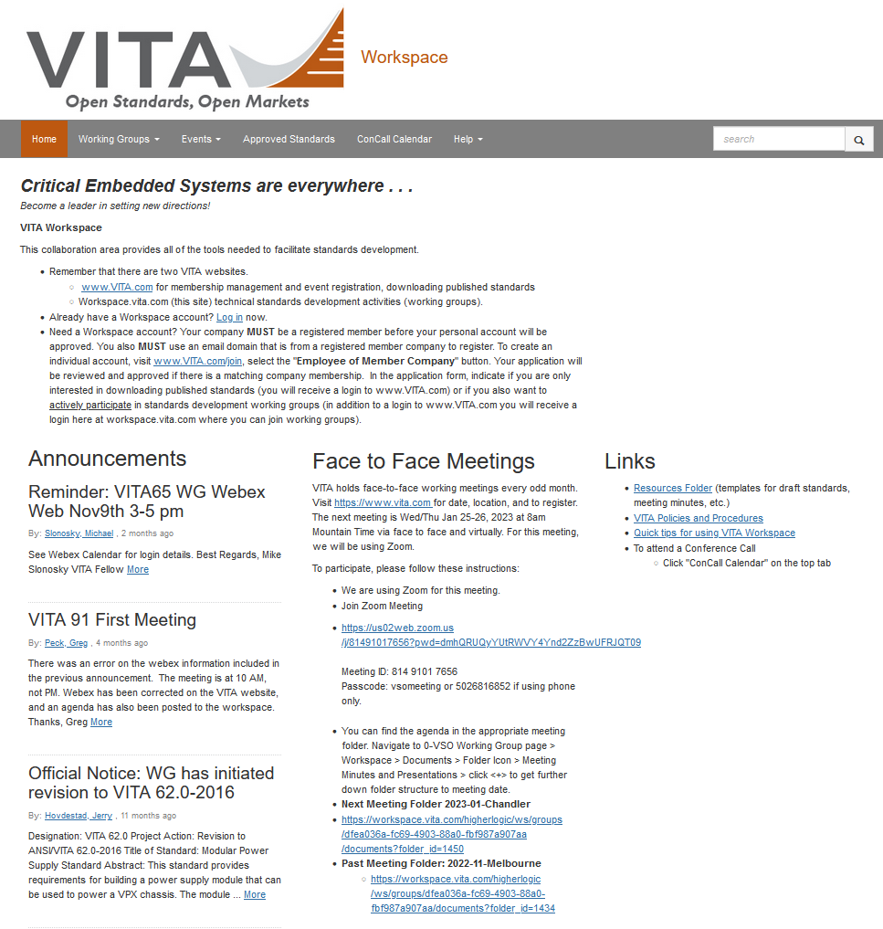
Workspace Home Page – Things to know
workspace.vita.com
Homepage [TABS]
Home
Working group Pages
Events
Approved Standards
Concall Calendar
Details on next f2f meeting
Link
Meeting folder
Past meeting folder
Links to
Resource Folder
Templates – Glossary, PPT, Drafts, Minutes, Agenda, Comment xls, Procedures
VITA P&P
Quick tips on website
Announcements are reposted here from respective working group pages

Slide 6
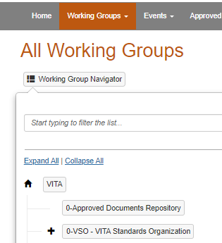
Workspace Home Page [Tabs] – Things to know
workspace.vita.com
All ANSI/VITA approved standards can be found/downloaded from here
Access working group pages here
Use “Start typing here” to search for WG page
Access all concalls from here – without knowing exact URL
Calendar of all reserved timeslots are shown
See scheduled WG Events here – WG chairs have to use the Events feature for events to be listed

Slide 7
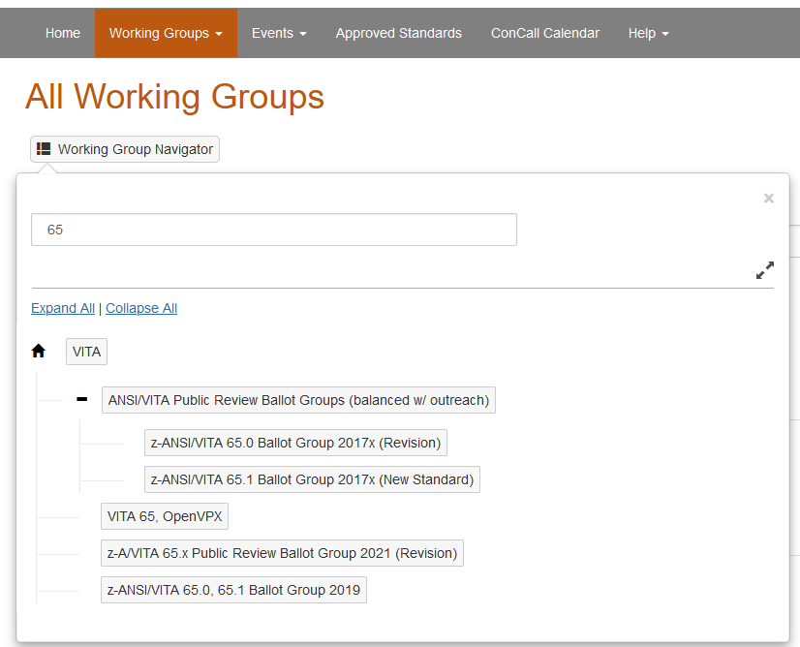
Navigating to Working Groups pages - Things to know
[Working Groups] tab
Click “Working Group Navigator” to get “dialog box” for WG list
Enter WG of interest to display the list of all WGs
Any symbol such as “space” or “.” is the delimiter that starts the search [ie “space” 65 will display all 5 working groups]
Click on WG to open the WG page [ie VITA 65, OpenVPX
A “z” prefix denotes a WG that’s been completed and put to bed “zzz”

Slide 8
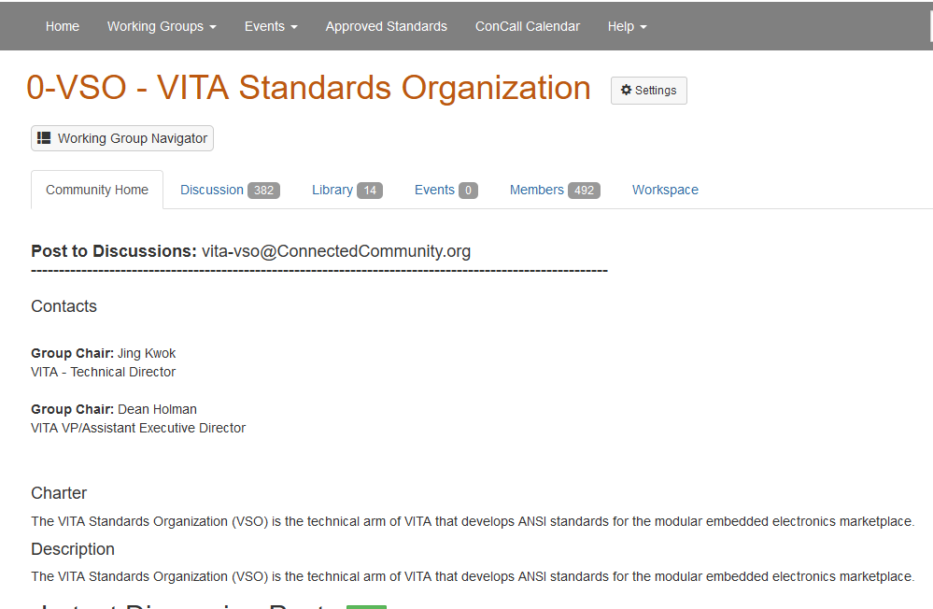
Navigating on the Working Group page - Things to know
Working Group Homepage tabs
Home, Discussions, Library, Events, Members, Workspace
Discussion and Library
Emails and posts are stired here – attchements from emails are the Library
All WG documents and Ballots are found here
Events
Scheduled WG meetings are listed here

Slide 9
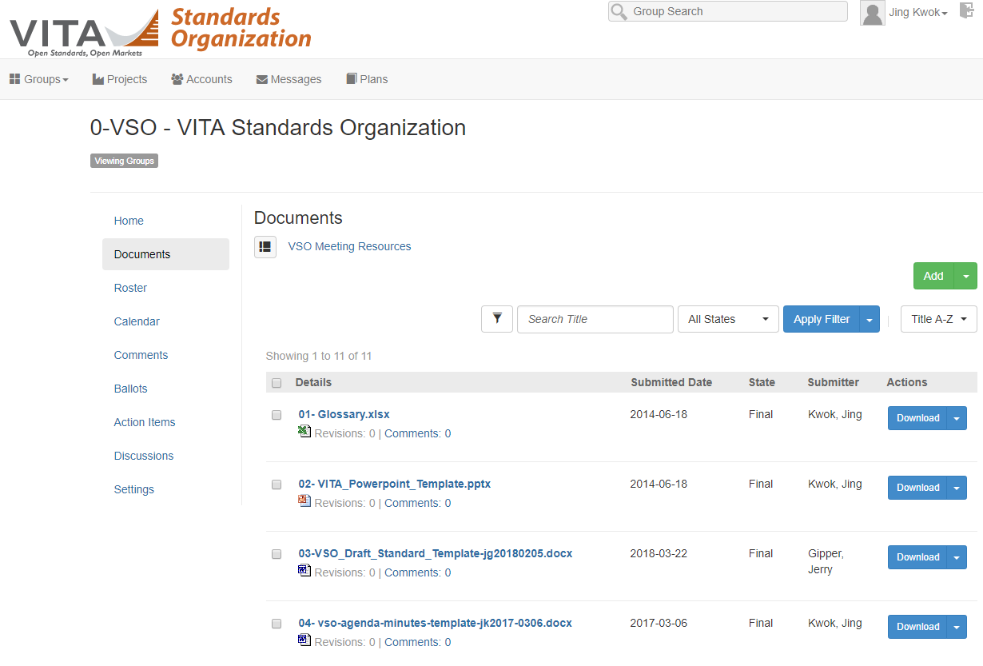
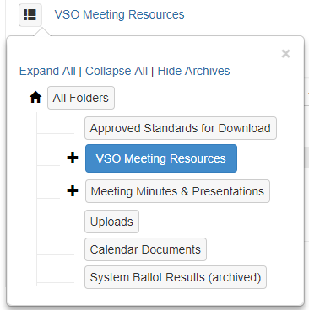
Navigating Workspace Hints (Cheat Sheet)
Folder Navigation is non-obvious
Click on Folder Icon “ “ to see folder structure
Folders are not shown in the files list like windows
Click on File Icon to open a file directly without downloading
“VSO Meeting Resources” in Group “0-VSO – VITA Standards Org” holds useful templates
Glossary, Policy and procedures
Templates for ppt, draft standard, minutes, ballot comment xls

Slide 10
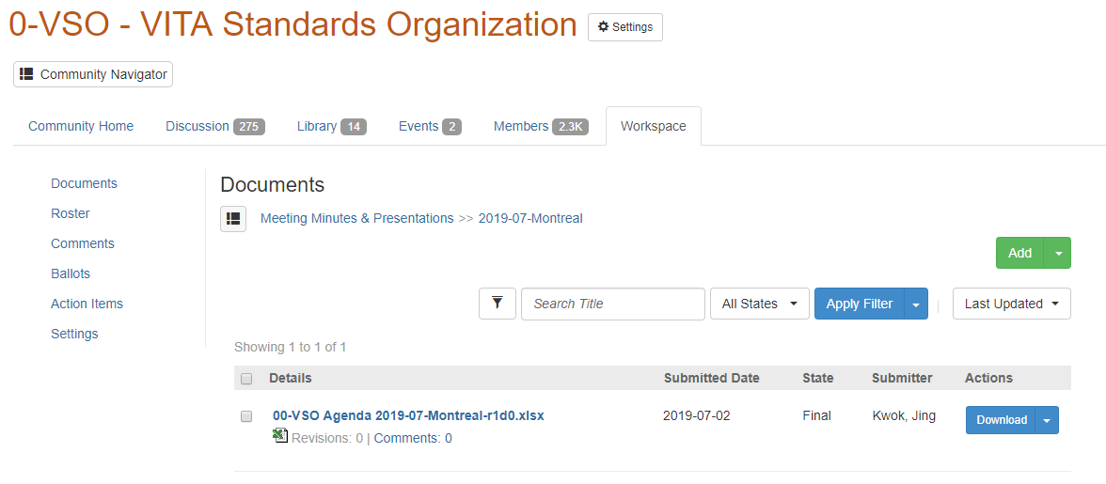
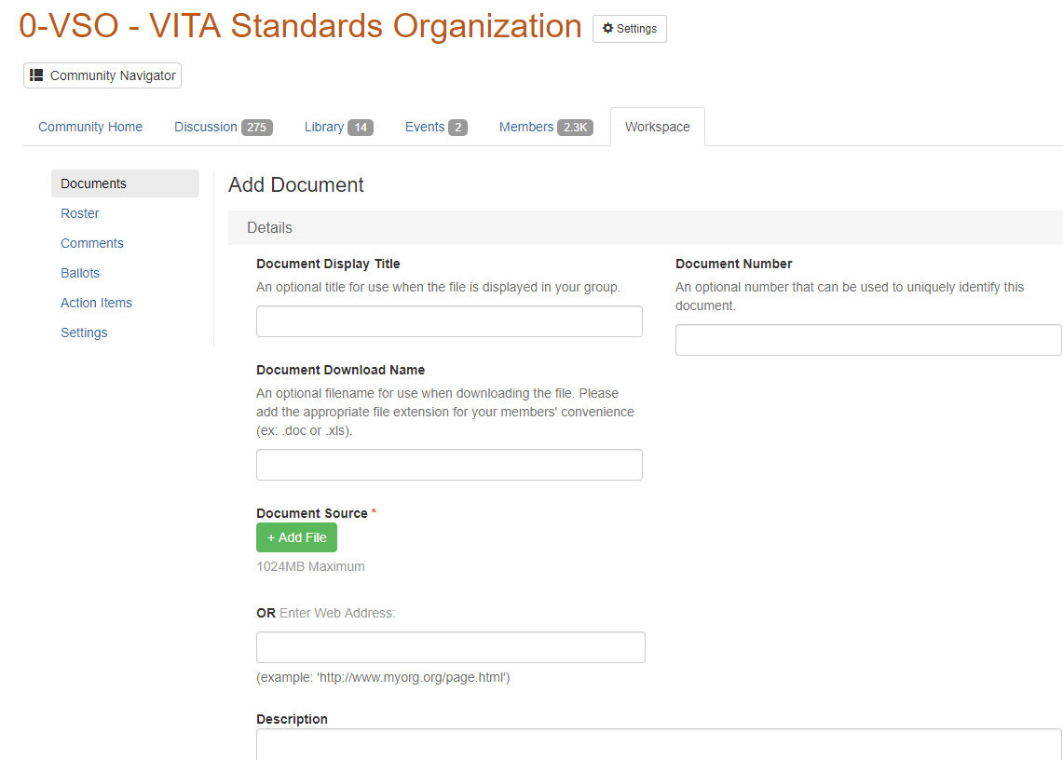
Posting Workspace Document
Click Add
Leave Document Display Title, Document Download name BLANK
Click Add File
Add Description as required
Leave Blank

Slide 11
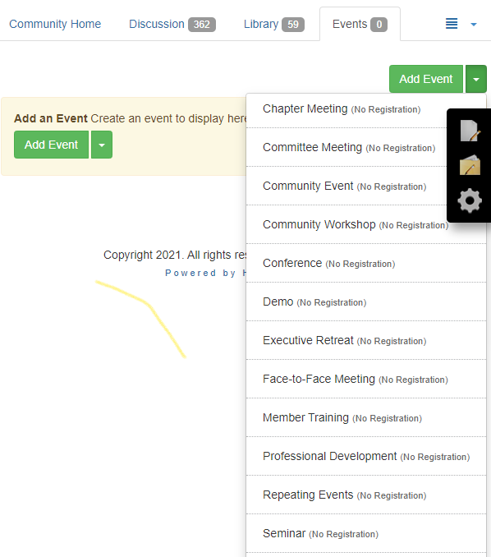
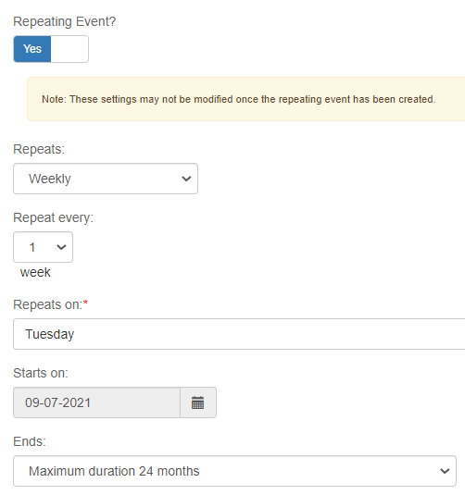
Setting up Events (Cheat Sheet)
Click Event Tab
Click Down Arrow next to Add Event
Select Repeating Events
Repeating Event – YES
Repeats Weekly
Start and End Dates
Set “Send Invitations” – YES
Members should receive email which includes link to add to their personal calendars
However removal needs to be made manually

Slide 12
Review WG Meeting Rules

Slide 13
WG Meeting Reminder
Standing Agenda …
https://workspace.vita.com/apps/org/workgroup/vso/download.php/417/05-%20meeting-how-to.pdf
Remind WG 48 hrs ahead of WG call and send agenda (P&P 7.1.5)
At meeting – follows Robert’s rule of order for deliberation and debate
Take Attendance
Acknowledge Patent, Anti trust, ITAR Policy
Review minutes and get seconder and record
Review agenda and modify as required
Follow agenda, vote as required for consensus
Voting eligibility rule set by WG … VSO is 2 of previous 4 meetings (P&P 5.1)
New business
Review Action Item list
Take late rollcall
Publish minutes … use vso-agenda-minutes-template.doc
https://workspace.vita.com/apps/org/workgroup/vso/download.php/1582/04-%20vso-agenda-minutes-template-jk2015-0924.docx
Hint: Minutes are a record of what is done and decided at a meeting, not what is said. Take them “live” on webex
Minutes are important … we are an accredited ANSI standards developing organization (SDO) … we need to show evidence that we are following our procedures to remain accredited

Slide 14
WG meetings Policy Statements : VSO patent, Anti-Trust and ITAR
Conduct WG meeting per VSO Policy and Procedure …
https://workspace.vita.com/apps/org/workgroup/vso/download.php/1692/10-VSO%20Policy%20and%20Procedures%20vso-pp-r2d8-jk2015-0901-final.pdf
Agenda/Minutes should follow template…
https://workspace.vita.com/apps/org/workgroup/vso/download.php/1582/04-%20vso-agenda-minutes-template-jk2015-0924.docx
Standard preamble …
1.1 VSO Patent, Anti-Trust and ITAR policy Acknowledgement
This meeting is covered by the patent, anti-trust and ITAR policy statement per VSO policy and procedures posted on its website. These policy statements are re-printed in section 1.2.
Are all participants aware of these policies? _YES??_
Are there any patent disclosures related to the contents of this meeting? _NONE??_

Slide 15
WG meetings Policy Statements : VSO patent, Anti-Trust and ITAR
1.2 VSO patent, Anti-Trust and ITAR policy statements
1.2.1 Patent Policy Statement
VITA's patent policy regarding the use of patented technology in standards is posted on its website. Working group members should read these policies. Working group members who are aware of any patents or patent applications that might be essential to the standards proposed by this working group are required to disclose them.
1.2.2 Anti-Trust Statement
These standards are developed in accordance with applicable antitrust and competition laws. Meetings amongst competitors to develop these standards are to be conducted in accordance with these laws. Hence don’t in fact or appearance, discuss or exchange information regarding:
Individual company prices, terms and conditions of sale, profits, margins or cost.
Industry pricing policies and levels.
Changes in industry production, capability, or inventories.
Individual company bids or bid procedures.
Plans of individual companies concerning the design, characteristics, production, distribution, marketing, or introduction dates of particular products, including proposed territories or customers.
Matters relating to individual suppliers that might have the effect of excluding them from any market.
Individual company market shares for any products or for all products.
1.2.3 ITAR Statement
This working group is an international community, thus no ITAR sensitive information shall be exchanged during this meeting.

Slide 16
Working Group Chair Guidelines

Slide 17
VITA WG Chair Guide Table of Contents
See Resource folder/file – 08-VSO Working Group Chair Guide
workspace.vita.com > 0-VSO > Workspace > Documents > VSO Meeting Resources
Table of Contents
1. Overview
2. Soliciting membership for the working/study group. (WG/SG)
3. Maintaining a working group membership list.
4. Scheduling Meetings
5. Leading working group meetings.
6. Keep meeting minutes unless the working group has a secretary.
7. Reporting development status to the VSO Chair.
8. Completing development in a timely manner.
9. Submitting the draft for a working group ballot.
10. Behind the Scenes at VITA
Appendix A - Standard form (example) for starting a WG/SG page
Appendix B - Standard form (example) for submitting the draft for ANSI/VITA public review
Appendix C - Two types of WG Ballot
Appendix D - Contents of a Ballot
Appendix E - Checklist for submittal to the ANSI/VITA public review process Ballot
Appendix F - Workspace Document File Naming Convention
Appendix G - WG member inclusion in VITA Draft Documents

Slide 18
VSO / ANSI
Process
Cheat Sheet

Slide 19
The VSO Process (Cheat Sheet)
VSO Policies and Procedures
7.1 Phase 1 – Standard Development
7.1.1 Study Groups – to investigate the need and ascertain interest
7.1.2 Working Groups – need at least three sponsors and continue to show forward progress 7.1.3 Working Group Officers – chair, draft editor, optional vice-chair, secretary. Chair and draft editor may be the same individual
7.1.4 Working Group Membership – sponsor, participant, and observer.
Sponsors make formal commitment and put forth extra effort to achieve standardization.
Participants attend on a regular basis and cast votes on all working group
Observers may attend meetings and may vote in ballots.
7.1.5 Working Group Meetings – regular, announced 15days for f2f; 48 hrs for telecon; follow roberts rule of order
7.1.6 Working Group Balloting
period may be 28 days; length proposed by WG chair with majority agreement of WG
may extend ballot period up to 14 to allow more time for voting upon request
7.1.7 Developing consensus – WG or recirculation ballot required when one or more significant changes are made
7.1.8 Recirculation Ballot – held if significant changes made as a result of the resolution of DISAPPROVE comments or if unresolved DISAPPROVE comments remain. Recirculation ballots shall be 14 days in length
7.1.9 Moving to Phase 2 (Passing a ballot)
2/3 majority vote in a WG ballot (means 2/3rds of the votes in the affirmative excluding abstentions {from 5.2})
7.2.1.2 VSO Specification –
VSO ballot open to WG members and to any other VSO members
must pass a 75/75 VSO ballot. Needs 75% return rate and 75% affirmative
14 “VITA Draft Standard for Trial Use”– A proposed standard that is intended for subsequent submittal for ANSI recognition;
VDSTU period is up to 36 months.
may only be issued once for any proposed standard
IDEA
FORM WG or SG
ANSI path?
DO WORK
Write doc
Hold telecon/f2f
WG ballot
VDSTU
VITA
ANSI

Slide 20
The ANSI Process (Cheat Sheet)
VITA
VSO WG
Procedures for the Development of American National Standards within the VITA Standards
Organization (VSO) known here as VSO ANSI Procedures {VAP} follows ANSI Essential Requirements {AER}
Main Principles
Open – members and non-members may vote {VAP 3}
Lack of dominance - not be dominated by any single interest category, individual or Organization {AER 2.2}
Balance, - no single interest category constitutes a majority of the membership of a consensus body {AER 2.3}
2.1 PINS – Project Initiation Notification System
The working group shall follow the requirements stated in section 2.5.1 of ANSI's Essential
Requirements regarding the submission and handling of PINs.
2.2 Public Review
The working group shall follow the requirements stated in ANSI Essential Requirements section 2.5.2 regarding the conduct of Public Review in the development of a proposed standard
3 Development of the Balloters List
shall conduct a pre-ballot interest survey, in which the standards development committee informs the potential balloters
4 Conduct of the Ballot
Approval of a new standard, revision or reaffirmation of an existing standard, or an addendum to part or all of an existing standard shall require a majority of the ballot list and a 2/3rds majority of the votes cast. Abstentions are not counted.
Submit PIN for new/revise
Complete Draft Standard in WG
Fast track
BSR8 – announce in “Standards Action”
Solicit for VSO Public Review (14 days)
ANSI Public Review (45 days
{AER 2.5.2})
Preferred track
VSO Public Review (30days
{VAP 4})

Consensus group
need 67% to PASS
Strive for 100% w/ edits



Recirculation Ballot (14d)
unresolved
Right to Appeal Notification
BSR9 – new/revision/reaffirm
BSR10 – stabilized maintenance
Publish ANSI/VITA Standard

Slide 21
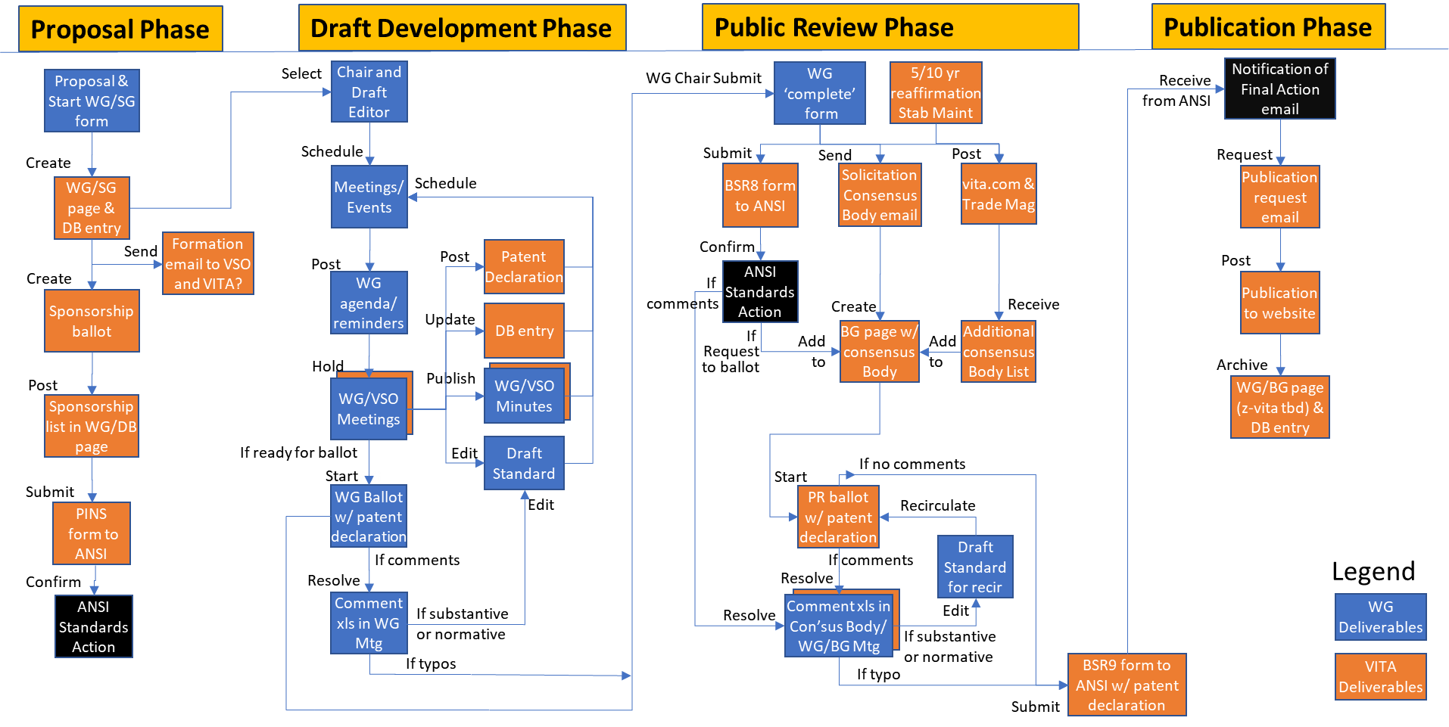
Life Cycle of a VITA Project (Cheat Sheet)

Slide 22
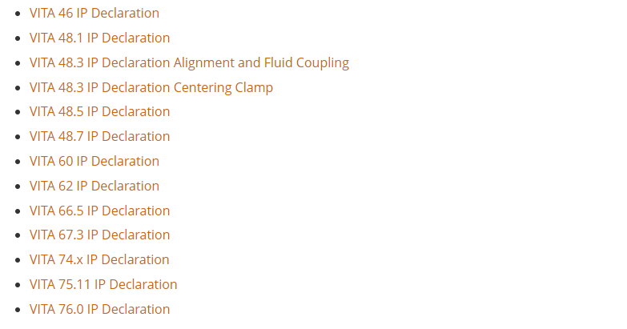
Patent Declarations on file
Per new 2020 ANSI policy, these are now publicly available from vita.com >> Standards >> Supporting Information >> Essential Patents
https://www.vita.com/Essential-Patents
You may discuss the terms of the declaration with the patent holder.
However, DO NOT discuss the terms of the patent declaration in a VSO meeting.

