Slide 1
VPX Power Supply Guide
Vito D’Erasmo, North Atlantic Industries, Inc.
5 October 2023
COPYRIGHT NOTICE
Published by VITA and North Atlantic Industries, Copyright © 2023. All rights reserved.
Notes:
1
1

Slide 2
Contents
Introduction
Available Power Supply Connector Standards
Input Power Types
Recommended Standard
Similarities in VITA 62.0, VITA 62.2 and VITA 86
VITA 62.0, VITA 62.2 Intermate-ability
Use Case for VITA 86
Plating and Guides
TE ConnectivityTM Part Numbers
North Atlantic Industries Part Numbers
[VITA 86] Part Numbers
VITA 62 to 62.0 Migration
Current Share for Redundancy
Holdup
Future Signal - Load-Shedding
Future Voltage Forms
Summary
References
Definitions

Slide 3

Introduction
This document provides guidance pertaining to power supply implementation and solutions for designers within the VITA VPX ecosystem. The following subjects are discussed.
Selection of VITA Connector Standard.
Maximize Interoperability when designing backplanes for power supplies.
Highlight differences between [VITA 62] and [VITA 62.0] .
Intermate-ability across Standards.
Part Numbers

Slide 4
Available Power Supply Connector Standards
[VITA 62] – This is an earlier version of the VPX Power Supply Standard. It allows for 3U and 6U widths and for multiple pitches focusing on 0.8” and 1.0” pitch. It also allows for multiple cooling methods.
[VITA 62.0] – This standard replaces [VITA 62] . It introduces +12V only, +12V Heavy and 5V Heavy options. Additional key positions have been added to support these new options. Some optional functions have been assigned to specific UD pins, therefore compatibility with backplanes designed to VITA 62 should be reviewed.
[VITA 86] – This standard defines a sealed connector solution to enhance performance for high voltage applications. A backplane designed for [VITA 62] or [VITA 62.0] will allow this connector to drop in. The backplane manufacturer may need to perform secondary operations to realize performance improvements underneath the connector.
[VITA 62.2] – This standard is an alternate solution for high voltage applications. Voids and spacers are introduced into the [VITA 62] connector to increase creepage and clearance between the high voltage nodes. Cutouts in the backplane and module are recommended.
[VITA 62.1] – This standard allows for 3 phase input on a 3U platform.

Slide 5

Input Power Types
Low Voltage +24V and +48V
The +24V and +48V inputs are commonly used in telecom devices, providing reliable power for their operation. While these devices are designed to deliver dependable performance during their intended operational hours, they are typically not required to withstand extreme environmental conditions. Instead, they are commonly installed within air-cooled equipment racks.
To ensure safety, the input voltage of these devices is usually already isolated from voltage rails that pose potential safety hazards. This type of VPX power supply usually incorporates a minor input to output isolation to prevent grounding issues. For connectivity, a connector that is compliant with the [VITA 62] standard is suitable and is recommended for this specific product category.
Image by DCStudio on Freepik

Slide 6

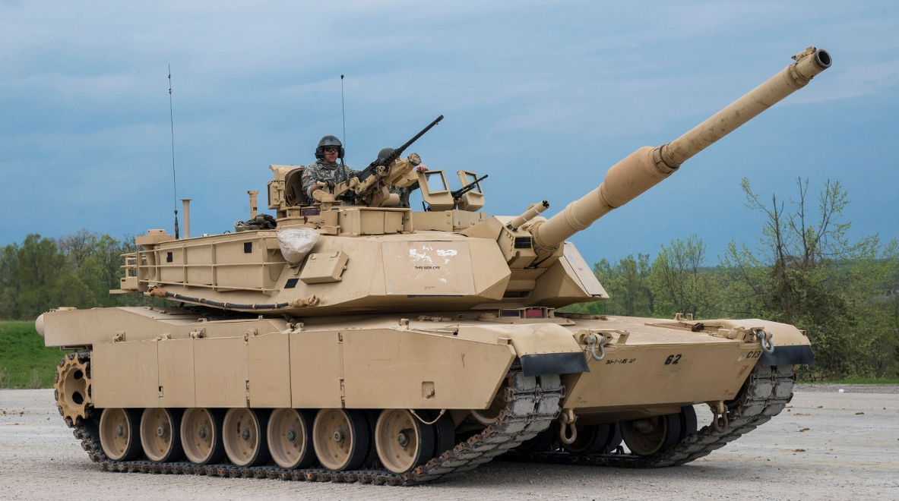
Input Power Types (continued)
Low Voltage +28V Input
This input is typical in high reliability (Hi-Rel) ground vehicles as well as subsystems aboard aircraft. Hi-Rel refers to exposure to extreme environments as well as extended operational availability. In the case of ground vehicles, the power is derived from a low voltage generator which is connected to the vehicle battery. It is common for a procurement authority to invoke a version of [MIL-STD-1275] . This standard describes ripple, transients, spikes and surges that are applied to the input voltage.
For aircraft, the 28V subsystem power is derived from a Transformer-rectifier unit (T-R) or a modern-day equivalent. The (T-R) will run off the aircraft generator, which is typically 115 VAC, 3-phase WYE, 400 Hz. This power configuration minimizes the size of the generator, the (T-R), and the associated wiring. The (T-R) will usually provide safety hazard isolation between the generator power and the 28V subsystem. Once again, a minor input to output isolation of the VPX power supply is required to avoid grounding issues. Here, the standard applied to the input power will be a version of [MIL-STD-704] . This standard also describes transients and spikes in addition to power dropouts and switch-over events. Switch-over events occur because aircraft can spend significant amounts of time being prepared for activity. During this time, the engine will be off, and the aircraft will be operating from external power provided by the flight line. Once a level of readiness is achieved, the engines will be started, and power will be switched from external to internal. The characteristic of this switchover is one of the events described in [MIL-STD-704].
For these applications, a connector based on the [VITA 62.0] standard will suffice. Nevertheless, if it is desired to have one backplane design to address high voltage and low voltage applications, it is prudent to adopt the [VITA 62.2] standard, which provides an improved voltage creepage path.
Image by FlightGlobal.com T7-A
Image by The National Interest M1A2 Abrams

Slide 7
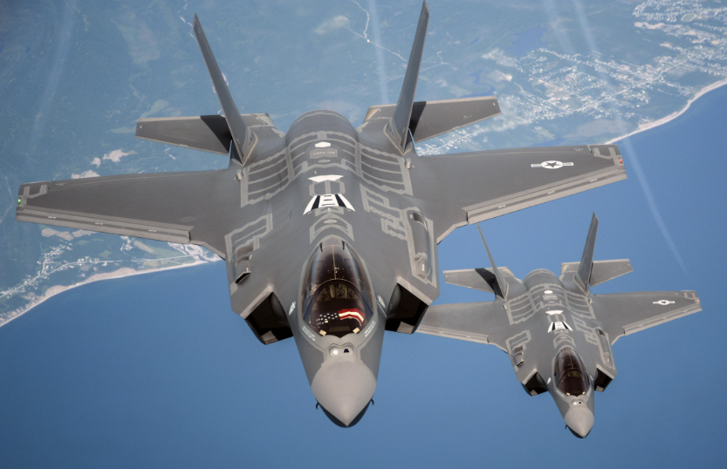
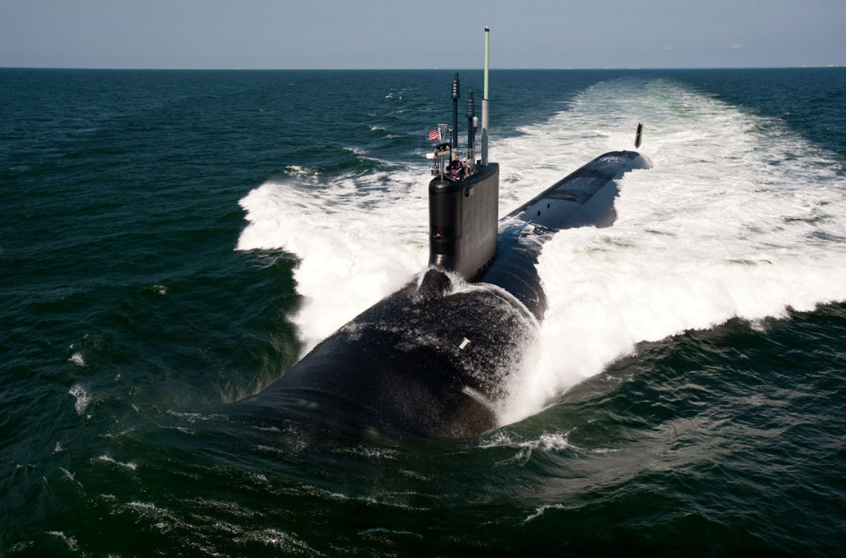
Input Power Types (continued)
High Voltage DC, 270 VDC Input
Newer aircraft and ships use +270 VDC (+- 135 VDC). The generator power is converted to non-isolated DC voltage within or near the generator. For aircraft, this eliminates the need for (T-R) units and reduces the need for +28V subsystems which decreases the weight. DC current also optimizes the wiring since there is no power factor effects and the down-stream equipment is not required to have power factor correction. A disadvantage is that +270 VDC external power will likely be needed for preparation and maintenance. In addition, switch-over events must now take place on high voltage DC lines, which is more difficult than on AC lines.
Ships will have the same advantages with an added advantage of having much less leakage current. Leakage current is caused by filters placed on the input power lines. The power lines require filtering to contain the effects of RF energy. On AC lines, these filters drive leakage current into the hull. Hull currents can cause corrosion, cause safety concerns, and other undesirable traits.
For the +270 VDC application, a connector based on the [VITA 62.2] standard will provide an improved voltage creepage path and with the optional spacers employed, the spacing between the nodes on the connector mating surface improves dramatically.
Designers may also consider using a connector designed to the [VITA 86] standard. This decision will be based on knowledge of the application and target system. If a significant amount of condensation is expected, it may be best to select the [VITA 86] type. This connector, complimented with a vapor deposited PCB coating, should deliver the best solution.
Systems aboard high-performance aircraft will experience several cycles of rapid altitude and temperature changes during even the shortest of flights. Even if the system has an environmental seal, the seal may fail, even intermittently, after many cycles. If the system is expected to last 20 years, it would be best to use the highest performance connector available.
Image by AF.mil F-35A
Image by Military.com Virginia Class Submarine

Slide 8

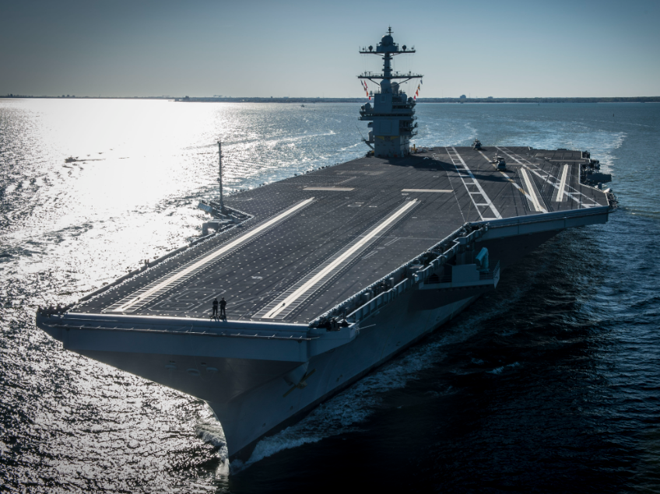
Input Power Types (continued)
115/208 VAC Three Phase Wye, 400 Hz
This input power type is common on many aircraft and associated vehicles that support aircraft. A version of MIL-STD-704 will typically be invoked when using this power. For 6U chassis, both [VITA 62.0] and [VITA 62.2] standards support this power form. It should be recognized that [VITA 62.2] allows for creepage and clearance along the connector the PCB surface as well as the connector intermating surface. The [VITA 62.2] standard would be a better choice to meet design rules.
For a 3U chassis with this power form, there is only one choice, which is the [VITA 62.1] standard. The improved creepage and clearance features of [VITA 62.2] are already integrated into the [VITA 62.1] standard.
Image by Defencetalk Seahawk SH-60
Image by The National Interest USS Gerald R. Ford

Slide 9
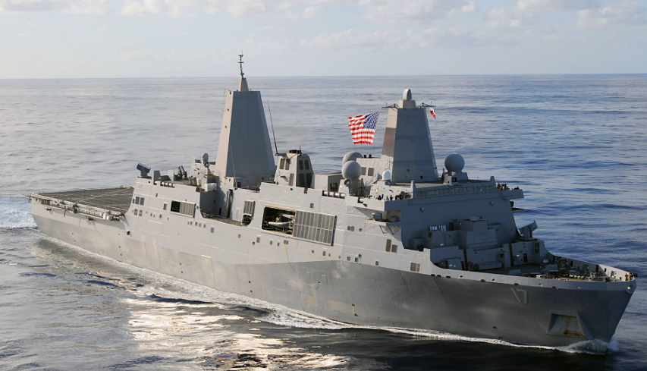
Input Power Types (continued)
115 VAC Three Phase Delta, 60 Hz
This power is used on ships and support equipment. This power form is described in [MIL-STD-1399-300-1]. This power is often referred to as 3-wire ungrounded. On larger ships, higher voltages are used to distribute power. A transformer will be used to translate the power to the subsystem level of 115 VAC phase to phase. None of the secondary wires are connected to ground and there is no neutral wire as part of the subsystem. This is done to avoid unwanted hull currents. The connector selection will be the same as was discussed previously for the Three Phase Wye power.
Image by Marine Link Amphibious transport

Slide 10
Recommended Standard
Recommended Standard by Application and Power
Input Voltage | Application
 | 3U |  |  |  | 6U
 | Ground | Ship | Air | Air - Rapid Δh | Ground | Ship | Air | *Air - Rapid Δh
3 Phase | [VITA 62.1] |  |  |  | [VITA 62.2]
270 VDC | [VITA 62.2] |  |  | [VITA 86] | [VITA 62.2]
28 VDC | [VITA 62.0] or [VITA 62.2]
24 / 48 VDC | [VITA 62.0]
*NOTE : As of the writing of this document, the VITA 86 standard does not address 6U, high
voltage applications or 3U three phase applications. VITA 62.2 and VITA 62.1
currently provide the best solution.

Slide 11
Similarities
Similarities in [VITA 62.0], [VITA 62.2] and [VITA 86]
These standards intentionally preserve the positioning of pin A1 to the guide pin on the backplane and the positioning of pin A1 to the primary surface and the guide module for the power supply module. This was done to allow a single backplane design to be used for multiple configurations.
To achieve this goal, the copper traces delivering input power should be designed to handle the full 40A rating of the pins. Some of the recently available, high-power Power Supply Modules have the capability of using this much current. It is best to use PCB material rated to at least 180°C glass transition temperature, then design the traces for under 10 °C to 20°C of self-heating. The connector to PCB and connector to connector interfaces will be generating additional heat.
At the same time, it may be desired for the board to support high voltage spacing associated with the +270 VDC input. Using the recommended ‘dog-bone’ cutouts in [VITA 62.2] will help achieve this goal. In addition, it is recommended to use the [VITA 62.2] spacers as well. If the spacers are not used, applying coating material or a similar insulation in the cut-outs should be considered.

Slide 12
Intermate-ability
[VITA 62.0], [VITA 62.2] Intermate-ability
Many combinations of [VITA 62.0] and [VITA 62.2] will mate. These combinations are shown in the following table.
Note that [VITA 62.1] will only mate with [VITA 62.1] and [VITA 86] will only mate with [VITA 86].
The table demonstrates that using a [VITA 62.2] connector on the backplane will guarantee that the slot will always mate with a [VITA 62.0] or [VITA 62.2] style connector.
Mating Pair |  | Module
 |  | 62.0 | 62.2 w/o Separators | 62.2 with Separators
Backplane | 62.0 | ✓ | ✓ | ✘
 | 62.2 w/o Separators | ✓ | ✓ | ✓
 | 62.2 with Separators | ✓ | ✓ | ✓

Slide 13
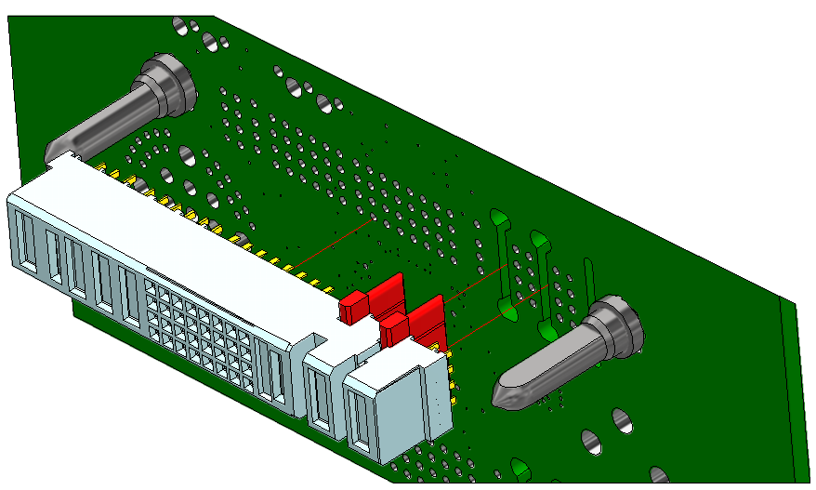
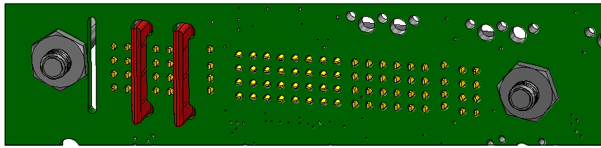
Intermate-ability (continued)
Backplane Design
It is recommended to design all Backplanes with [VITA 62.2] cutouts.
[VITA 62.2] Seperators are optional at the assembly level.
  Separators can not be installed once the connector is pressed in !!!
Use [VITA 62.2] connector for [VITA 62.0] and [VITA 62.2] applications – Extra voids will not affect mating.
Design input voltage nodes to handle full pin current rating with 10 to 20˚C rise.
Recommend to use 180˚C minimum Tg rated material.
Design traces to support 270 VDC. Separators improve creepage and clearance.

Slide 14
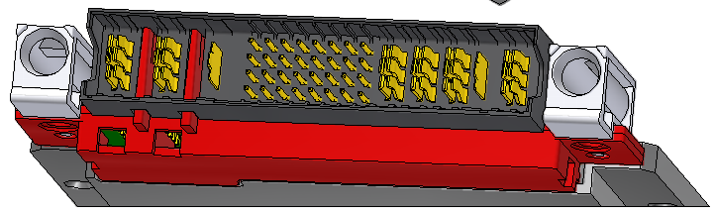
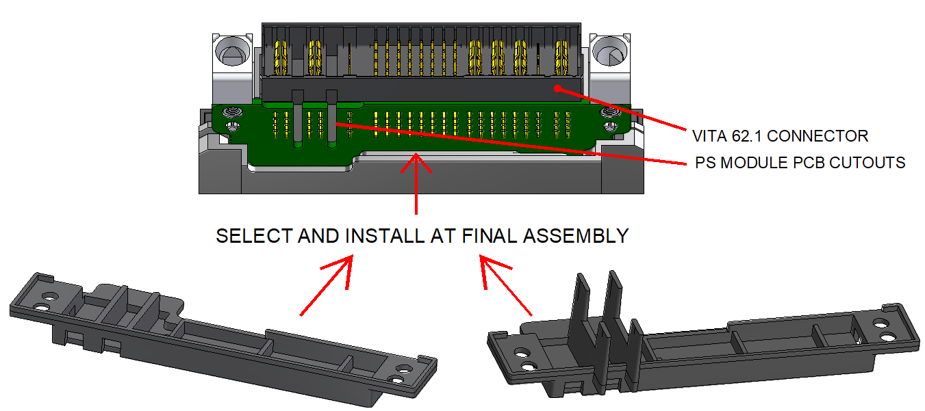
Intermate-ability (continued)
Module Design
(NAI Version Shown)
[VITA 62.2] Module Separators protrude into the connector seating plane.
  May Lead to inter-mateability issue.
Consider designing modules to support [VITA 62.2] cutouts. One board can address multiple applications.
Consider using [VITA 62.2] connector for all [VITA 62.2] and [VITA 62.0] applications.
NAI Separatiors can be installed at the final Assembly level
  After the connector has been pressed in.
TE Separators can also be used, however they must be installed before the connector is pressed in.

Slide 15
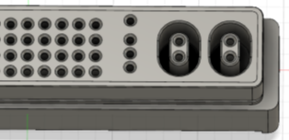
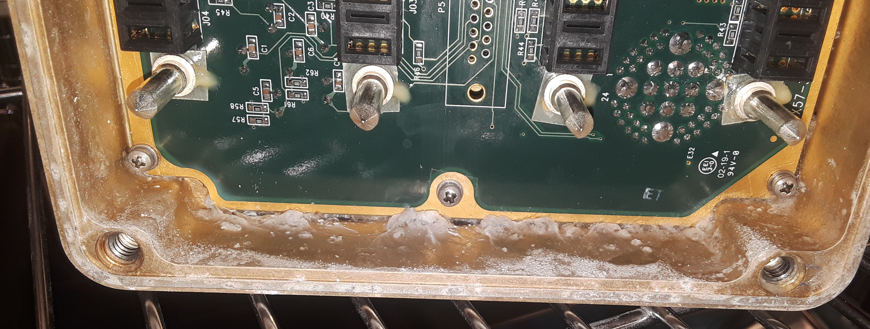
Use Case for VITA 86
Certain environments and applications cause condensation to take place within the system chassis. Connectors designed to the [VITA 62.2] standard allow for improved creepage and clearance on the printed circuit board mating surface and the connector-to-connector mating surface. With proper implementation, design guides such as [IPC-2221] can be met.
With that understood, it should be recognized that [VITA 62] and other solutions derived from it are not sealed. For applications requiring a sealed interface, connectors designed to the VITA 86 standard offer the best solution for VPX plugin Power Supply modules.
A case for using such connectors might be in an environment where condensation or corrosion is expected to reach the high voltage nodes on the backplane. Another use case might be to provide a secondary seal. Harsh environments with many temperature and altitude cycles can age the primary seal. To extend the life of such an application, a secondary seal designed to the VITA 86 standard could be applied.
VITA 86 3U Backplane Connector
Corrosion Intrusion Due to Primary Seal Failure

Slide 16
Use Case for VITA 86 (continued)
[VITA 86] Assembly Concerns
The right-angle connector designed to the [VITA 86] standard inherently provides a seal on the connector-to-connector interface but does not address the connector to PCB interface. To enhance this interface, the assembly process can include the application of underfill, or a vapor deposited coating such as Parylene.
The [VITA 86] straight pin module connector includes integrated spacers to enhance creepage along the printed circuit board surface. In this case, a urethane based coating compound may be sufficient.
[VITA 86] Design Concerns
Full engagement of the connector is vital to achieve the seal at the connector-to-connector interface. VPX modules have several features in the same plane as the connector seating plane. These features are the extractor levers and the guide modules. The Power Supply should be designed such that the connector seating plane is the first feature to fully engage. The levers and guide module position cannot interfere with the seating of the connector surfaces.
Another concern is the alignment of the connector to guide modules. The [VITA 62.0] standard and its derivatives have a common seating plane for the connector shell and the guide modules. This single plane minimizes the tolerance chain between the guide module location and the connector pin locations.
The [VITA 86] shell cannot sit on the Power supply module PCB board. To maintain a common backplane design, the [VITA 86] style connector shell needs to sit below flush of the PC Board. This means that there can be more components involved in the tolerance chain to achieve the same alignment as compared to [VITA 62.0] . The [VITA 86] straight pin module connector provides integrated guide modules to alleviate this issue.
With the integrated guides seated on the PC Board, the alignment of the connector pins to guide modules is, once again, automatic.

Slide 17
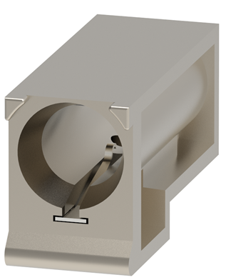
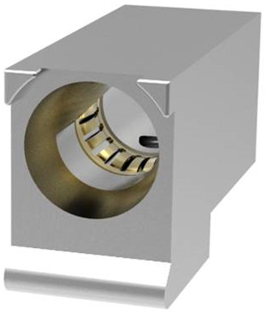
Plating and Guides
Plating – 30u Au vs. 50u Au
The [VITA 62.0] connectors are offered with two plating styles. They are 30u thickness gold and 50u thickness gold.
The thicker plating will be better able to resist wear due to fretting. Fretting occurs due to vibration and / or repeated injection and ejection of the connector. It is best to use the 50u plating whenever possible.
In addition to being thicker, the 50u plating style connector has additional features intended to mitigate tin whiskers.
The newer standards, [VITA 62.1] and [VITA 62.2] only offer connectors with the 50u plating.
Guide Modules
Guides that meet [VITA 62.0] are available in three types. They are Casted, Machined Aluminum and Machined Stainless Steel.
The casted type are made to less precise specifications and have a grounding tang to provide an ESD connection. The tang occupies position angles 135, 180, and 225. This is why the earlier [VITA 62] specification only listed 5 of 8 possible guide angles.
The Stainless Steel and machined aluminum guides use a more robust grounding collar which does not restrict angles for the guides.
The additional 3 positions are an added offering to the machined aluminum type (only).
The tighter fit of the grounding collar restricts vibration and can reduce fretting. It is recommended to use the Stainless Steel or machined aluminum guides.
Cast Guide Module with Tang
Machined Guide Module with Collar
Pictures Courtesy of TE Connectivity

Slide 18
TE Connectivity™ Part Numbers
TE Connectivity Connector Part Numbers (50u Au Only)
TE Connectivity Guide Module Part Numbers
Standard | Size | Style | Termination | TE Part Number
62.0 | 3U | Backplane | Press Fit | 2309390-1
 |  | Plug-In Module | Press Fit | 2314578-2
 |  | Plug-In Module | Solder | 2317477-1
 | 6U | Backplane | Press Fit | 2314581-1
 |  | Plug-In Module | Press Fit | 2314577-1
 |  | Plug-In Module | Solder | 2314579-1
 |  | Backplane | Press Fit | 2309390-2
 |  | Plug-In Module | Press Fit | 2314578-1
 |  | Plug-In Module | Solder | 2314580-1
62.1 | 3U | Plug-In Module | Solder | 2332791-1
 |  | Plug-In Module | Press Fit | 2332793-1
 |  | Backplane | Press Fit | 2332795-1
62.2 | 3U | Plug-In Module | Solder | 2313443-1
 |  | Plug-In Module | Press Fit | 2313442-1
 |  | Backplane | Press Fit | 2313441-1
 | 6U | Backplane | Press Fit | 2348888-1
 |  | Plug-In Module | Press Fit | 2348886-1
 | Separator | Plug-In Module | N/A | 2313445-1
 | Separator | Backplane | N/A | 2313444-1
Key Position | Material / Ground
 | Casted Al / Tang | Machined Al / Collar | Machined St / Collar
0 | 1-1469492-1 | 2000713-1 | 2000713-7
45 | 1-1469492-2 | 2000713-2 | 2000713-8
90 | 1-1469492-3 | 2000713-3 | 2000713-9
135 |  | 1-2000713-4
180 |  | 1-2000713-5
225 |  | 1-2000713-6
270 | 1-1469492-7 | 2000713-4 | 1-2000713-0
315 | 1-1469492-8 | 2000713-5 | 1-2000713-3
No Key | 1-1469492-9 | 2000713-6 | 1-2000713-2
Note: These connectors are protected under the following patents.
US 5,630,720
US 6,488,549 B1
US 5,582,519

Slide 19
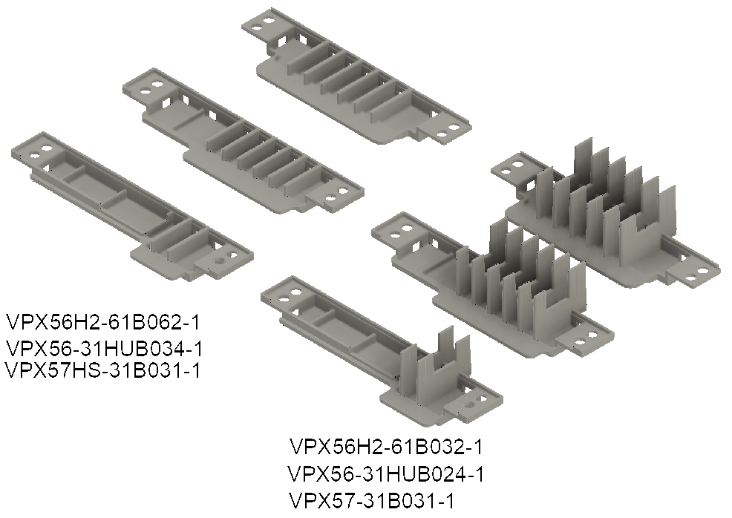
North Atlantic Industries Part Numbers
North Atlantic Industries, Inc. Insulators
Note: These insulators are protected under U.S. Patent No. 11,276,948
NAI Insulators | VITA 62.1 |  | VITA 62.2
 | 3U Only |  | 3U |  | 6U
 | With Separators | Without Separators | With Separators | Without Separators | With Separators | Without Separators
Drawing | VPX56-31HUB023 | VPX56-31HUB033 | VPX57-31B021 | VPX57HS-31B021 | VPX56H2-61B031 | VPX56H2-61B041
P/N | VPX56-31HUB024-1 | VPX56-31HUB034-1 | VPX57-31B031-1 | VPX57HS-31B031-1 | VPX56H2-61B032-1 | VPX56H2-61B062-1

Slide 20
[VITA 86] Part Numbers
Connector Type | Pin Orientation | Guides | Part Number
 |  |  | Rantec™ | Glenair™ | TE Connectivity™ Part Number
Backplane Connector | Straight | Separate Guide Pins | 37133 | 797-470 | 2373384-2
PSU Module Connector | Right Angle - Towards Mezzanine | Separate Modules | 37174 | 797-471
PSU Module Connector | Straight | Integrated Modules |  |  | 2383876-1

Slide 21
[VITA 62] to [VITA 62.0] Migration
+12V heavy, +5V Heavy and +12V Only options were introduced.
  On 3U, Heavy Option, the 5V Vs3 node (Pin P3) is reassigned to Vs1 to allow for increased current from Vs1.
  On 3U, 12V Only Option, in addition to reassigning Pin P3 to Vs1, The 3.3 Vs2 node (Pin LP2) is reassigned to 3.3 Aux to allow for 20A for system management. It is not expected to have the +/-12V Aux outputs for this configuration.
  On 6U, 12V Only Option and Heavy Option, Vs3 nodes (Pin P5 and P6) is assigned to Vs1 to allow for higher current.
Geographical Addressing expanded from 4 to 8 on 3U.
More suggested uses were assigned to UD pins.
Added key rotations and modified definitions.
  3U now has one key dedicated for input and one key for output.
Grounding parameters were changed from recommendations to rules.
The two (UD) Sync Pins have been defined as Sync In and Sync Out
Inhibit / Enable logic changed from recommendations to rules.
Guide Rail Clearance for conduction cooled modules was made optional per VITA 48.
Foxconn connector part numbers were removed.
Connector part numbers for 50u plating added.

Slide 22
[VITA 62] to [VITA 62.0] Migration (continued)
UD Pin assignments have been updated.
Pin Name | 3U Pin Assignment | 6U Pin Assignment | 3U Recommended Function | 6U Recommended Function
UD0 | A3 | D9 | SYNC_IN
UD1 | A1 | D8 | SYNC_OUT
UD2 | B1 | A3 | NVMRO
UD3 | C1 | A1 | GA2* | None
UD4 | D1 | B1 | 3.3V_AUX_SENSE | SHARE_4
UD5 | None | C1 | Not Applicable | 3.3V_AUX_SENSE
UD6 | None | D1 | Not Applicable | 3.3V_AUX_SENSE_RTN

Slide 23
Current Share for Redundancy
Current share is employed to distribute load current evenly among parallel-connected devices. It enables multiple converters to work together, sharing the load in proportion, preventing a single converter from being overloaded while others remain under-utilized.
VITA standards do not require current share performance. The standards do allow for current share by providing a signal bussed between the power supplies on a backplane. The signal is intended to be bi-directional, so there is only need for one signal per power form being shared.
It should be expected that the implementation of current share will vary from vendor to vendor.
Current share can be configured to provide fault tolerance. In the event of a failure or removal of one power converter, the remaining converters can share the remaining load.
Depending on the reliability model being considered, it becomes advantageous to employ fault isolation components so that a short circuit on the input or output of a single power supply does not cause a complete system failure.
Input Fault Containment can be part of the PDU, a dedicated module or system component or it can be internal to each Power Supply.
Output Fault Containment can be Internal or External to the Power Supplies.

Slide 24
Energy Storage
Energy storage plays a vital role in meeting the power transfer specifications outlined in [MIL-STD-704].
Energy must be captured and stored for later use. The [MIL-STD-704] specification describes transfer events that can last for 50mS, followed by a normal transient. The next transfer can occur as soon a 500mS later. This requires that the power supply have at least 10% excess capability to charge the bulk storage element(s).
VITA depicts two methods to achieve energy storage, but does not discount other methods, provided that existing rules are not violated.
VITA Single Module
VITA Multiple Module
Compact
Limited Performance
Intermediate Power is within the Module
Two, Three, or More Modules
Bulk Storage can be P/O Front End, Final or Separate Module
Intermediate power is on the Backplane

Slide 25
Energy Storage (continued)
Alternative Method – Back End Storage
Approach
  Can be used with a Standard VITA Single Stage Power Supply
  No impact on efficiency or EMI
  All backplane nodes can be bussed between 2 slots.
  A backplane designed for redundancy will support a Back End Storage Module

Slide 26
Future Signal - Load-Shed
Load-Shed
  As stated earlier, many VPX products are used on platforms that must endure exposure to input power switchover events and abnormal transients.
  These events can last for 100mS or more.
  3U Power products are rated to 750W and greater, while 6U products are at 1500W.
  This amount of energy storage will require excessive cost, size and weight.
  A smarter approach would be to add a ‘Load-Shed’ signal to the system signals (P0).
  Future system Standards should allocate pin(s) for this function.
  On [VITA 62.0] and [VITA 86] - Re-purpose Share 4 on 6U and Aux Sense on 3U.
  On VITA 46.11, assign FRU policy BITs for vendors to use to shed Load.
    VITA to make assignments.
    Ensure FRU policy BITs do not overlap SOSA assignments.

Slide 27
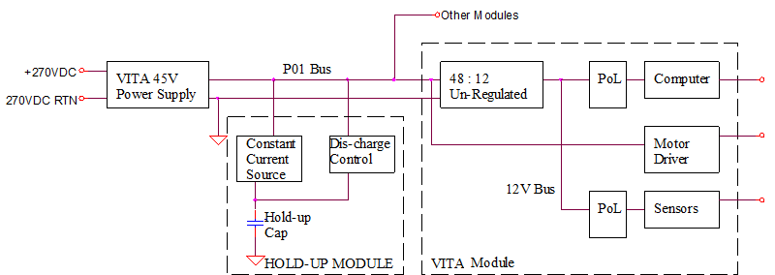
Future Voltage Forms
Existing High-Power Ecosphere is based on +12V Heavy and +12V Only platforms.
High Power 12V POL regulators are Abundant from many manufacturers.
  If a New Power Form is Specified, there needs to be new POL devices to compliment it.
Limits of Existing v62 Connector
  3U [VITA 62.0] Limited to 80A for return current = 60A of +12V and 20A of 3.3A = 786W.
  6U Limited to 160A of +12V and 40A of 3.3Aux = 2052W.
3U Products are offered up to 800W – These are already at the connector limit.
6U are offered to 1400W – Limited by efficiency and thermal management as opposed to the connector.
A 45V final output is being considered for a power form to significantly increase output power.
  Roughly 4x growth
  Most Volumetrically efficient Storage Capacitors are rated at 50 VDC.

Slide 28
Summary
There are several available options for connector selection for system designers working within the VPX ecosphere.
[VITA 62.2] is a connector standard that offers improvements in creepage and clearance while minimizing the impact on costs. By adopting [VITA 62.2] connectors, system designers can achieve enhanced safety and reliability without incurring significant additional costs.
For designers who have previously implemented power supply designs using [VITA 62.0] connectors, migrating to [VITA 62.2] offers several benefits, particularly in terms of future system compatibility. By upgrading to [VITA 62.2] , designers can ensure that their power supply modules remain compatible with newer systems and components built to the latest VITA standards.
[VITA 86] provides a sealed connector interface which offers additional protection against environmental factors such as dust, moisture, and contaminants. This sealing ensures a higher degree of ruggedness and reliability, making it suitable for applications directly exposed to harsh or challenging environments. It is essential, however, to note that the adoption of a sealed connector will have a significant impact on costs.
[VITA 62.1] is the de facto standard for 3U, three phase applications. It is offered with the creepage, and clearance improvements introduced in [VITA 62.2]

Slide 29
References
Reference | Description | Website
[VITA 62] | ANSI/VITA 62-2016, Modular Power Supply Standard | VITA.com
[VITA 62.0] | ANSI/VITA 62.0-2022, Modular Power Supply Standard
[VITA 62.1] | ANSI/VITA 62.1-2023, Three Phase High-Voltage Power Supply Front-End in a 3U Plug-In Module Standard
[VITA 62.2] | ANSI/VITA 62.2-2020, Modular Power Supply Standard for 270V Applications
[VITA 86] | ANSI/VITA 86-2019, High Voltage Input Sealed Connector Power Supply
[MIL-STD-704] | Electrical Power, Aircraft, Characteristics and Utilization Of | dsp.dla.mil
[MIL-STD-1399-300-1] | Section 300, Part 1”, Electrical Power, Alternating Current
[MIL-STD-1275] | 28 Volt DC Input Power to Utilization Equipment in Military Vehicles
[IPC-2221] | Generic Standard on Printed Board Design | ipc.org

Slide 30
Definitions
T-R: A T-R, in aircraft power terms, is an electrical component that converts AC power from the main electrical system into DC power for an aircraft sub-system. The AC input is typically 3 phase, 400 Hz, wye, 208V RMS line to line. The output is typically 28VDC. These units are typically rated to 3kW. They tend to be heavy and bulky by modern standards, however they are extremely reliable due to the low number of internal components. These units can be replaced by modern power converters which are smaller, lighter and have additional features, however the modern solution will be more complex.
Tang: A mechanical extension that serves a functional purpose. For the context of this document, it refers to a feature within certain guide modules to provide an ESD grounding path when a VITA Module is inserted.
Fretting: Corrosion or wear that occurs at the contact interface between mating connector pins. Fretting is commonly caused by vibration or highly repeated mating cycles. The number of tolerated mating cycles will be reduced if connector assemblies meet at an angle outside of the design intent which causes unbalanced stress on the mating surfaces.

